Slide 1
Jo Davis, M.Ed, LPC-S, RPT, NCC
Coordinator Prevention Education/Counselor

Slide 2
What We Do at CHIPS
The CHIPS Center was created to help families when there are concerns for abuse.

Slide 3
What We Do at CHIPS
Since 1995, The CHIPS Center-Children’s Hospital Intervention and Prevention Services has been at Children's of Alabama to help when there is a concern related to abuse. We have a long name, so we go by CHIPS!
We do all that we can to help children, siblings, caregivers, DHR, medical providers, courts, teachers, counselors, principals, and so many others throughout the community!

Slide 4
What Do We Do At CHIPS-Medical Exams
If someone has concerns that a child has experienced physical abuse, sexual abuse or neglect, they can come to the CHIPS Center for outpatient forensic medical exams.

Slide 5
What We Do At CHIPS-Medical Exams
If it has been less than 72 hours since the alleged abuse occurred, the child should go to Emergency Department for an Acute Medical Exam.

Slide 6
What We Do At CHIPS-Medical Exams
If it has been more than 72 hours since the alleged abuse occurred, children can come to the CHIPS Center for a forensic medical exam. Children also come to CHIPS for medical exams when there is a concern for failure to thrive.

Slide 7
What We Do At CHIPS-Medical Exams
At CHIPS, the forensic medical exams are done in a way to help the child and the caregiver to feel as comfortable as possible!

Slide 8
What We Do At CHIPS-Medical Exams
After arriving at CHIPS, after checking in, the children are left in the lobby where they are always supervised, they can play games, color pictures and play while caregivers meet with the Case Managers before the medical exams.

Slide 9
What We Do At CHIPS-Medical Exams
Once children go in for medical exams, the goal is not to answer caregiver questions during the exam, the goal is to get the medical exam completed and to answer any questions the child has about their body!

Slide 10
What We Do At CHIPS-Medical Exams
After the medical exam is complete, the child usually goes back into the lobby and the caregiver meets with the Medical Provider and the Case Manager and can ask any questions that the caregiver has at that time!

Slide 11
What We Do At CHIPS-Medical Exams
We also now have the Sunrise Clinic at the CHIPS Center. This is a Clinic that is specifically focused on youth when there is a concern for child trafficking.
We provide comprehensive medical exams and also work towards educating others in the community about child trafficking.

Slide 12
What We Do At CHIPS-Medical Exams
We have Social Workers who are our Case Managers who work with professionals throughout the community regarding setting up medical appointments, answering many questions and providing support for caregivers.

Slide 13
What We Do At CHIPS-Medical Exams
Youth who come in for medical exams are given toys/items at the end of their medical exams. We want them to have as positive experience as possible when they come in for medical exams. Children are also offered snacks and juice when they come to the CHIPS Center for appointments.

Slide 14
What We Do At CHIPS-Medical Exams
The medical exams that children receive at the CHIPS Center is similar to the other medical exams they get during regular medical appointments, in addition, their private parts are also examined, and lab work is often done regarding concerns for abuse.

Slide 15
What We Do At CHIPS-Medical Exams
We have Doctors and Nurses who provide Forensic Medical Exams and who also testify in court regarding these cases as well.

Slide 16
What We Do At CHIPS-Medical Exams
We now charge for Medical Exams at the CHIPS Center.

Slide 17
What We Do At CHIPS-Medical Exams
If you questions about a child possibly getting a medical exam at CHIPS, call the CHIPS Center 205-638-2751 and ask to speak to someone regarding a medical exam.

Slide 18
What We Do At CHIPS-Medical Exams
We do not do forensic interviews at the CHIPS Center. Children go to their local Child Advocacy Centers to get forensic interviews done, where they are asked questions regarding allegations of abuse.

Slide 19
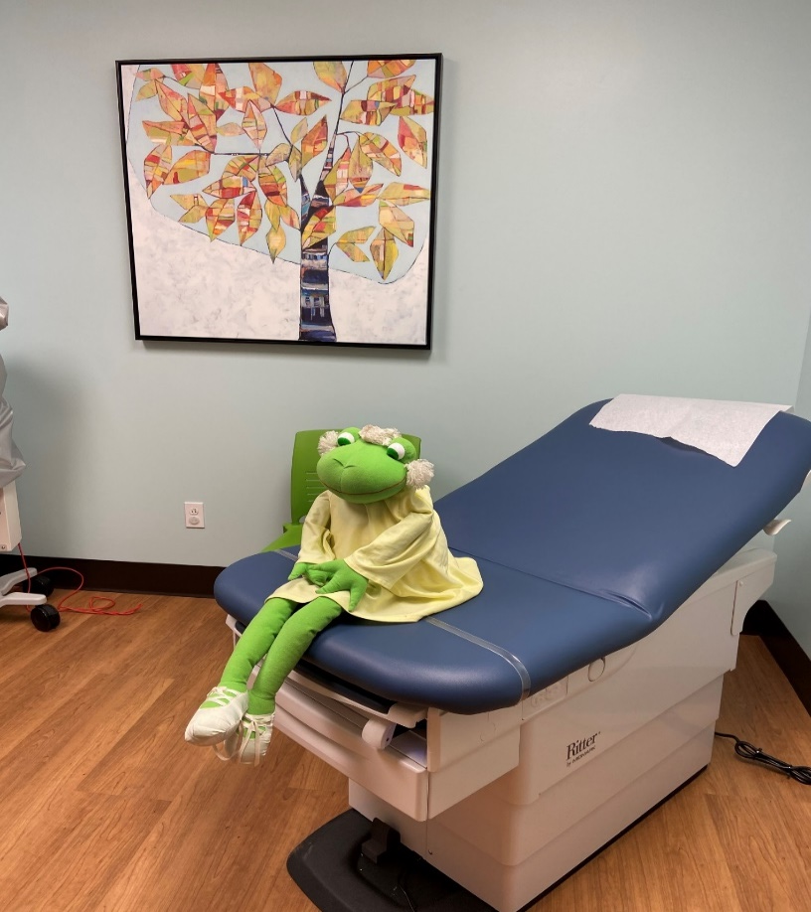
CHIPS Center Medical Exams

Slide 20
What We Do At CHIPS-Counseling
We also provide counseling sessions for children from birth to the age of 18 when there is a concern for physical abuse, sexual abuse, neglect and child trafficking.

Slide 21
What We Do At CHIPS-Counseling
We offer counseling for a child who has being abused, when there are concerns for abuse, for any non-offending caregiver, and for any sibling who has been affected by abuse.

Slide 22
What We Do At CHIPS-Counseling
Different types of Counseling modalities are available at the CHIPS Center including:
Play Therapy
Trauma Focused-Cognitive Behavioral Therapy
Art Therapy
Family Therapy
Child Parent Psychotherapy
Cognitive Behavioral Therapy
Group Therapy

Slide 23
What We Do At CHIPS-Counseling
We also provide services when there is a concern due to the child exhibiting inappropriate sexual behavior or when the child has made inappropriate sexual comments.

Slide 24
What We Do At CHIPS-Counseling
In addition, we also provide services when there is a child who has been affected due to witnessing domestic violence.

Slide 25
What We Do At CHIPS-Counseling
Counseling is free, there are no charges at the CHIPS Center for any counseling services.

Slide 26
What We Do At CHIPS-Counseling
We do not provide counseling to a caregiver when there is an allegation of abuse made against that person.

Slide 27
What We Do At CHIPS-Counseling
We do not provide counseling when a child is exhibiting sexual inappropriate behavior that is forceful or manipulative. Once we are given more information about what is going on, we can give out referrals if we deem counseling somewhere else is more appropriate for that child.

Slide 28
What We Do At CHIPS-Counseling
The Counselors at CHIPS also sometimes go to court and offer court support when children’s court cases arise. And, at times, we are also subpoenaed to sometimes go to court to testify regarding cases of abuse as well.

Slide 29
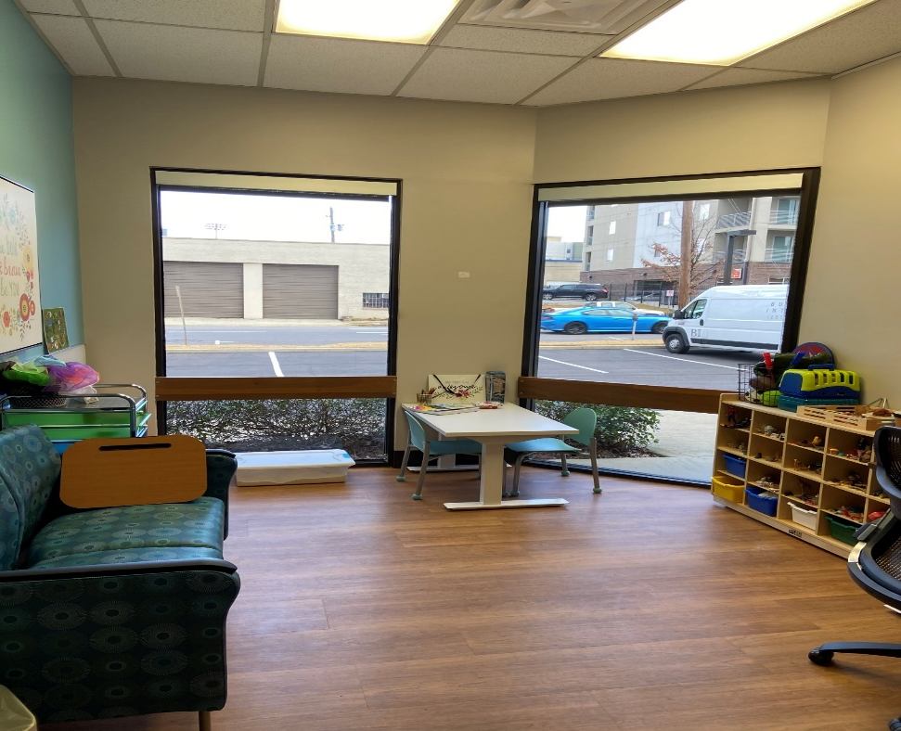
What We Do At CHIPS-Counseling

Slide 30
What We Do At CHIPS-Counseling
Just call the CHIPS Center for more information about possibly setting up a child to have Counseling at CHIPS.
If someone needs counseling, just ask them to call 205-638-2751 and request to speak to our Counseling Coordinator Lisa Cowart.

Slide 31
Counseling or Medical
We also have Interpreters that help us at the CHIPS Center with medical exams and counseling sessions! We are truly grateful for the Interpreters that help our families as needed.

Slide 32
CHIPS Center
When families need an Interpreter, ask them to call the Interpreters at Children’s of Alabama at 205-638-9191.
Then tell the Interpreter they need to talk with the CHIPS Center 205-638-2751.

Slide 33
What We Do at CHIPS-Prevention Education
Before Erin’s Law was passed, we provided prevention at the CHIPS Center, but this was typically after something inappropriate had occurred at a school and we were contacted to see that classroom of students.

Slide 34
What We Do at CHIPS-Prevention Education
Prevention Education became a bigger part of the CHIPS Center due to a woman named Erin Merryn.

Slide 35
What We Do at CHIPS-Prevention Education
As a survivor of childhood sexual abuse, she is now working towards getting every state in the United States to pass Erin’s Law.
The goal of Erin’s Law is to mandate that all public schools throughout the US utilize age-appropriate curriculum to teach children sexual abuse prevention education concepts.

Slide 36
What We Do at CHIPS-Prevention Education
In 2010, Illinois was the first state to start a task force dedicated to Erin’s Law
Alabama was the 24th state to pass Erin’s Law

Slide 37
What We Do at CHIPS-Prevention Education
As of 2023, 38 states have now passed Erin’s Law. (There were only two states in the US that had previously passed laws similar to Erin’s Law, Texas and Vermont.)

Slide 38
What We Do at CHIPS-Prevention Education
Erin has dedicated her life to protecting children throughout our nation from childhood sexual abuse.
Her goal is to empower children in an attempt to prevent and stop childhood sexual abuse.

Slide 39
What We Do at CHIPS-Prevention Education
Per the Alabama Governor’s Task Force Guidelines for Child Sexual Abuse Prevention, Instructional Program:
“In accordance of Erin’s Law (HB197) passed by the Alabama Legislature on June 11, 2015 the Alabama Governor’s Erin’s Law Task Force has established state guidelines for a child sexual abuse prevention instructional program for students in Grades kindergarten through 12 consistent with techniques to teach children to recognize child sexual abuse, equip them with skills to reduce their vulnerability, and encourage them to report the abuse.”

Slide 40
What We Do at CHIPS-Prevention Education
Different School Systems ask for different grades to be seen, but for many schools, we see students who are in kindergarten, 2nd grade and in 4th grade in Elementary School presentations, in 7th grade for students in Middle school presentations, and we see students in their Health class when they go to High School.

Slide 41
What We Do at CHIPS-Prevention Education
We also do many presentations on Erin’s Law to Parent groups conducted throughout the community.

Slide 42
What We Do at CHIPS-Prevention Education
We present to children from PreK all the way up to students in high school.
We now do presentations with schools throughout Alabama and see thousands of students each year, talking to them about sexual abuse prevention.

Slide 43
What We Do at CHIPS-Prevention Education
When we present to PreK through 4th grade children some of the resources we give out to each child is a Caregiver Guide and 4-part prevention education book series; “Personal Space”, “The I Can Plan”, “Feelings”, and “Do You Know the Private Property Rule”?
We share books in English and in Spanish.

Slide 44
When we present to 5th graders, we give each student a Caregiver Guide and the prevention education book, “Birthday Boundaries and Body Safety”.

Slide 45
CHIPS Center Children’s of Alabama We all work hard at the CHIPS Center to do all that we can to help when there are concerns for abuse. And we also work within the community to help to prevent abuse from occurring.

Slide 46
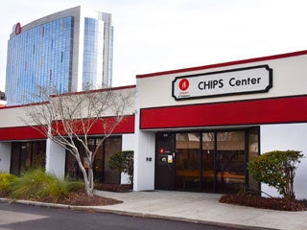
CHIPS Center Children of Alabama

Slide 47
CHIPS Center Children’s of Alabama
Address: 1501 4th Avenue South Birmingham AL 35233
Main number (205) 638-2051
At our new location we now have free parking at the front door of the CHIPS Center!

Slide 48
CHIPS Center Children’s of Alabama
Specify when you are calling if you want to speak to someone regarding a Medical Exam, Counseling or if you want more information about our Prevention Education Presentations.

Slide 49
References
Centers for Disease Control and Prevention
https://www.cdc.gov/violenceprevention/childabuseandneglect/fastfact.html
Erin Merryn
https://www.erinslaw.org/
CHIPS Center/Children’s of Alabama
Alabama Governor’s Task Force
Guidelines for a Child Sexual Abuse Prevention Instructional Program
azquotes.com/quotes/topics/child-abuse.html
The United States Department of Justice
justice.gov/criminal-ceos/child-sex-trafficking

Slide 50
THANK YOU
Any questions?

