Slide 1
ENGAGEMENT STRATEGIES: Eliminating Unconscious Bias
First Friday Forum
May 5, 2023
Notes:
(1 minute slide) Narrator – Welcome to “Unconscious Bias” training. This training will define unconscious bias, investigate why it is inherent in us all and how we can recognize and deal with it at work. The training takes a practical approach through everyday examples, and explores the psychology behind unconscious bias. Throughout this presentation, you might hear the term “implicit bias.” “Implicit” and “Unconscious Bias” are the same thing. Course content includes:
#1 ~ Participants will be able to understand and identify Bias
#2 ~ Participants will be able to explain why the “check the box” approach to training on types of bias lacks efficacy when it comes to behavior change

Slide 2
From Moment to Movement
Public Health Administrator: Retired (25 years)
Trainer/ Motivator/ Community Organizer
Human Impact Partners Health Equity Fellow
RWJF Culture of Health Leader Alumni
National Collaboratives for Health Equity Member
Jefferson County, Al Health Equity Connector

Slide 3
Today’s Learning Overview/ Learning Objectives
#1 ~ Participants will be able to define and identify your Unconscious Bias
#2 ~ Participants will be able to explain why the “check the box” approach to training on types of bias lacks efficacy when it comes to behavior change

Slide 4
A father and his son are in a car accident. The father dies at the scene and the son, badly injured, is rushed to the hospital. In the operating room, the surgeon refuses to operate, saying, “I can’t operate on this boy. He is my son.”
Who is the surgeon?
Notes:
Studies have shown that as many as 75% of people cannot solve it, and those who do figure it out take several
minutes to grasp that the boy’s mother could be the surgeon.

Slide 5
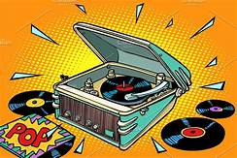
Play Your Records
We are born innocent without bias or prejudice
We get our biases (Records) just by living
Everyone has negative attitudes about other groups
Records are misinformation about other groups
Records bring up emotions
Records lose power when exposed
Don't Let Your Records Play You!
Source: NCBI

Slide 6
“When we confront a stranger, we must substitute an idea – a stereotype – for direct experience. And that stereotype is wrong all too often…”
(Talking to Strangers, Malcolm Gladwell, 2019, p. 163).

Slide 7
What Is Implicit Bias?
Implicit Bias: im•plic•it bi•as: The attitudes or stereotypes that affect our understanding, actions, and decisions in an unconscious manner. Activated involuntarily, without awareness or intentional control. Can be either positive or negative. Everyone is susceptible.
Implicit Bias exists when people unconsciously hold attitudes toward others or associate stereotypes with them.

Slide 8
Implicit Associations and Automatic Associations
Gender Listening: Men listen to do something/ Women connect with the tone and emotion of the conversation
The Name Game: Create a space of belonging for everyone
These hidden, automatic, involuntary associations influence behavior in consequential always. They extend beyond the images in our heads to our beliefs about performance and potential.
Notes:
These are implicit, automatic associations.
They happen outside of our awareness, and they often happen in direct contrast to our consciously held, explicit beliefs.
Job applicants with white-sounding names are 50% more likely to get callbacks for interviews than those with black sounding names.
Further, the job applicant “John” is rated as significantly more competent and hirable than “Jennifer,” and is offered a higher starting salary, despite their identical credentials .
The name game - I’m going to mention a few job titles and names. Please close your eyes and envision or associate a face with the titles and names.
The titles are Nurse, Flight Attendant, Construction Worker, Police Officer, CEO, Surgeon, Field Worker, Maid, Thug, Scientist, Custodian, Librarian, Plumber, Airline Pilot, Rock Star, Rap Star, Basketball Player, Hockey Player, Serial Killer, President
The names are Gunner, Abdul, Jamal, Juan, Tad, Shaniqua, Biff, Jesus, Muhammad, Katie, Worthington, Hillary, Trayvon
Additional names are: Tad Gonzalez, Jamal Horowitz, Jesus Stepnoski, Abdullah O’Malley, Penelope Jenkins, Shaniqua Ludwig, and Guadalupe Chang.
Why do you think that when these job titles and names were stated that the picture of who or what that person looked like, appeared into your mind? The reason may be because we have a programmed picture in our minds of what that job title or person may look like. This could impede how we interact with that person and could possibly confine them into mental categorical boxes. Did we struggle with the mixed names (example – Guadalupe Chang)? Why? Take a few minutes to process this activity with a shoulder partner then we will discuss matters in the larger group. In the book “Listen UP’ by Larry Barker and Kittie Watson they found that men and women have different listening styles. Other research suggest that there are physical difference which occur too.

Slide 9
Revealing Hidden Biases of Good People
We all carry unconscious biases. That is, we hold assumptions about social groups that—our awareness or conscious control—shape our likes and dislikes and our judgments about people’s abilities, potential, and character.
Implicit Associations Test has shown that even the most consciously fair people are quicker to associate positive attributes with white faces than with black faces.
Notes:
In the mid-1990s, psychologists at Harvard University and the University of Washington
developed an intriguing way of uncovering these unconscious biases and revealing just
how pervasive they are. This computer-based test, called the Implicit Associations Test. Discovering unconscious biases doesn’t mean we are a bad people. Unconscious bias is an assessment and process of helping us discover hidden biases and assumptions we might have about others that might be influencing our likes, dislikes, and judgments.
An example of statistics gained from an accumulation of assessments reveal that (read bullet #2).
To take additional assessments or share access to others who might be interested in taking the unconscious bias assessment, feel free to share the following link.

Slide 10
Revealing Hidden Biases of Good People
75% have an implicit preference for white people over black people
76% more readily associate “males” with “career” and “females” with “family”
70% more readily associate “male” with “science” and “female” “with the arts”
76% have a preference for people without a disability.
https://implicit.harvard.edu/implicit/selectatest.html

Slide 11
Let’s Talk About our Records

Slide 12
Our Biased Brains
The human brain is hard-wired to make decisions rapidly, drawing upon our assumptions and experiences without our awareness.
Completely unbeknownst to our conscious brain, we are constantly making lightning-fast generalizations about the people, places, and things we encounter. (2 seconds)
Additional influential factors:
Personal or traumatic experience
Upbringing
Association or awareness
Media
Notes:
In evolutionary times, humans needed to make instantaneous judgments--about who and what was safe, favorable, and valuable – as a matter
of survival. Indeed, a quick determination of whether or not a person was in one’s “in group” could be lifesaving. Also state – the left side of our brain influences unconscious bias especially when we fail to process and enter into the WYSIATI stage of thinking. WYSIATI means, “what you see is all there is.” The right side of the brain takes the time to process and analyze matters. However, when results from the unconscious bias assessment are received by most participants, they still have a difficult time accepting the results. The results aren’t provided to make the participant feel like a bad person. The results are given to bring unconscious biases to the surface so the participant can begin to gradually make improvements. One cannot fix what they don’t realize is in need of repair.

Slide 13
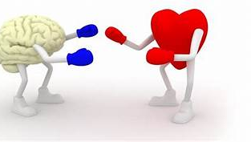
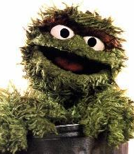
Two Types of People in the World: Head vs. Heart

Slide 14
Leading with your Head People who lead only with their head can seem unemotional or uncaring about the unique qualities those around them bring to the table. They usually don’t know their team (or peers) well, and they aren’t intuitive about how to excite or motivate others.
Strengths
• Stays focused on goals. • Engages in long-range thinking and planning. • Takes a big-picture view. • Enjoys seeing new possibilities. • Scans the horizon for the next big opportunity.
Weaknesses
Doesn’t fully consider the effects a change has on others. Less apt to focus on team members’ individual needs.
Complains about lack of progress Does not give sufficient attention to the process by which goals are met.
Neglects to ensure that the tactical details of the change process are handled.

Slide 15
Leading with your Heart People who lead only with their heart can seem overly emotional, basing their decisions on whether or not someone’s feelings may get hurt. This type of behavior usually results in the leader avoiding conflict.
Strengths • Encourages people to join in discussions, decisions. • Steps in to resolve process problems, such as conflict. • Listens to all viewpoints. • Recognizes and praises others for their efforts. • Helps reduce stress by lightening the mood.
Weaknesses • Sees team process and organizational climate as ends in themselves. • Fails to challenge or contradict others. • Does not recognize the importance of accomplishing tasks. • Overuses humor and other conflict-mitigation techniques. • Does not emphasize long-range planning
Source: https://www.linkedin.com/pulse/head-vs-heart-leadership-great-debate-joshua-miller

Slide 16
Impact of Unconscious Bias in the Workplace
Race, gender, and age are some of the categories that come to mind when we think about biases.
People carry unconscious biases, both positive and negative, about a myriad of characteristics that can be much more subtle.
For example, we hold stereotypes based on height and weight, marital or parental status, foreign or regional accents, country or region of origin, introversion or extroversion, just to name a few.
Notes:
It can be harder to recognize the differential treatment that might occur based on these subtler biases. For example: Do we see the married man as a more stable employee? Does the single mother seem unreliable? Does an employee’s Southern drawl make him seem less bright and savvy?

Slide 17
Positive and Negative biases affect:
Recruitment, hiring, and offer terms
Onboarding and benefit plan design
Employee interactions and employee satisfaction
Team and project assignments
Performance evaluations, compensation, and promotions
Client or customer service
Openness to new ideas and innovative solutions
Corrective action
Notes:
At every point of contact, unconscious biases can lead people to make decisions and act in
ways that inadvertently undermine an organization’s goal of creating a diverse and
inclusive work environment and hiring the most qualified candidates. The results can be
poor employee performance, stifled and stunted creativity, lost business, or, even worse,
lengthy and costly litigation. At every point of contact, unconscious biases can lead people to make decisions and act in ways that inadvertently undermine an organization’s goal of creating a diverse and inclusive work environment and hiring the most qualified candidates. The results can be poor employee performance, stifled and stunted creativity, lost business, or, even worse, lengthy and costly litigation.

Slide 18
Affinity Bias and Micro-aggressions
Favoring our family members, members of our own community, and people with whom we feel a connection based on shared characteristics or experiences are examples of Affinity Bias.
Micro-aggressions are defined as “the brief and commonplace daily verbal, behavioral, and environmental indignities, whether intentional or unintentional, that communicate hostile, derogatory, or negative racial, gender, sexual-orientation, and religious slights and insults.“ –Derald Wing Sue, Ph.D.
Notes:
Aﬃnity bias, can lead to preferential treatment of candidates and employees whom we consider to be more “like us.”
Consider a manager who discovers that she and a candidate whom she is interviewing have a shared background – they both moved from small Midwestern towns to pursue their
careers in the “big city.” As a result of this connection, the manager feels an almost instant rapport with the candidate. Consequently, the manager views the candidate’s
accomplishments, demeanor, and presentation more positively than those of the other equally (or potentially more) qualified candidates, and she deems her to be a better “fit” for
the job.
If the candidate is hired, the affinity bias will likely continue to exert its influence, as the manager eagerly welcomes ideas from this employee and provides opportunities for the
employee to shine. The subtle, unintentional advantage conferred by this Midwestern “bond” has the effect of creating unequal opportunities that limit diversity and may
undermine organizational performance. This manager is essentially, if unknowingly, reproducing herself throughout the organization.
Micro-aggressions, we might unwittingly send subtle messages to the people around us through our body language, word choice, and behavior.
Ex. An employee jokingly asks a male and female co-worker who share an office: “Who does the dishes?”
Ex. A male co-worker expresses surprise at a female co-worker’s skill at a “typically male task”
Ex. A third generation Asian American is complimented for his perfect English
Such communications can diminish employee engagement, undermine workplace relationships, and expose a company to legal risk.

Slide 19
Examples of Racial Macroaggressions
“You are a credit to your race.”
“When I look at you, I don’t see color.”
“I’m not a racist. I have several minority friends.”
People of my race are generally not as intelligent as others.
Denying a person of color’s racial/ethnic experiences.
I am immune to races because I have friends that are minorities.

Slide 20
Combating Microaggressions
Don’t expect people to be the expert for their entire group (or others). Do not “Single Out” individuals
Establish clear ground rules and expectations when talking about issues of diversity
Be aware of how you challenge opinions that do not agree with your own.
Interrupt problematic behavior immediately
Source: Examples of Microaggressions in the Classrooms
www.earth.miami.edu

Slide 21
Combating Unconscious Bias
It’s universal, therefore it does not make us bad people
Recognize its harmful (albeit unintended) effects, and accept the challenge to work on counteracting the biases that we all have.
This does not need to involve complex new processes or costly initiatives.
Start with deliberate, conscious eﬀorts to incorporate inclusiveness in our business decisions and in our everyday workplace interactions.

Slide 22
Preventing Affinity Bias
Diverse interview team
Mentor people who are not like you
Expand who is providing input and new ideas
Ask, “do they resemble me in some way.”
Focus on skills
Keith Reynolds, Director of DEI Training
Wichita Ks Public Schools Office of DEI
kreynolds1@usd259.net
Notes:
Conduct joint interviews so that multiple managers interact with the same candidate simultaneously
Deliberately increase mentoring people who are not like them
Examine critically who they are identifying to provide input and new ideas, attend client meetings, work on and lead projects, and be promoted.
In an increasingly global business environment with changing workforce and client demographics, it is clear that a workplace that embraces diversity is simply good for business. Diverse and inclusive work environments promote more ideas, more innovation, and better problem-solving. They attract clients, and attract, cultivate, and retain talent.

Slide 23
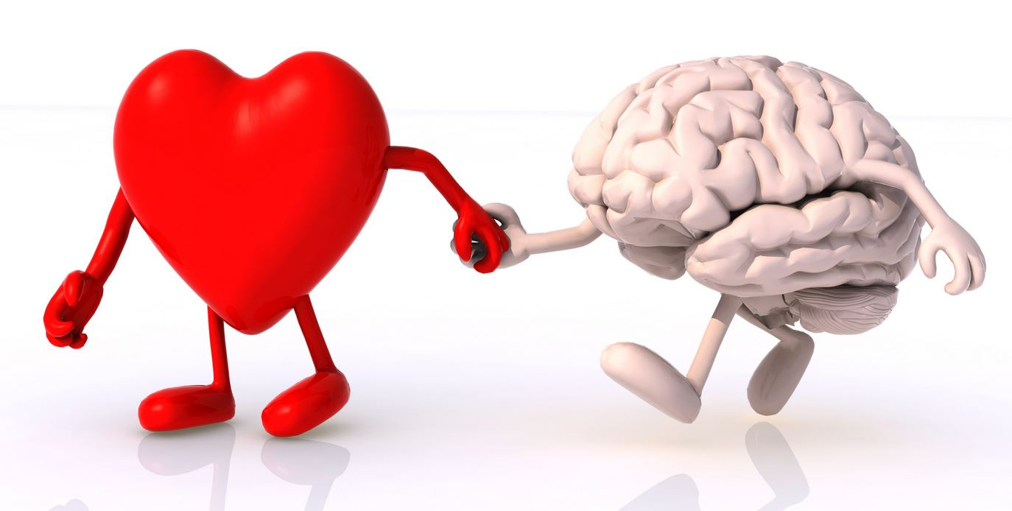
Which type are you? Head vs. Heart
“To handle yourself, use your head; to handle others , use your heart.” ~ Eleanor Roosevelt
“A good head and a good heart are always a formidable combination.” ~ Nelson Mandela

Slide 24
What Is Implicit Bias?
Implicit Bias: im•plic•it bi•as: The attitudes or stereotypes that affect our understanding, actions, and decisions in an unconscious manner. Activated involuntarily, without awareness or intentional control. Can be either positive or negative. Everyone is susceptible.
Implicit Bias exists when people unconsciously hold attitudes toward others or associate stereotypes with them.

Slide 25
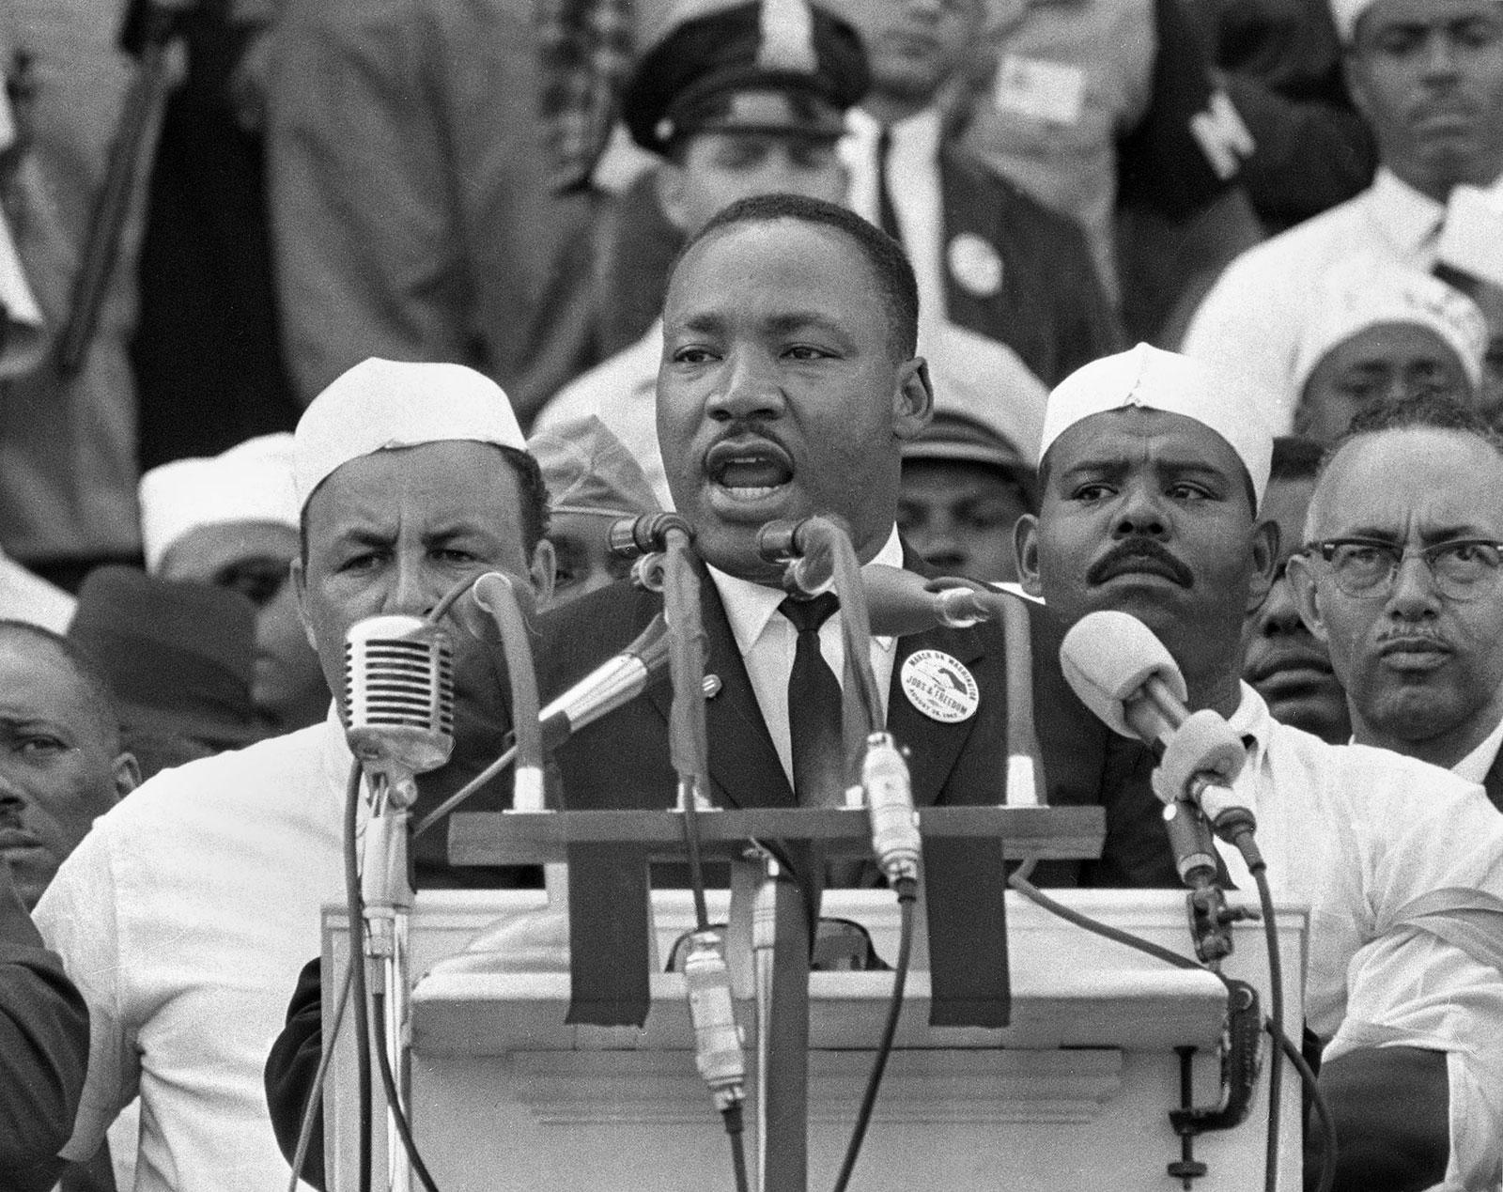
The Fierce Urgency of Now
“We are now faced with the fact that tomorrow is today. We are confronted with the fierce urgency of now. In this unfolding conundrum of life and history, there 'is' such a thing as being too late. This is no time for apathy or complacency. This is a time for vigorous and positive action.”
~Reverend Dr. Martin Luther King Jr.
Notes:
Racial equity has had a complicated trajectory. Furthermore, it is important to acknowledge how inextricably linked racism is to the customs, policies, and practices of American society. People of color fare worse than their White counterparts in areas such as wealth, income, education, housing, and health.
Racialized policies and systems shape economic and social institutions.
Over the years, while working with states to develop comprehensive approaches to help us all move toward health equity, it didn’t take long to realize that no matter which social determinant we focused on, race and racism are the greatest predictors of health in our country. Therefore, we must work steadily to counter the root causes of bias and institutional racism in realize better health, better birth and maternal outcomes.
We must be intentional with addressing racial inequities and turning up the volume Infant and Maternal Mortality disparities.
With George Floyd, Breonna Taylor and many more coupled with high unemployment and the pandemic there is a perfect storm so to speak.

Slide 26
Tools
We all hold biases. Here’s an opportunity for you to recognize and overcome them. This resource is a two-part tool that allows an individual to unpack specific behaviors to identify if those behaviors may be rooted in implicit bias. The tool consists of a list of yes/no questions and a brief reflection on each question.
Implicit Bias Analysis Guide: https://drive.google.com/file/d/1cRe8PUliGkT6u8FNGy9qYVKeV_Btd4l9/view
Implicit Bias Test (Harvard): https://implicit.harvard.edu/implicit/takeatest.html
Notes:
(

Slide 27
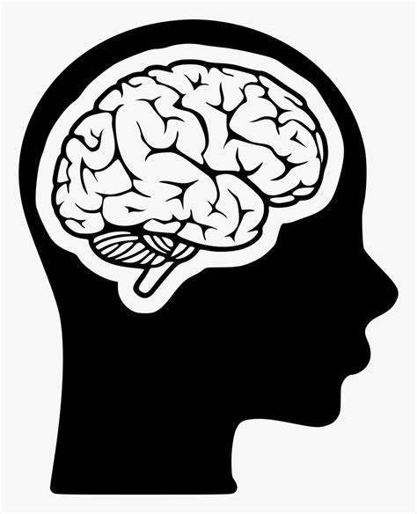
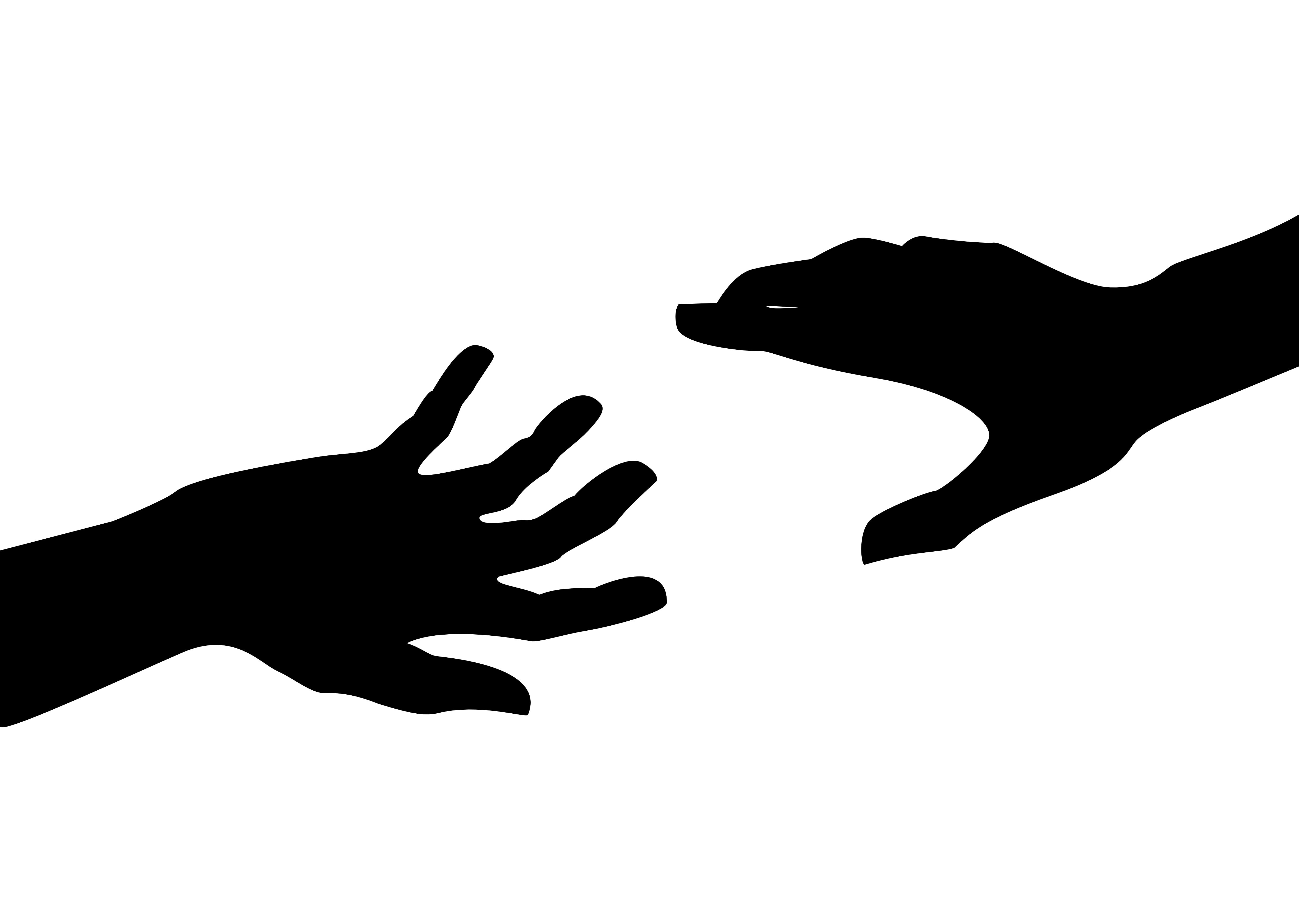
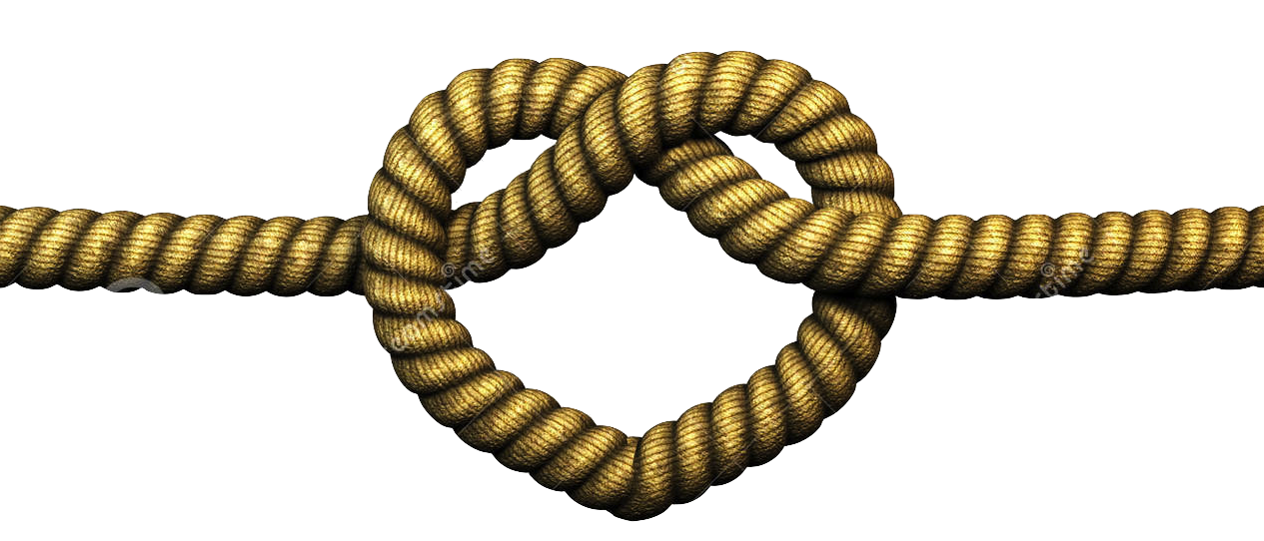
4 Steps Forward
We Think
We Feel
We Build
We Do

Slide 28
THANK YOU!
GREGORY C. TOWNSEND, M.P.P.M GCARLOSTOWNSEND@GMAIL.COM

