Slide 1
What is CASA?
Kelly Burke, Executive Director

Slide 2
Mission:
To support and promote court-appointed volunteer advocacy so every child who has experienced abuse or neglect in Jefferson County has a safe, permanent home and the opportunity to thrive.

Slide 3
History of CASA
1977
In 1977 Seattle Judge David Soukup started a pilot Court Appointed Special Advocate (CASA) to recruit and train community volunteers to speak for the best interests of children in the courtroom.
The Alabama State CASA network was formed on September 24, 1993. The first three local CASA programs were in Jefferson, Madison, and Shelby counties.
Out of that, CASA of Jefferson County was established and became a 501(c)3 and incorporated on July 15, 2010.

Slide 4
Court Appointed Special Advocates of Jefferson County provides abused, neglected or abandoned children with a trained volunteer to advocate for the child’s best interest before family courts in Jefferson County.

Slide 5
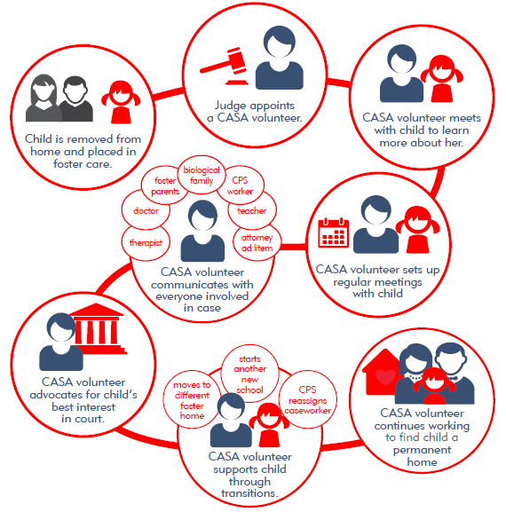

Slide 6
Abused and Neglected Children…
Lower health related outcomes than their peers
30% of abused/neglected children suffer from chronic illness
Asthma, allergies, diabetes, etc.
35%-50% of abused and neglected children suffer from some type of mental illness
Higher likelihood of learning and behavioral issues
Higher risk of teen pregnancy and risky sexual behaviors

Slide 7
CASA volunteers mitigate Adverse Childhood Experiences
The American Academy of Pediatrics has stated that adverse childhood experiences can be counterbalanced by protective factors and healthy attachment relationships. These protective factors can lead to increased motivation and the ability to engage and regulate emotions and behaviors.
CASA = protective factor

Slide 8
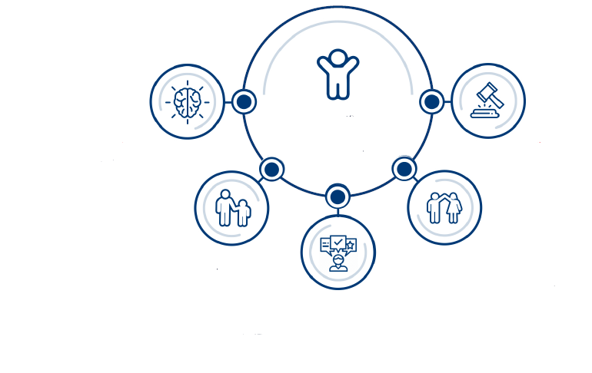
Best-Interest Advocacy
Learn
Report
Engage
Collaborate
Recommend
Notes:
When reviewing Job Descprtion or responsibilities was there anything that stuck out to you?
Information Gathering
Facilitation
Advocacy
Monitoring

Slide 9
CASA volunteers mitigate
TRAUMA
Children with advocates:
are more likely to find a safe, permanent home
spend less time in foster care
less likely to be further victimized
experience better educational outcomes
find increased access to necessary resources and services
less likely to become homeless, addicted, or incarcerated as an adult

Slide 10
How Can You Help?
Volunteer!
Goal for every case/child to be staffed with a volunteer
We currently serve 143 children
We need 30 volunteers!

Slide 11
How you can help CASA...
Invite us to speak at your church groups, neighborhood clubs, civic organizations.
Tell your friends about what we do!
Ask judges to appoint CASA.
Follow us on social media and share our posts.
Tell your clients that they can ask for a CASA.

Slide 12
Children bear the consequence of two things.
What we do.
What we fail to do.

Slide 13
WHAT IS THE ACTUAL COMMITMENT?
Volunteers must see their child once a month.
Cases typically last one year.
Most volunteers spend between 5 and 10 hours a month on their case.
Case work may involve in-person meetings, virtual meetings, phone calls, emails and court time.
CASA cases typically go to court every few months. In the course of your time as a volunteer, you could attend court several times.

Slide 14
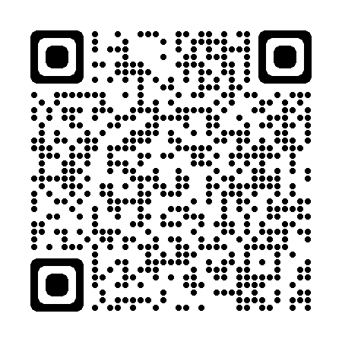
I have some time!
Count me in!”
NEXT STEPS
Complete an application.
Have a short telephone interview.
Attend training. Next training starts November 5!
November 5 In-Person 11:30-1:30 Family Court Meeting Room
November 7 Virtual 11:30-1:30
November 12 Virtual 11:30-1:30
November 14 In-Person 11:30-1:30 Family Court Meeting Room
November 19 Virtual 11:30-1:30
November 21 In-Person 11:30-1:30 Family Court Meeting Room
Application here

Slide 15
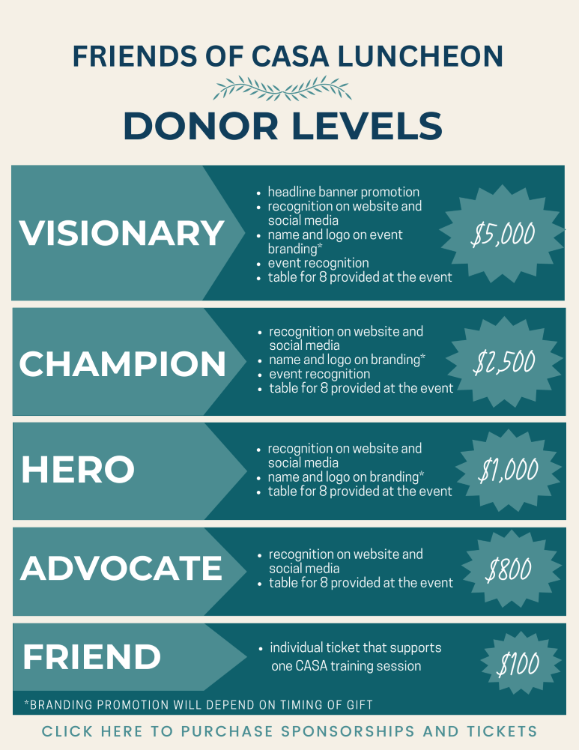

Slide 16
Board of Directors
President: Alex LaGanke
Vice President: Suzanne Ashe
Secretary: Cindy DIllard
Treasurer: Ryan Grauel
Drake McGowin S. Darrin Chatham Patricia Osborne

Slide 17
Contact Information
Kelly Burke, Executive Director
kburke@casaofjeffco.org
Christy Wright , Program Director
cwright@casaofjeffco.org
Birmingham Division
Quin Elmore, Advocate Coordinator qelmore@casaofjeffco.org
Bessemer Division
Ashlei Dotson, Advocate Coordinator
adotson@casaofjeffco.org
Katy Leverett, Advocate Coordinator
kleverett@casaofjeffco.org
Vivian Scott, Advocate Coordinator vscott@casaofjeffco.org

Slide 18
ORGANIZATION INFO
Website: www.casaofjeffersoncounty.org
Social Media:
@casaofjeffersoncounty
@casaofjeffersoncounty
@CASAofJeffCo
@casaofjeffersoncounty

Slide 19
Questions?

