Slide 1
Leadership Development Institute:
How do we recruit & Retain High-Performing Employees
KK Owen, Leader Coach, Studer Education

Slide 2
Great leaders love to see people grow

Slide 3
Our Learning Today…
Why do leader actions matter as we seek to recruit and retain employees?
What can leaders do to increase recruitment and retention?
  Rounding
  30/90 Day New Employee Meetings
  Reward and Recognition of Good Work
How do we get started?

Slide 4
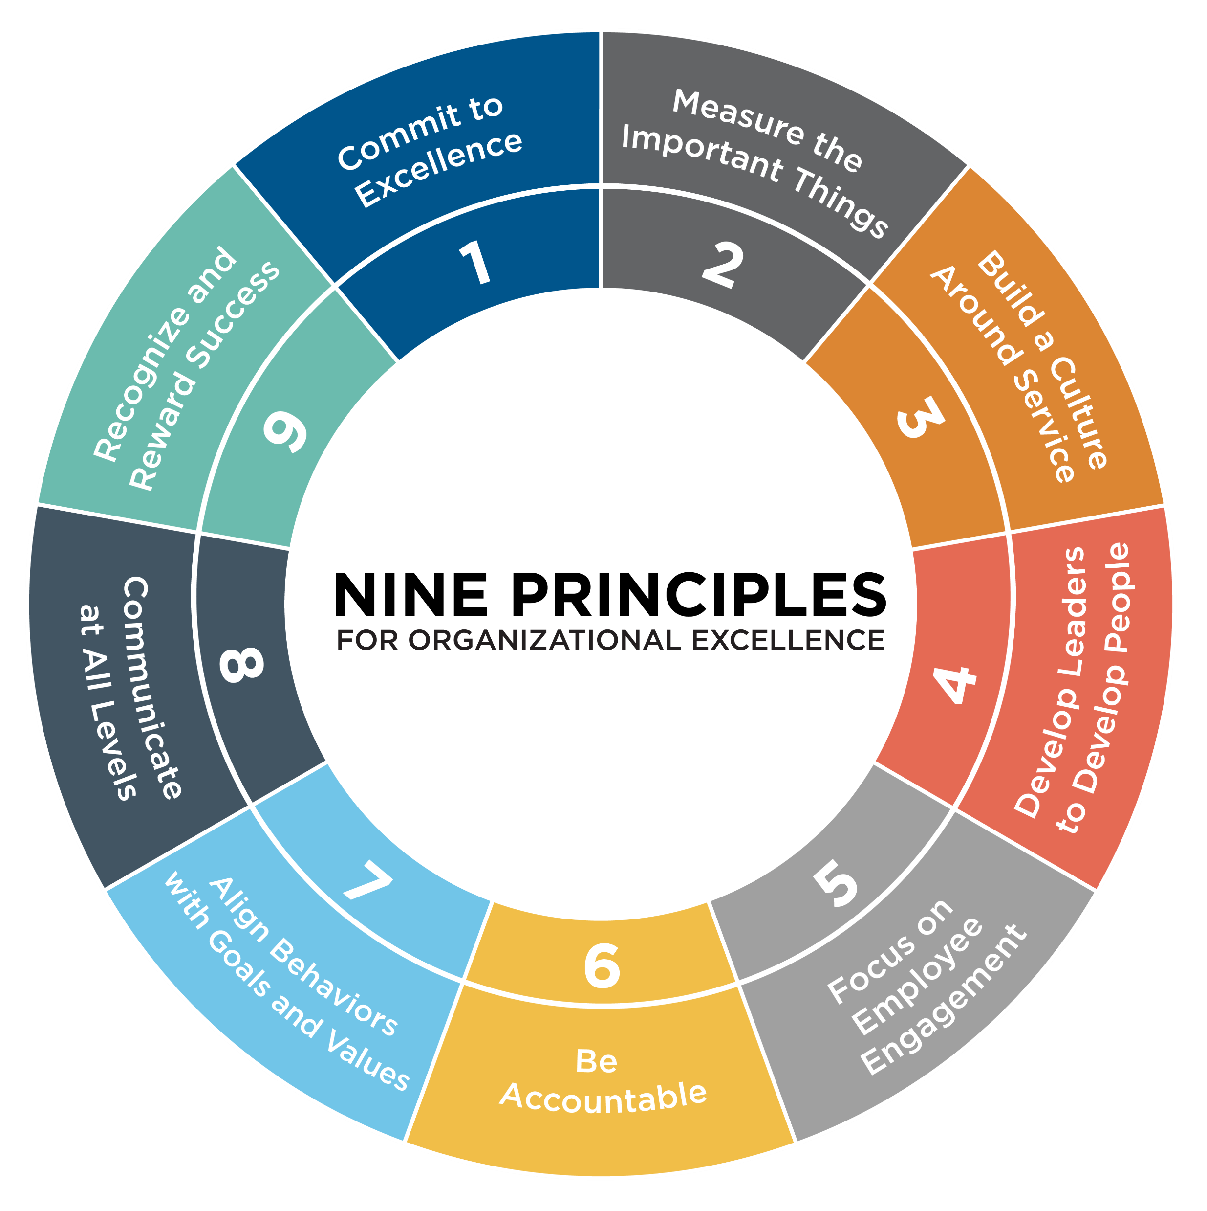
Principle 1: Commit to Excellence
Set high expectations to achieve results while living out mission and values.
Nine Principles®
Principle 2: Measure the Important Things
Continuously track progress to achieve results with an improvement mindset.
Principle 3: Build a Culture Around Service
Serve others with great care and concern.
Principle 4: Develop Leaders to Develop People
Coach people to be their best at work.
Principle 5: Focus on Employee Engagement
Attend to aspirations and desires in the workplace.
Principle 6: Be Accountable
Commit to individual accountability to achieve organizational goals.
Principle 7: Align Behaviors with Goals and Values
Apply consistent practices to move the organization in a positive direction.
Principle 8: Communicate at All Levels
People know why what they do matters.
Principle 9: Recognize and Reward Success
Value and appreciate people working together to get results.

Slide 5




What are Employees Looking For in Their Leaders?
A GOOD
RELATIONSHIP
APPROACHABILITY
WILLINGNESS TO
WORK
SIDE-BY-SIDE
TRAINING
& DEVELOPMENT
RESOURCES TO
DO THE JOB
APPRECIATION

Slide 6




High employee engagement is positively correlated with:
Increased customer satisfaction
Reduced absenteeism
Reduced employee turnover
Increased results
Increased productivity

Slide 7
Rounding on Employees
1

Slide 8

What are Employees Looking For in Leaders?
A good relationship
Approachability
Willingness to work side by side
Efficient systems
Training and development
Resources to do the job
Appreciation

Slide 9
Rounding is an Intentional Conversation
Why? Improve processes in the workplace Recognize people for good work
What? Build relationships between leader and employees Gain their input to create a good workplace where they want to engage
How? Ask them questions about improving processes and recognizing others Take notes and take action to follow up

Slide 10

How do you round?
Schedule a Conversation, make a connection, ask 4 questions
Genuine care-personal connection
Questions:
  What is working well?
  What ideas do you have for improvement?
  Do you what you need to do your job?
  Is there anyone who has been especially helpful to you lately?

Slide 11

Role Play:
Rounding

Slide 12
Tips for Successful Rounding
  Your calendar is your friend (put rounding on your calendar just like meetings)
  LISTEN & take notes (use the log or your computer/iPad/phone)
  FOLLOW UP on any requests for resources, answers to questions, etc.
  Recognize those individuals called out by others in rounding
  The goal for you is to JUST START! If we wait until we are perfect at it, we will never round. As leaders round, engagement increases among employees.

Slide 13
30/90 Day Meetings
2

Slide 14
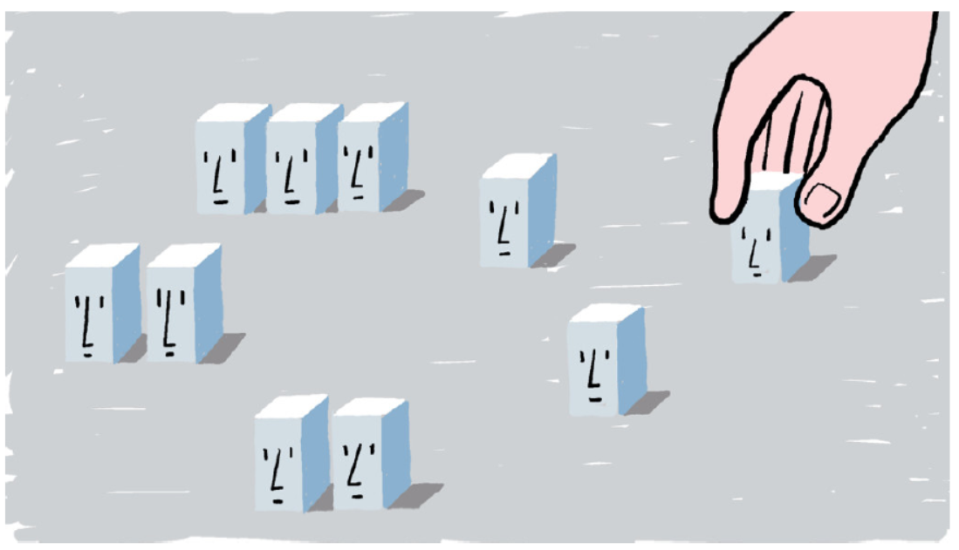
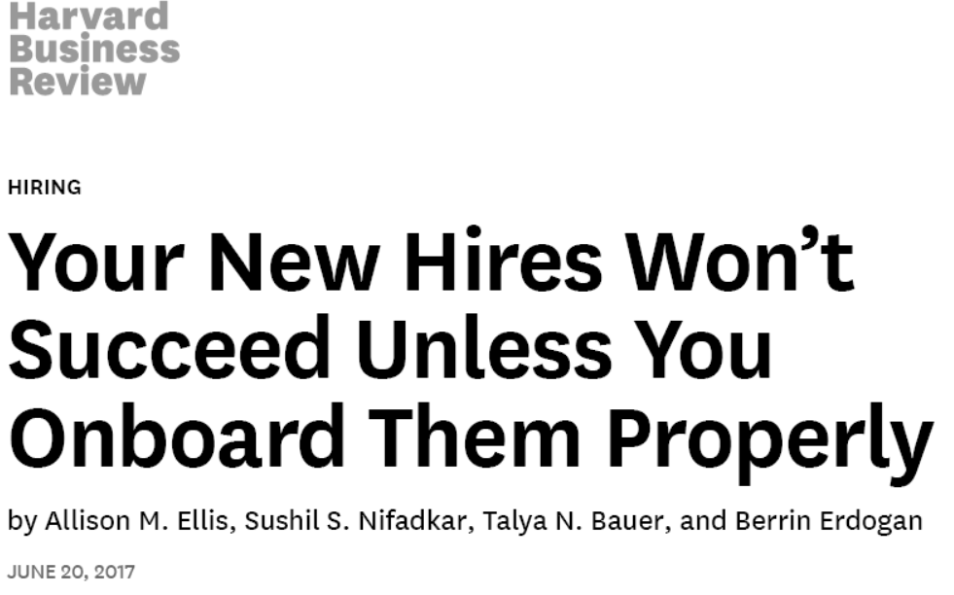
How Leaders Matter to New Hires
17% of employees leave new jobs in the first 30 days.
Feeling socially accepted and able to ask questions for information are key to new employees’ success
Building a relationship with a leader through formal and informal interactions supports new employees to feel accepted and glean important information

Slide 15

What do new employees need to stay on the job?
Relationship with the leader
Confidence in ability to do the job
Finding a friend/buddy at work
Feeling informed and valued

Slide 16

Why should we conduct 30/90 Day Meetings?
Focus attention on new employees-invest in their success
Check onboarding processes for the purpose of improvement
Reward and Recognize employees who have been helpful to new employees
Increase the chances of retaining the new employees

Slide 17
30 Day Meeting with New Hires
Question | What Was Heard | Action Taken | Date Completed or Next Follow-Up
How do we compare with what we said?
What’s working well?
Have there been any individuals who have been helpful to you?
Based on your prior work, what ideas for improvement do you have?
Is there any reason that you feel this is not the right place for you?

Slide 18
90 Day Meeting with New hires
Question | What Was Heard | Action Taken | Date Completed
How do we compare with what we said?
What’s working well?
Based on your previous work, are there things you did there that might be helpful to us?
Is there any reason that you feel this is not the right place for you?
Have there been any individuals who have been helpful to you?
Is there anyone you know at your previous work that might be a good fit here?
As your supervisor, how can I be helpful to you?

Slide 19
Reward and Recognition
3

Slide 20
What gets recognized gets repeated

Slide 21

Remember a time you were recognized…
What was said or done?
How did it make you feel?
Why do you still remember it today?

Slide 22
High Performers Want…
Feedback and development
Recognition
Responsibility and advancement
Resources
TNTP, The Irreplaceables: Understanding the Real Retention Crisis in America’s Urban Schools, 2012

Slide 23
Reward & Recognition Myths
You may avoid reward & recognition because of beliefs like:
  “Big Head”
  Complacency
  Martyrdom
  Another Day, Another Dollar
  Scrooge Mentality
  Culture of Mediocrity
Source: Quint Studer, Results That Last

Slide 24

Reward & Recognition
Write thank you notes
Send emails
Thank employees in front of others
Be specific and explain “What right looks like”
Make it a routine

Slide 25

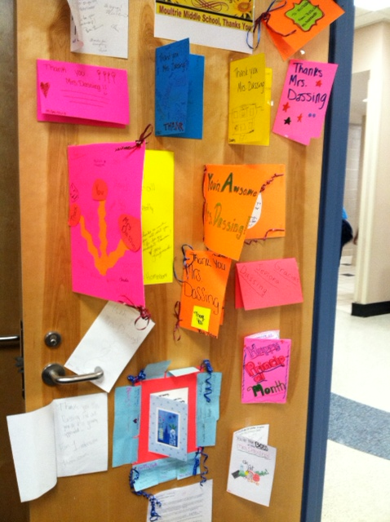


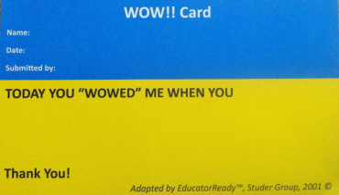
Reward & Recognition

Slide 26
Leader “Always Actions”
Here’s what you can start doing today to recruit and retain employees:
Set up a rounding schedule, introduce rounding to your team, and start rounding (quarterly or monthly or any set schedule that works for your team)
Conduct 30 and 90 Day New Employee Meetings (don’t forget to put them on your calendar when new hires start to work) and follow up on needs/questions
Decide on 2-3 ways you can recognize employees for good work (shout-outs, written thank you notes or emails, public recognition at a staff meeting)

Slide 27

Good Luck!
KK Owen
Leader Coach
Studer Education
kowen@hcg.com

