Slide 1

Advocacy 101
What It Is, Why It Matters, and Practical Tips
Emily Herring Bryan and Dr. Shelly Mize

Slide 2
What is Advocacy?
Educating decision-makers about issues
Speaking up for community needs because others may not have the power to do so
Promoting policy solutions that align with your mission
Engaging the public in civic participation
Advocacy ≠ lobbying ≠ campaigning

Slide 3
Why Advocacy Matters
Nonprofits see community needs firsthand
Policies directly affect the people we serve
Advocacy helps create systems change, not just temporary fixes
Nonprofits are trusted messengers
Advocacy amplifies impact beyond programs alone

Slide 4

Why Advocacy is a MUST in Our Roles
YOU are the subject-matter expert!
Your voice adds credibility
Policymakers need real-world insight, which you have!
Advocacy aligns with nonprofit missions
You don’t have to be an expert at politics to be an advocate!

Slide 5

Effective
Advocacy
Combines
Stories
(who is
affected)
Data
(what’s
happening)
Expected
Outcomes
(what you
hope to see)
Solutions
(what should
change)

Slide 6

If you could change one policy impacting your organization or clients, what would you change?

Slide 7
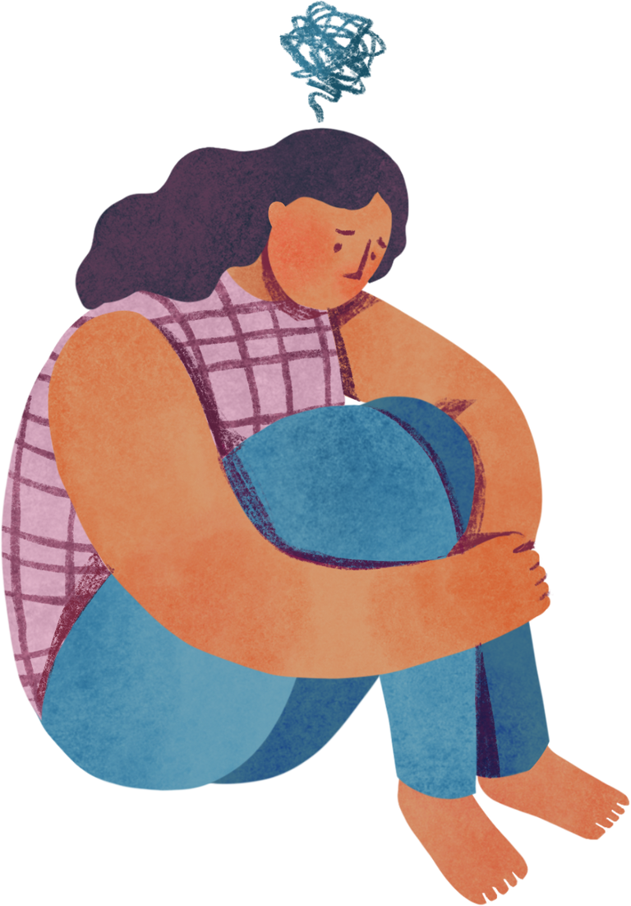

Quantifying the Problem
Per the most recent CDC statistics...
students have experienced poor mental health
1 in 3
of children with a mental health disorder do not receive care from a mental health provider
80%
22%
of all teens seriously considered attempting suicide and 10% of teens attempted suicide

Slide 8
Student Voice
“I have had depression for three years, but my family members are the type of people who don’t believe in depression. They tell me that nothing is wrong with me and that I have it better than most people. I feel stuck.”
Student Voice
“Nobody else in the school building knows this, but my mom died from cancer last year. I got put out of school because I didn’t feel like being there on the anniversary of her death, but I didn’t feel like telling anyone why.”

Slide 9
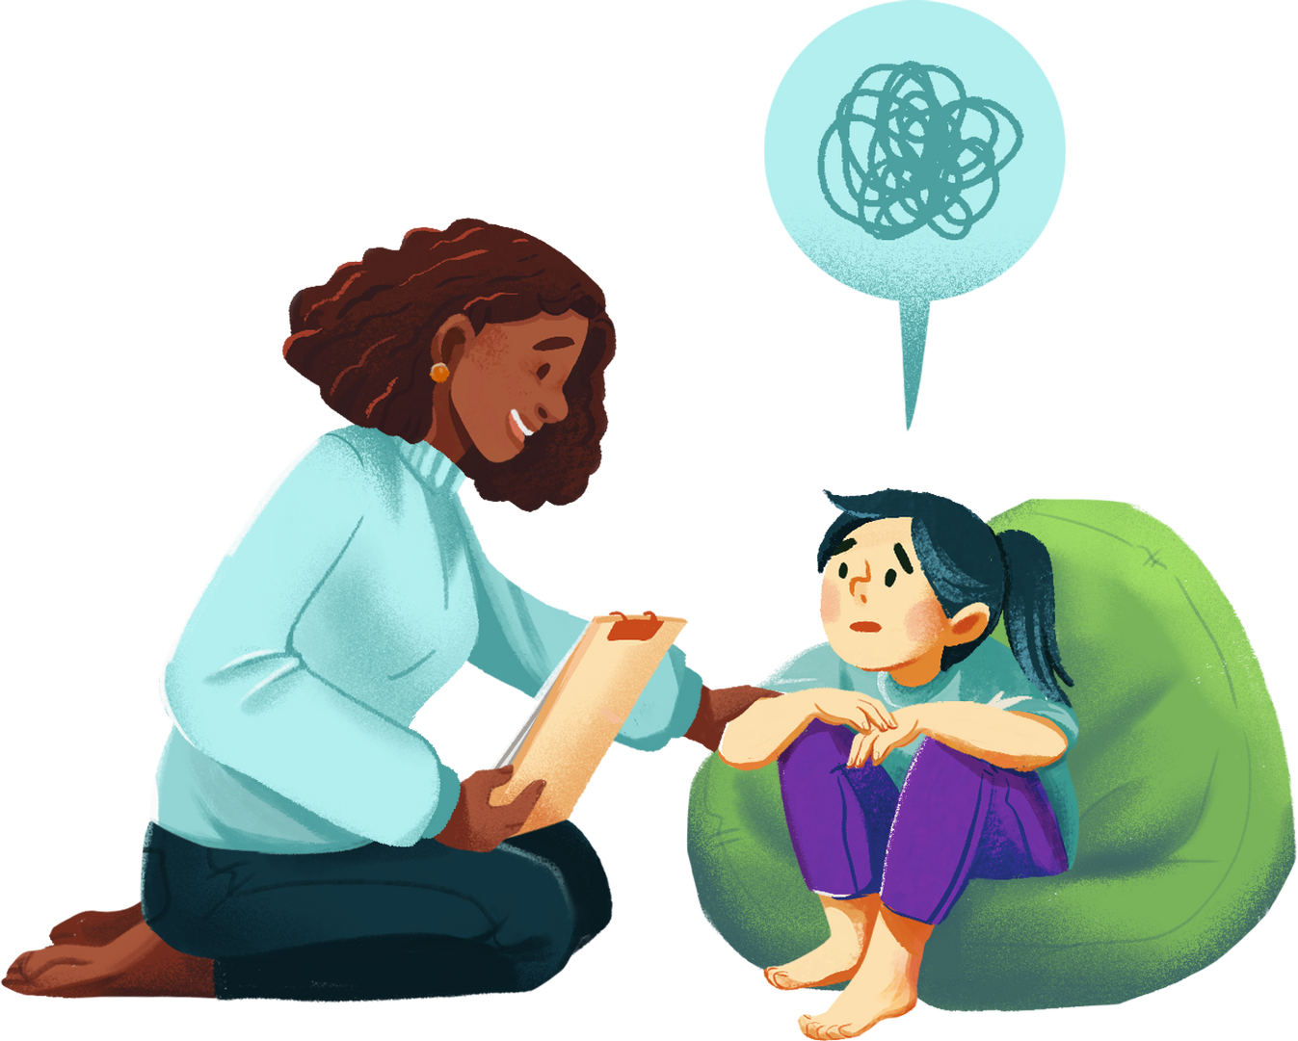
The Solution:
We need additional funding for School Mental Health!
Make Mental Health Coordinators a foundational unit in education funding.
Create grant-based funding for high-needs districts to have additional funds for school mental health.

Slide 10
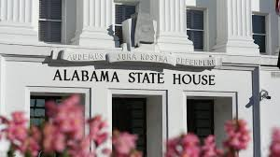
AL Legislation Under Consideration
HB78 – proposes development of guidelines for screen time in early childhood settings
HB152 – repeals the statute that establishes the School of Social Work at the University of Alabama
HB187 – requires public schools to implement mobile emergency rapid response systems accessible to school personnel
HB41 – classifies certain sexual offenses to victims under 12 as capital offenses and permits the death penalty
HB189 – requires courts to notify school district of student charged with certain offenses
SB61 – requires regular cross-checks for Medicaid and food assistance; categorical eligibility for food assistance prohibited

Slide 11
What does advocacy look like for you or your organization currently? What is working well? Where is there room for improvement or growth?

Slide 12
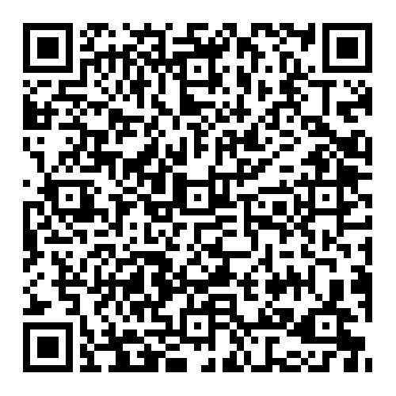
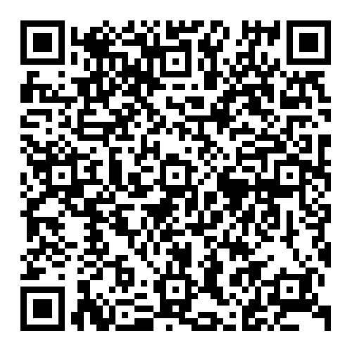
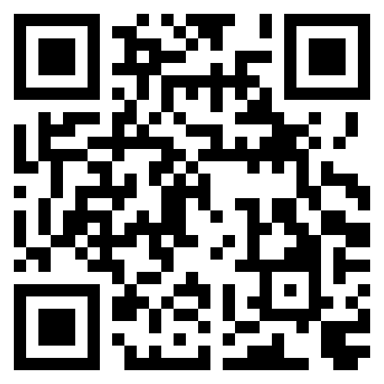
Advocacy Resources in Alabama
Voices for Alabama’s Children
Finding your legislators
A+ Education Partnership
Where else do you go for resources?

Slide 13
Questions? Want to connect?
Emily Herring Bryan
eherring@fairfieldk12.org
Dr. Shelly Mize
mizes@jccal.org

