Slide 1
j
Mobile Crisis Response Team

Slide 2
Mission Statement:
The Mobile Crisis Response Team (MCRT) was created to provide crisis intervention services to Jefferson County children, adolescents and families who are dealing with a behavioral or mental health crisis and have involvement with DHR.

Slide 3
The Solution
JBS Children’s Services provides MCRT services for youth who are showing signs of behavioral or mental health concerns that pose a threat to the youth’s stability within their home, school, or community. The MCRT services are provided Monday through Sunday with 24/7 availability, 365 days a year.

Slide 4
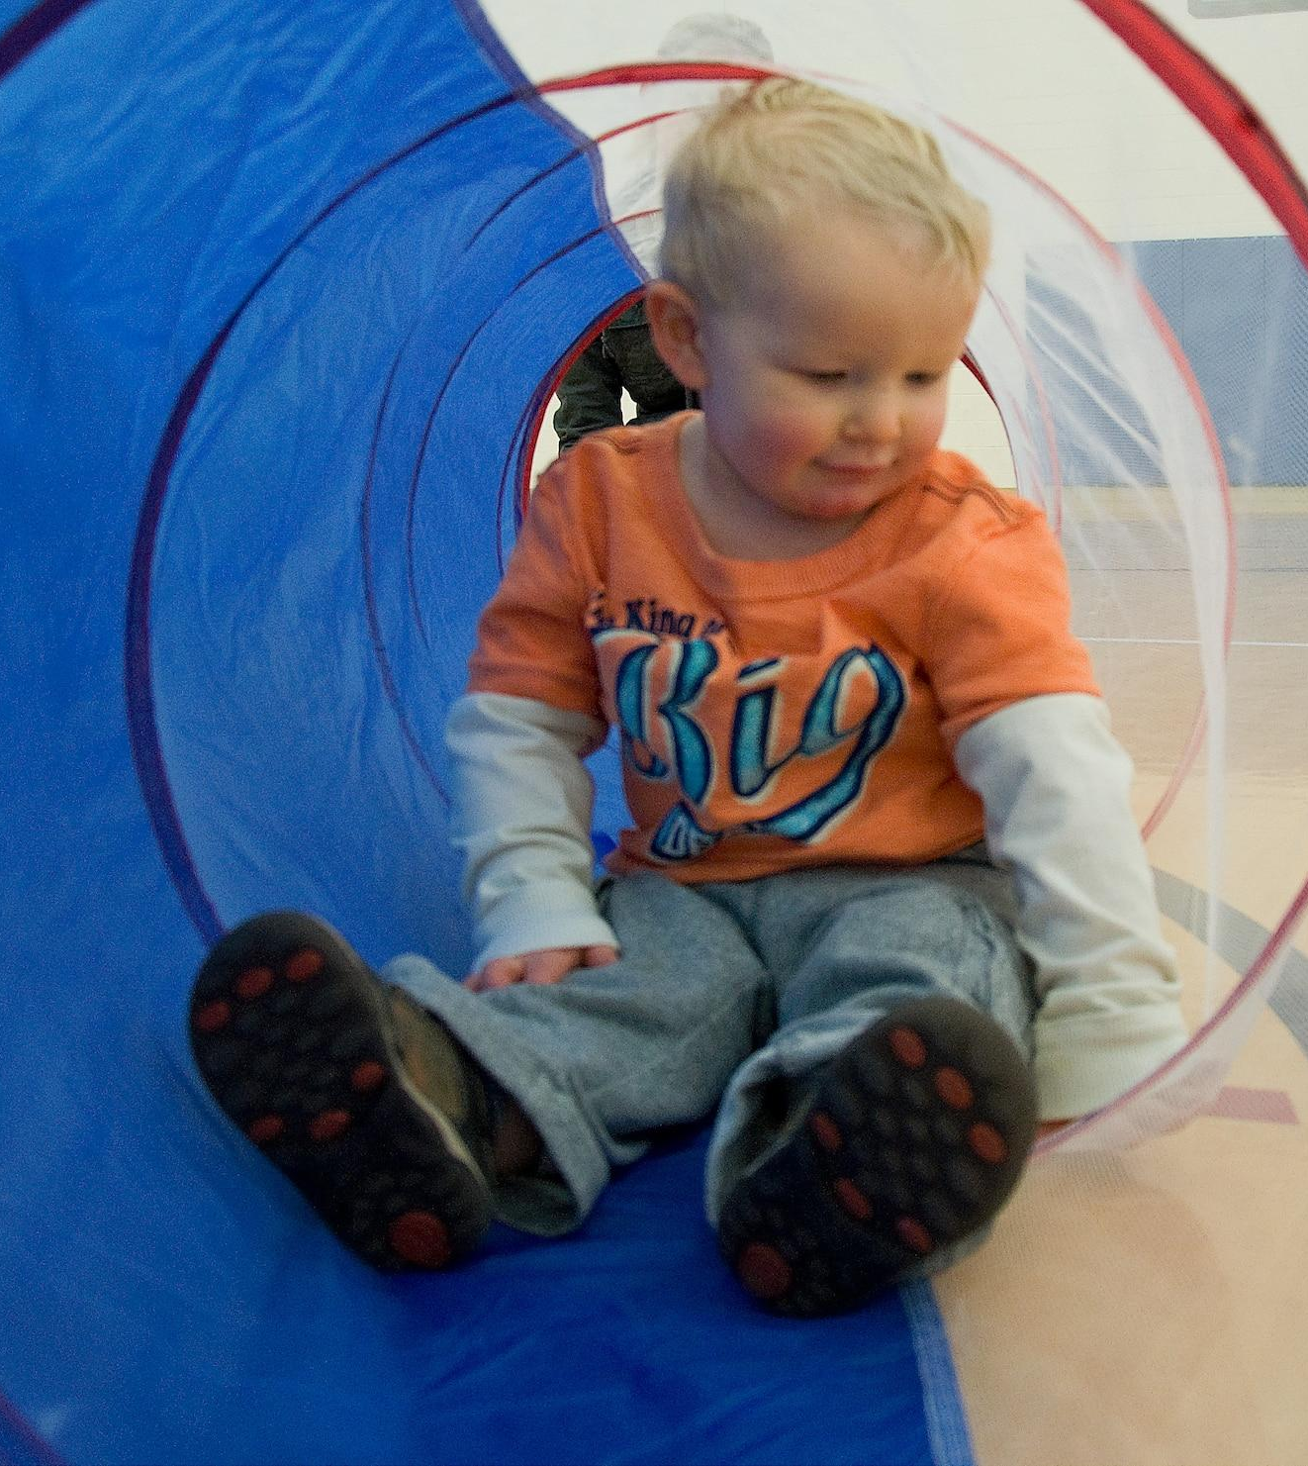
Eligibility
Eligible youth must be under the age of 21, have DHR involvement, and live in Jefferson County.
Eligibility

Slide 5
Services can be obtained by calling our 24/7 helpline at (205) 443-2294. Aftercare services can include outpatient treatment, care coordination, and psychiatric services.

Slide 6
Coordinator:
Keisha Kennedy
205-949-2963
kkennedy@jbsmha.com
JBS Mental Health Authority
956 Montclair Rd.
Birmingham, AL 35213

