Slide 1
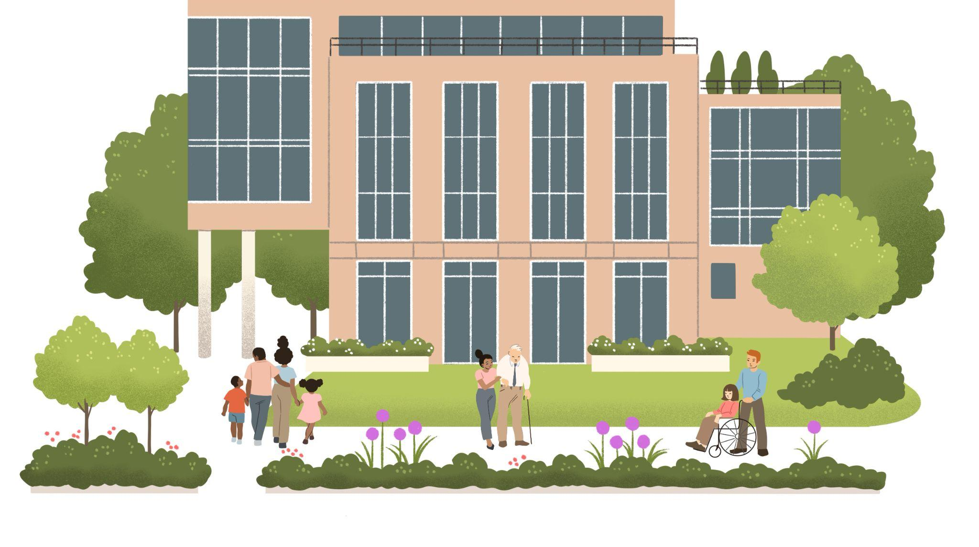
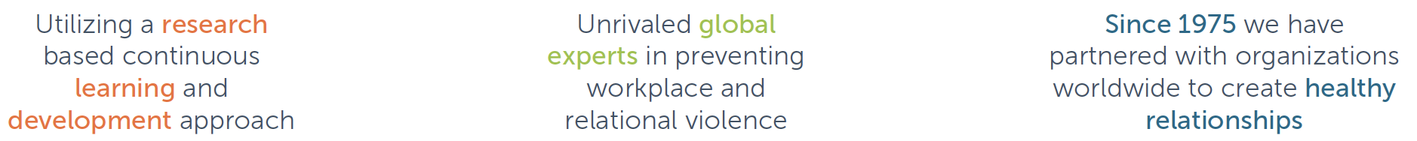
We believe you need to support people, not just their behaviors. ™

Slide 2
Understanding the basics of behavior:
What is behind challenging behavior?

Slide 3
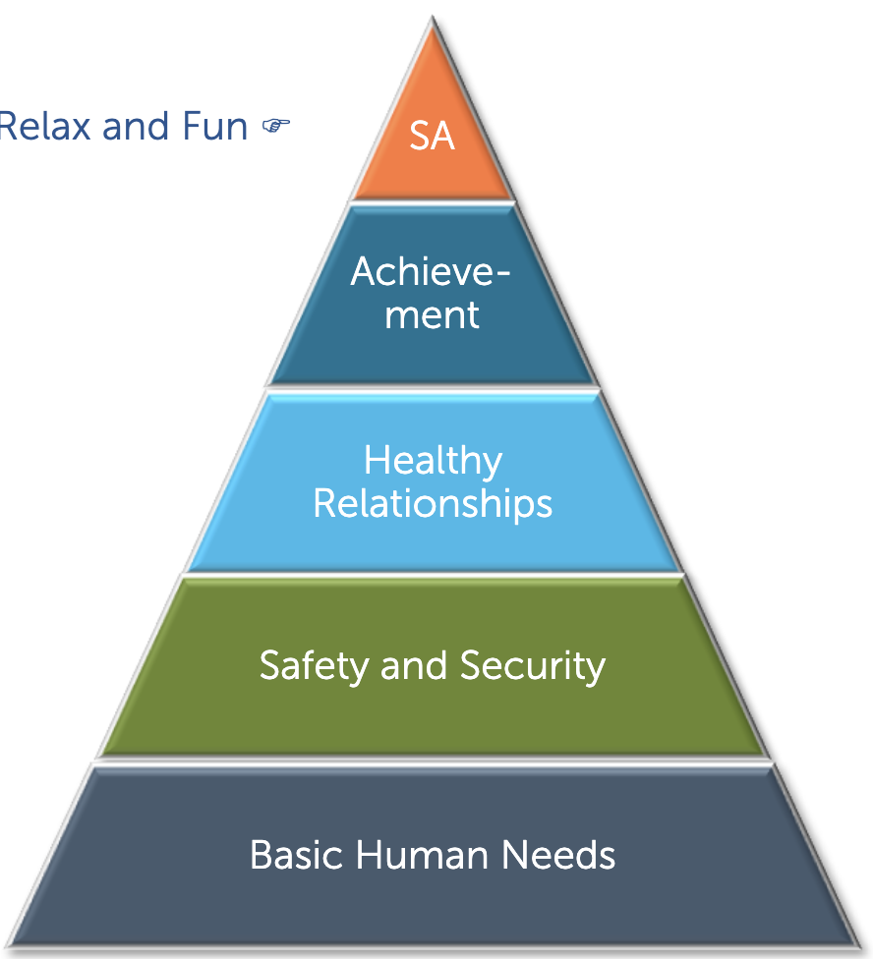

Slide 4
CRISIS
ESCALATION
STIMULUS
BASELINE

Slide 5
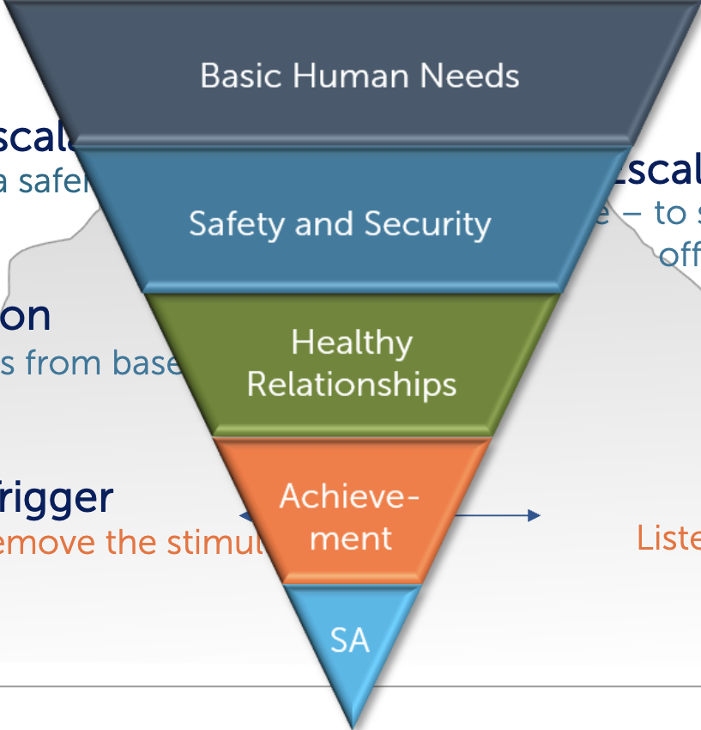
CRISIS
ESCALATION
STIMULUS
BASELINE

Slide 6
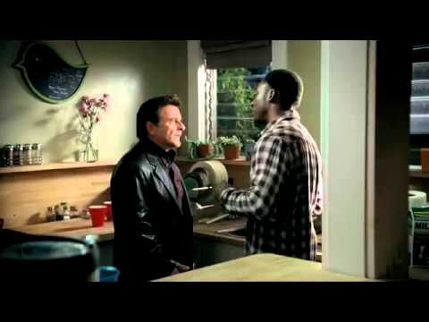

Slide 7
Understanding the basics of behavior:
So why do we reach for the gasoline instead of the water?

Slide 8
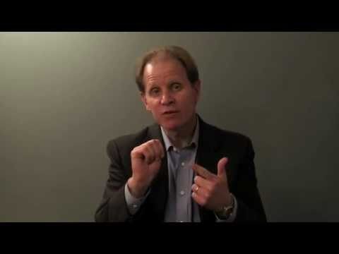

Slide 9
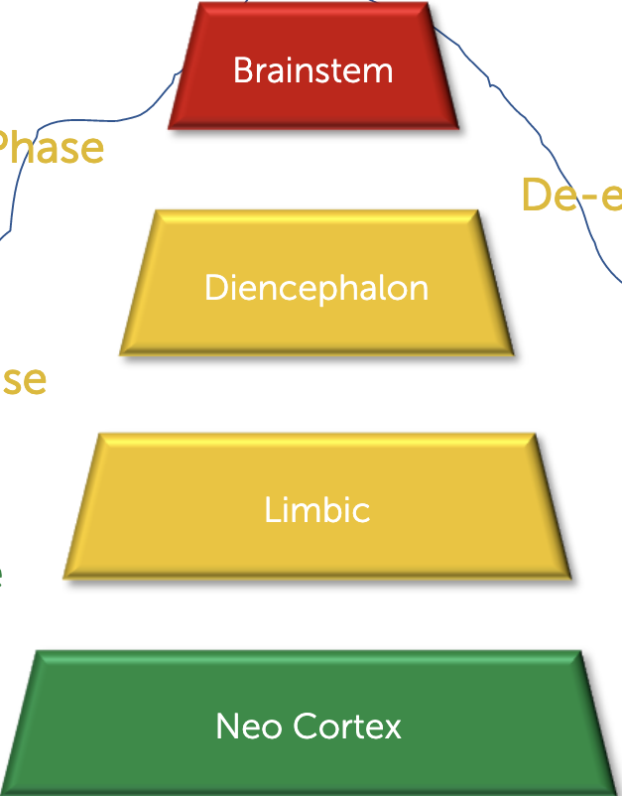
CRISIS
ESCALATION
STIMULUS
BASELINE

Slide 10
Learning to de-escalate:
What does reaching for the water look like?

Slide 11
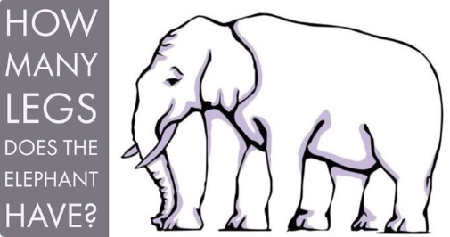

Slide 12
Putting all of the pieces together:
The power of relationships.

Slide 13
Choose five characteristics:
Dignity
Respect
Integrity
Humility
Fidelity
Courage
Kindness
Justice
Patience
Quality
Trust
Forgiveness
Temperance
Fairness

Slide 14
“I possess tremendous power to
make ________ life miserable or joyous.
In all situations, it is my response that decides whether a crisis will be escalated or de-escalated,
and a person humanized or de-humanized.”

Slide 15
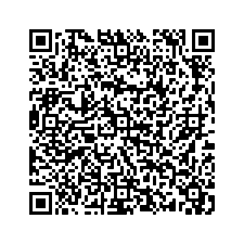
Scan this to download my contact info!

