Slide 1
Family Guidance Center of alabama
Regina G. Allison, M.S.
Program Director

Slide 2
ABOUT US
Family Guidance Center of Alabama is dedicated to strengthening families through partnering with families, organizations, and communities and through the provision of an accessible comprehensive system of coordinated programs and services designed to enable people of all ages in Alabama to envision and achieve their goals.

Slide 3
Family service Center Jefferson County is a program of Family Guidance center.
Family Service Centers are the place where families meet to get information, share ideas, set goals, and make their goals happen. Available FREE to all families residing in Jefferson County, the center offers a unique and exciting place for positive change.
Because the center IS linked with many organizations and agencies in THE area, Families can be assured of being connected with as many services as they need.
This program makes it easier for consumers to find answers to their family questions and receive the help they are looking for.

Slide 4
Target Population
DHR Consumers
Families involved with Court
Our programs are designed to help consumers meet their DHR requirements.
Our programs are designed to assist consumers meet their court ordered assignments.
At risk families
Any family needing a hand up
Our programs are designed to help prevent child abuse and to help families become more stable with all aspects of their family unit.
Our programs are designed to assist all families who want to set goals and strengthen their family through emergency services, education, and employment related services.

Slide 5
Center Overview
Family advocacy
Working Matters
The Family Advocate/ Case Manager helps families set important goals for themselves and their family. The Family Advocate connects individuals with community resources to help families thrive.
Working Matters is a collaborative partnership between the Jefferson County Department of Human Resources and Family Guidance Center of Alabama to help individuals become employed and to retain their employment. Working Matters is currently seeking community placement sites for our volunteers.
Parenting matters
Small wonders
Parenting Matters is an advocacy program that assists men with fathering skills, life skills, job readiness and employment assistance.
The Small Wonders Program assists families of children, birth to 18 years, who have special healthcare & developmental needs. Services are provided via zoom and in home.

Slide 6
Life skills Classes
Positive Parenting
Anger Management 101
Stress Management
Parenting Presentations

Slide 7
Coaching for excellence
TANF eligible consumers with a trained, on-staff coach. Coaches empower consumers to pursue and reach their goals. Need a little support to get to your next level? Contact Coaching today!
Dr. Wanda Ward (334) 541-6127

Slide 8


Counseling services
Free
Family & Individual
We have slots available FREE of charge for counseling.
Please call (205) 945-6000 for more information!
We can work with individuals and couples for counselling needs.

Slide 9
Community Partnerships
Currently, we have over 300 partners.
We would love to partner with you!
Partnerships help move the community forward!
Member of Bundles of Hope Diaper Bank.
Member of One Roof.
Member of Voices for Alabama’s Children.
Member of Jefferson County CPC.
Member of CAVC.
Partner with Trips for Kids to gift bicycles to the community.
Partner with several churches to offer one- time financial aid.
Resource room with varied items free of charge.

Slide 10
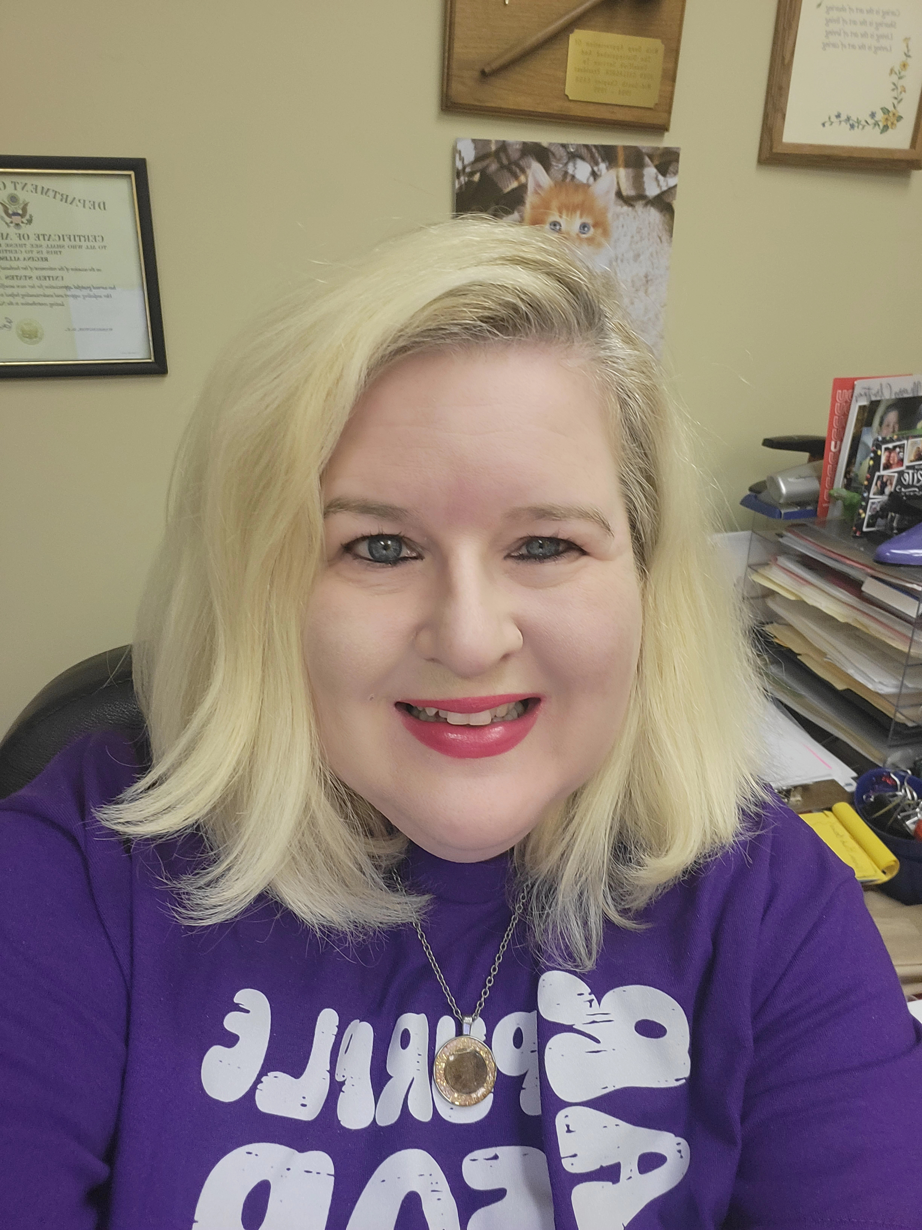
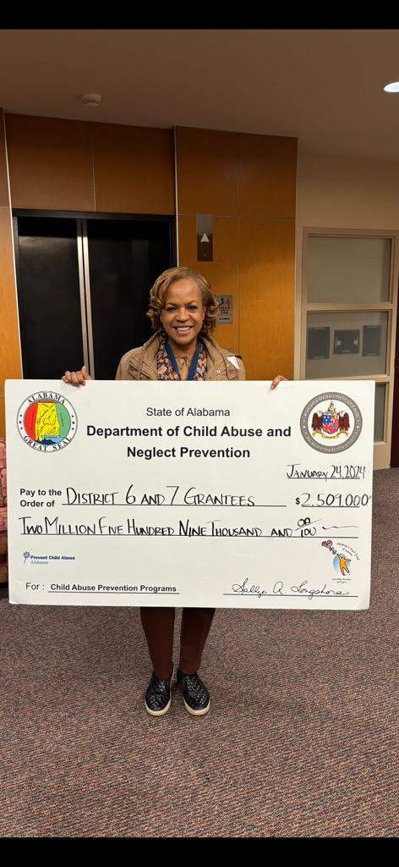
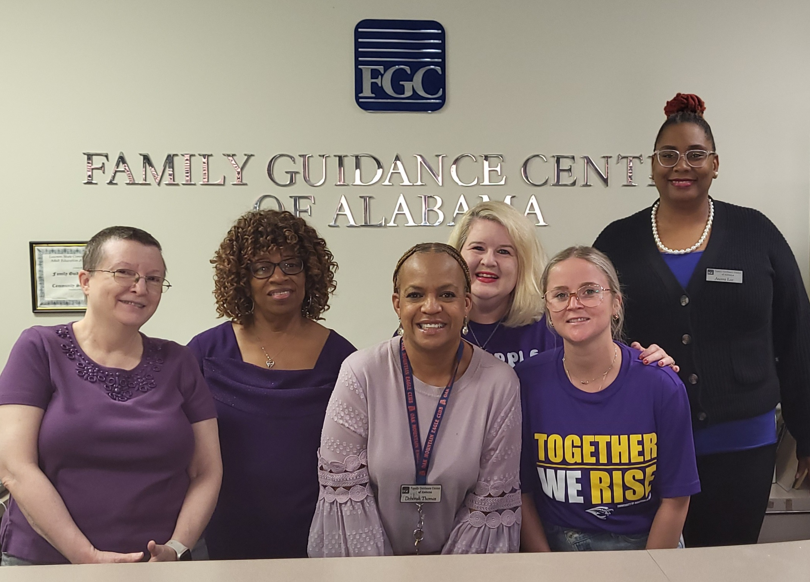
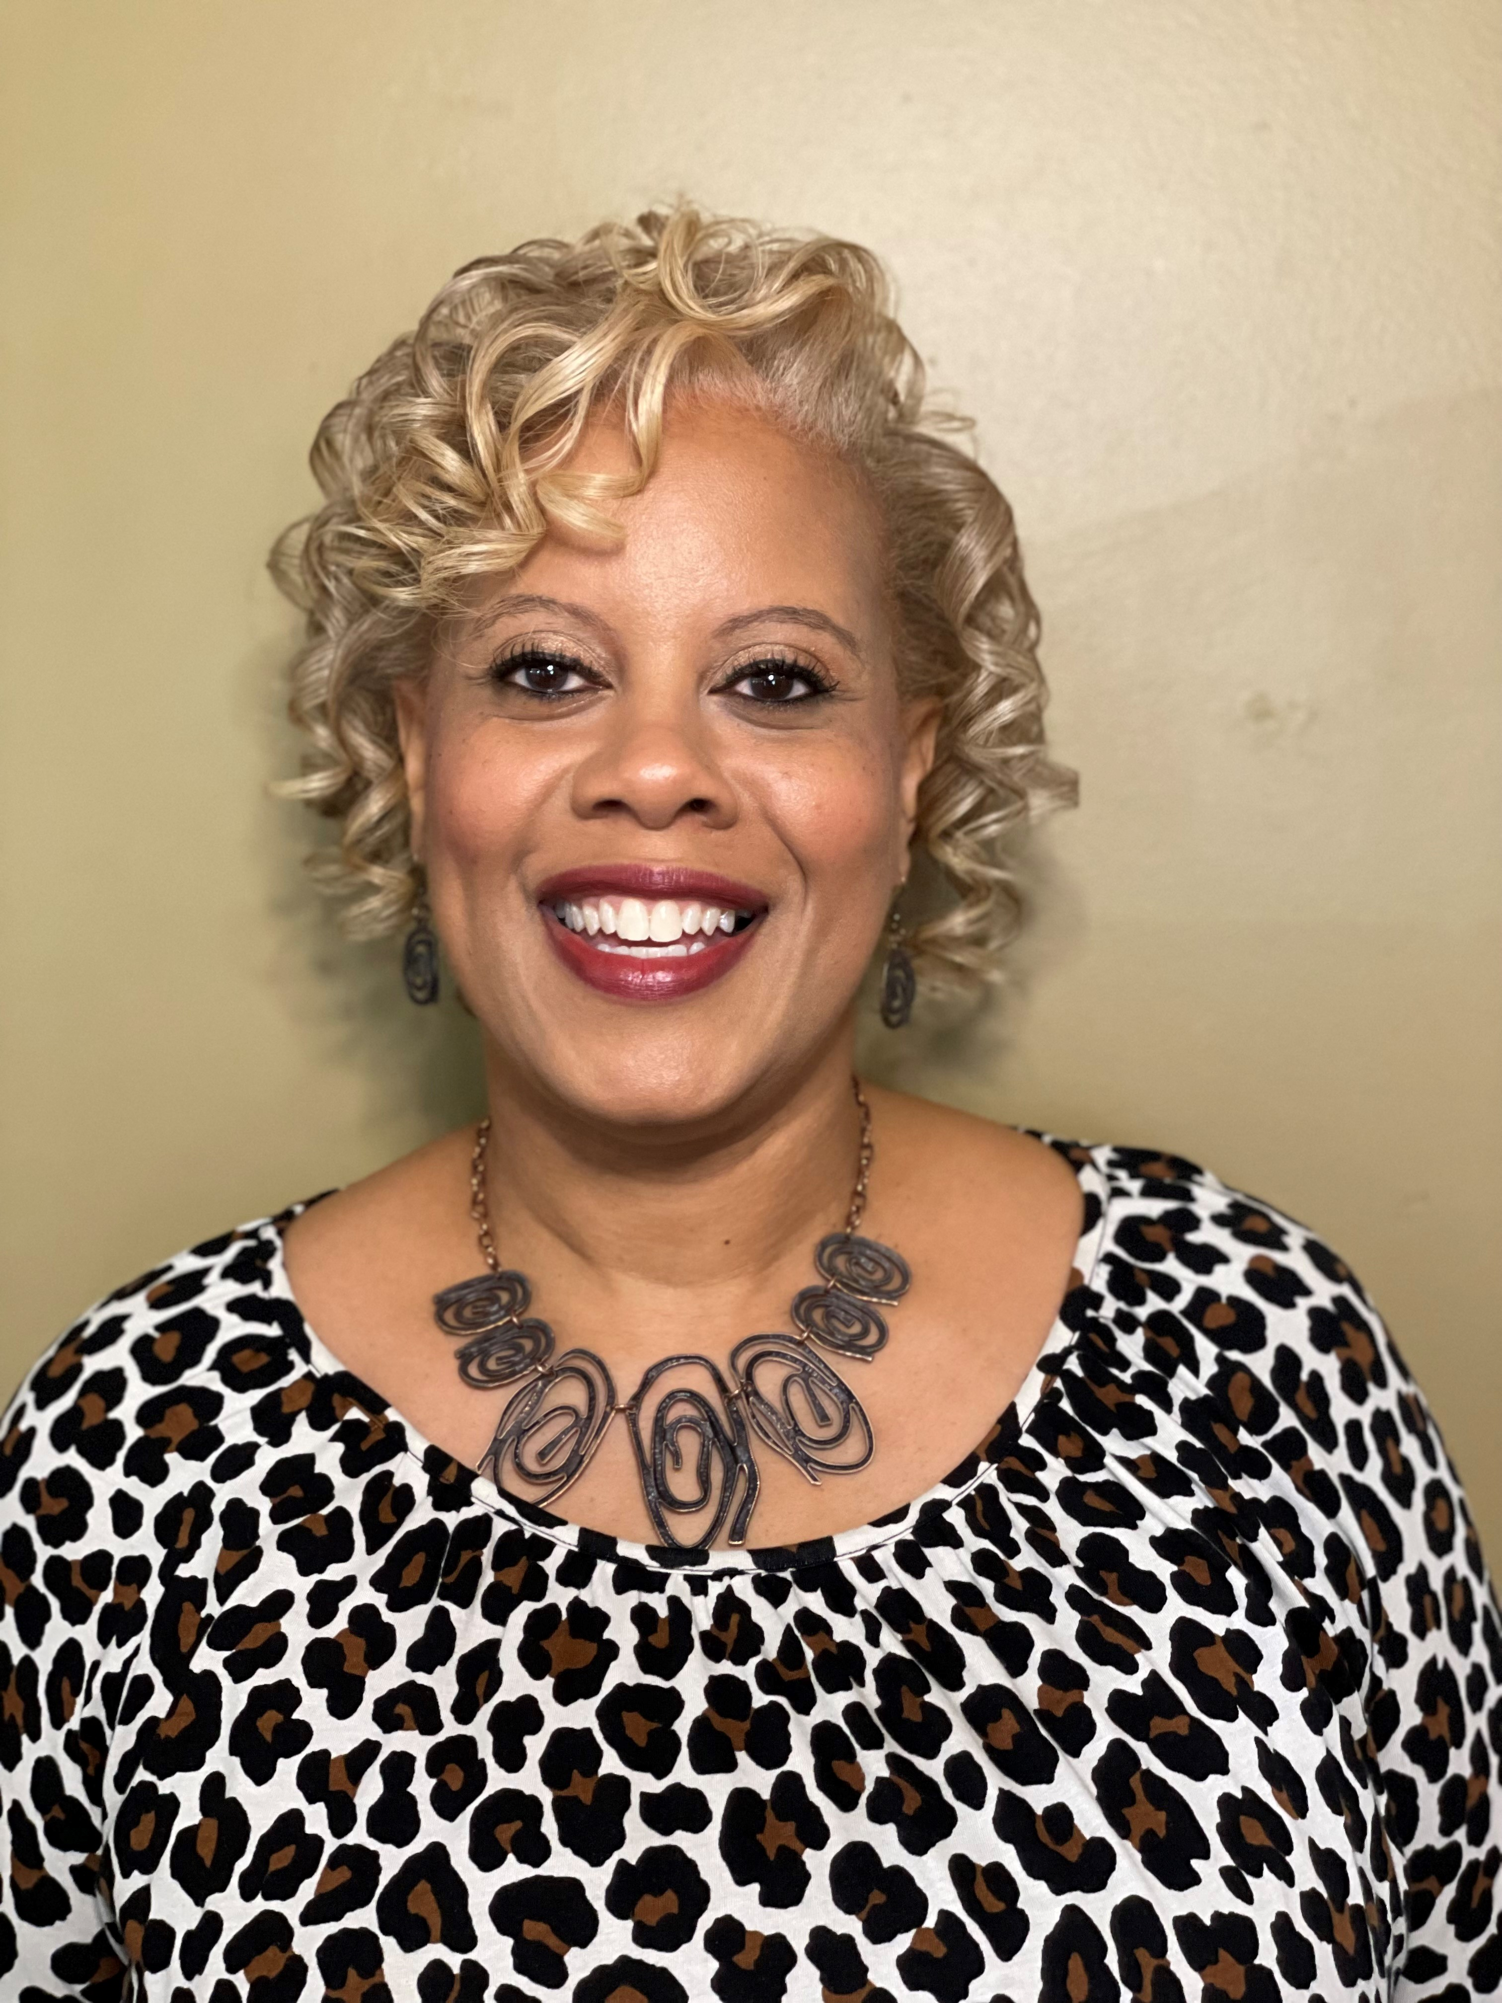
MEET THE TEAM

Slide 11
How to Connect with us
Please call (205) 945-6000 for all inquiries or visit
www.familyguidancecenter.org
Regina G. Allison, Program Director
Deborah D. Thomas, Program Supervisor
Marcia Carter, Office Manager/Intake Coordinator
Tameka Richardson, Small Wonders
Aterra Lee, Working Matters
Linda Young, Life Skills
Jennifer Dussich, Family Advocate
Fred Hilliard, Parenting Matters
Amy McDuffee, Counselor (Retiring end of February)

Slide 12
THANK YOU
Regina G. Allison, M.S.
205-945-6000
rallison@familyguidancecenter.org
www.familyguidancecenter.org

