Slide 1
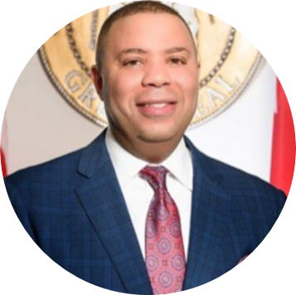
District Attorney, Danny Carr 10th Judicial Circuit Court
Tina Thornton, Executive Director Helping Families Initiative
Notes:
Our Mission:
The Helping Families Initiative (HFI) is a crime-prevention effort designed to improve family functioning, child well-being, and educational outcomes through assessment, intervention, and social service referrals.

Slide 2
HFI Case Officer Team
Vacant Intern Positions
HUFFFMAN
AUSTIN, DE’SHANNA
JACKSON OLIN
BELL, JEROME
WENONAH
FORTE, SHARON
WOODLAWN
IKNER, BRITTANY
CARVER
PROWELL, SHANEKA
PARKER
RANSOM, LATORIA
ADMIN. ASST. HARRIS, SABRINA

Slide 3
Who Is HFI?
HFI is a top tier initiative of the Jefferson County District Attorney’s Office.​
The Birmingham branch of the Helping Families Initiative is comprised of Executive Director, Tina Thornton and a team of passionate Case Officers.​
Attendance, excessive absences & behaviors leading to out-of-school suspension
Our program work by referrals received from BCS feeder pattern through the schools’ administration when there is a concern for any student in relation to attendance, behavior and out of school suspensions
Notes:
The biggest benefit of the HFI approach is that it focuses on the root causes of a student's struggles, not just the visible issues like poor attendance or suspensions. By addressing a family's deeper needs, we can improve their situation and help break the cycle of poor school performance for the child.

Slide 4
The Helping Families Initiative): A School/Community Collaboration
The Helping Families Initiative (HFI) unites schools, law enforcement, and community efforts to support families.
HFI aims to prevent crime by helping families function better, improving children's well-being, and enhancing educational outcomes.
The main focus is early intervention for at-risk students to keep them from entering the juvenile or criminal justice system.
“Making Alabama’s Education Laws Benefit Everyone”
Notes:
Gov. Kay Ivey signed the Creating Hope & Opportunity for Our Students’ Education (CHOOSE) Act into law (Creating Hope and Opportunity for Our Students’ Education Act of 2024). This plan will not only work for Alabama families – it will work for the state and will be effective and sustainable for generations to come.

Slide 5
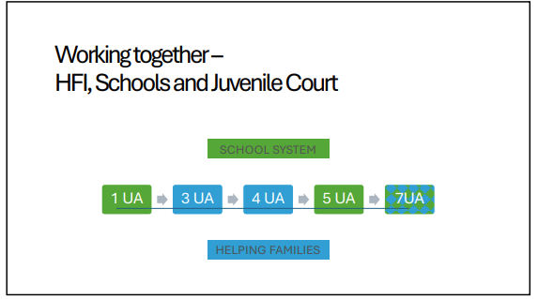
Notes:
Ala. Code §16- 28-16(1975) Act 2001-344, p. 446, §1
Quantity: The combined letters (Assessment/Alert Letters) for scholars who qualified according to State guideline os (11,654) for scholars qualified to receive Assessment and Alert Letters - for scholars: Alert (

Slide 6
2023-24 MEASUREABLE OUTCOMES
HFI provided critical wraparound support services for 2,383 students and their families. ​
Of these, 149 were experiencing homelessness. With support from HFI, 69 Families have successfully acquired temporary or permanent housing. ​
Affordable housing is a national crises and limits, affecting millions of people. With rents going up and wages staying the same, many families are finding it hard to afford a safe place to live. It's not just an economic issue but a moral one, demanding immediate action from both the government and private sectors to ensure everyone has access to safe, affordable housing
Notes:
Without addressing the local issues impacting BCS’s most vulnerable student population, their academic performance, behavior, and school attendance would be at even greater risk.

Slide 7
2023-24
BCS Attendance Data

Slide 8
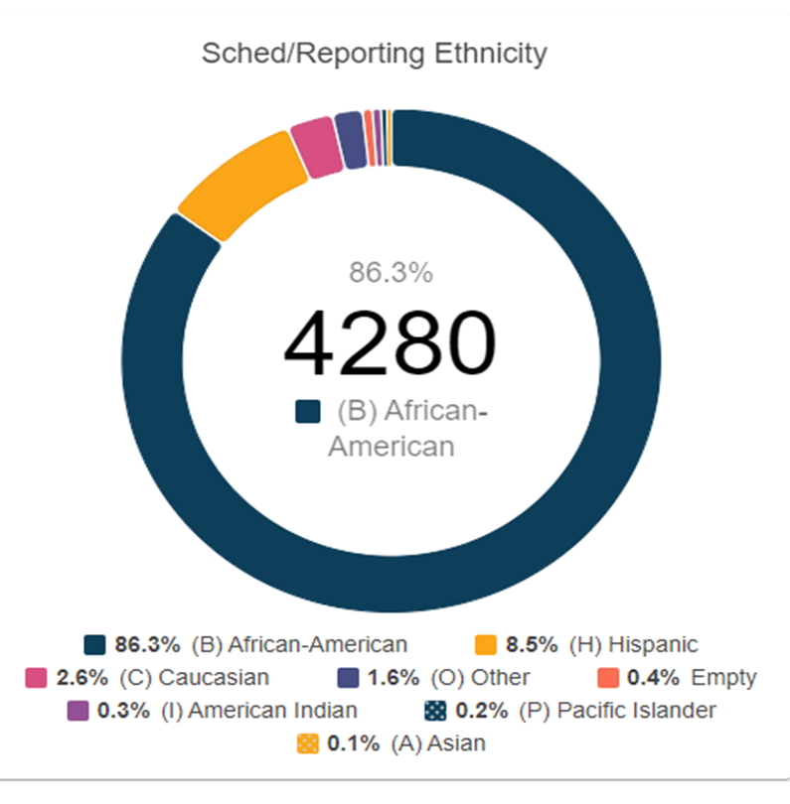
BCS DATA REPORTED
ALL ABSCENCES LISTED IN POWERSCHOOL
Notes:
UNREPORTED DATA: 4,477 (COMBINED DATA: EPORTED/UNREPORTED: TOTAL 8757)

Slide 9
23-24
# REPORTED BY SCHOOLS
81
# IDENTIFIED BY HFI
68

Slide 10
23-24 HFI SERVICES PROVIDED
# Of Services Provided
3228

Slide 11
EARLY WARNING
22-23
# EW REPORTED: 1290/325
23-24
# REPORTED BY FC - 81
Notes:
UNREPORTED #874

Slide 12
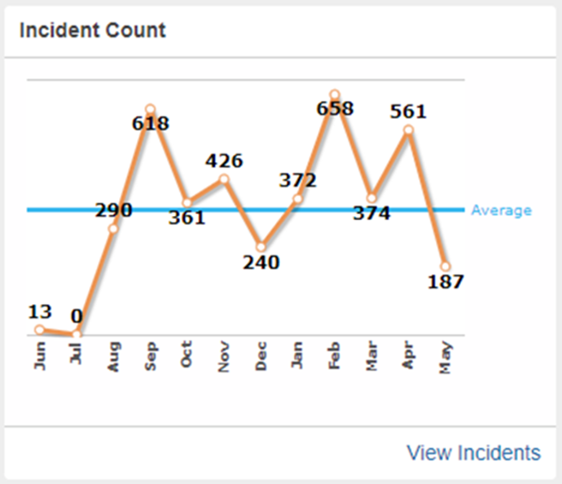
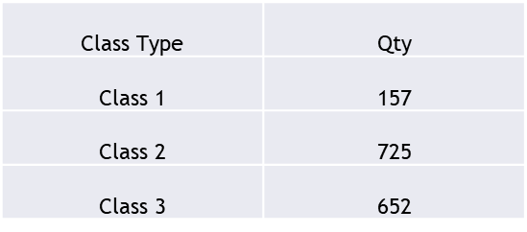
BEHAVIOR RELATED INCIDENTS
23-24
# REPORTED BY SCHOOLS
12 – Class 1
UNREPORTED DATA
***
POWERSCHOOL DATA TIME STAMPED 5/15/2024
Notes:
UNREPORTED #992

Slide 14
HOW DOES HFI HELP?
​HFI connects families with resources to strengthen families and improve student behavior and academic engagement.
1
HFI accesses information across multiple agencies, conducts in-home assessments, and provides individualized intervention plans and support to meet specific needs across a wide range of domains BEFORE students and families are in trouble. ​
2
HFI recognizes warning signs, identifies root causes and empowers families for long-term success!​
3
HFI helps to resolve chronic absenteeism, provides wrap –around services for students and their families, and provides crisis intervention and case management for the entire household. ​
4
HFI is in partnership with the District Attorney’s office. The Alabama Attendance Law REQUIRES parents to responsibly ensure that all children between the ages of six (6) and seventeen (17) attend school regularly and behave properly.​
5
Notes:
(5) HFI links families to resources that support family well-being and boost student behavior and academic involvement.
(4) HFI gathers information, conducts home assessments, and provides personalized support to help students and families before problems occur.
(3) HFI detects warning signs, finds root causes, and empowers families for lasting success!
(2) HFI addresses chronic absenteeism, offers support services, and provides crisis intervention and case management for families
(1) HFI partners with the District Attorney's office. Alabama law requires parents to ensure children aged 6 to 17 attend school regularly and b

Slide 15
Who Is HFI?
Notes:
The biggest benefit of the HFI approach is that it focuses on the root causes of a student's struggles, not just the visible issues like poor attendance or suspensions. By addressing a family's deeper needs, we can improve their situation and help break the cycle of poor school performance for the child.

Slide 16
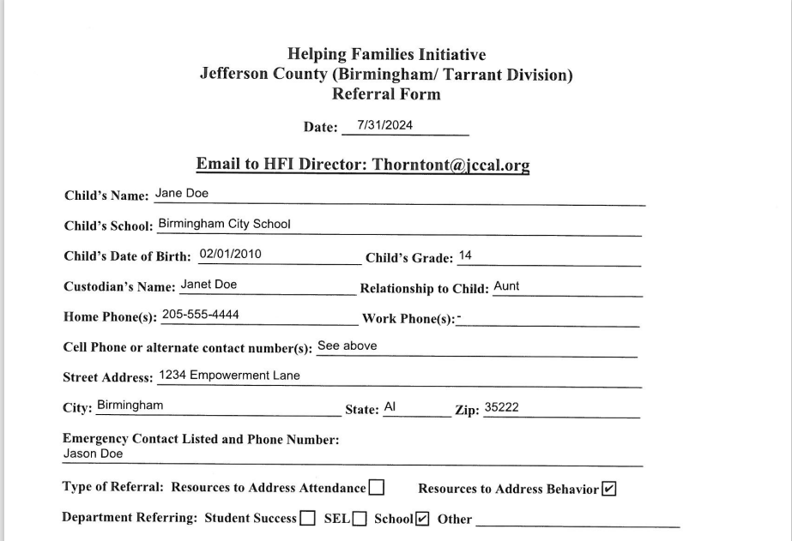
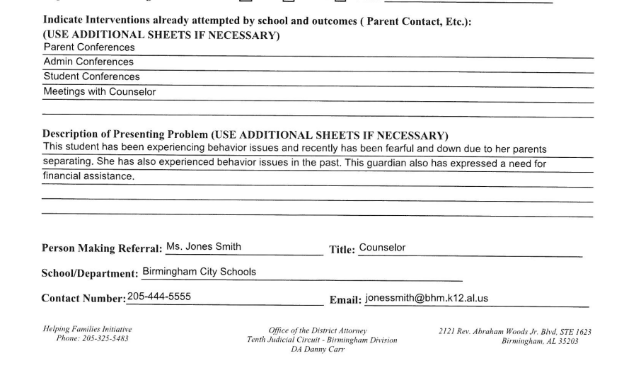
BCS REQUEST FOR SERVICES
Notes:
A new 2024-25 procedure is in place for service requests directly from BCS family members. The highlighted arrows are essential for sharing results following intake and HFI assessments, ensuring school representatives, school/district liaisons, if applicable are notified immediately. Needs identified may vary, utility assistance, clothes, food donations, legal,

Slide 17
HFI Internal Assessment
Notes:
HFI STRUCTURED PROCESS: TRIGGERING – ENGAGEMENT – ASSIGN CASE OFFICER AND CONDUCT FAMILY ASSESS,EMT – INTER-AGENCY TEAM/INDIVIDUAL INDUALIZED PREVENTION – RFERRRAL/REQUEST FOR SERVICES –FOLLOW-UP FAMLY ASSESSMENT

Slide 18
Collaboration thrives where common goals align, trust is built, and every voice is valued—together, we achieve what no one can accomplish alone."
Notes:
Our collective strength comes from having shared goals and respecting each other. When we work towards the same purpose, we use everyone's unique strengths. Building trust allows us to communicate openly, support each other, and solve challenges together. By valuing every voice, we encourage innovation and creativity.
Through this collaborative approach, we can overcome challenges and achieve more than we could individually. By staying united and committed, we can drive success and make a significant impact together.

Slide 19
QUESTIONS

