Slide 1
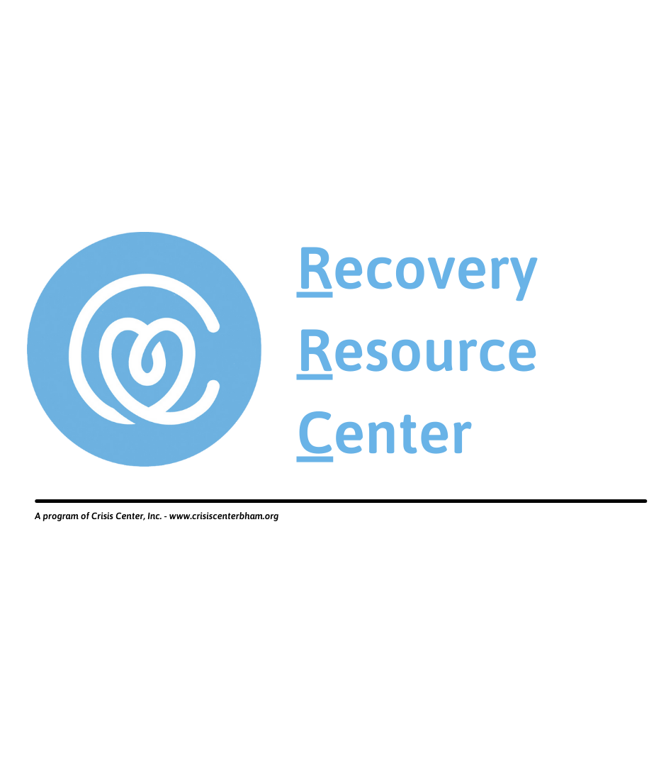
A collaborative initiative to simplify the substance use treatment process and remove barriers to recovery
Presenter Name

Slide 2
The RRC was a direct response to the Opioid epidemic by local health officials and treatment providers.
ORIGIN of the RRC
Fatal overdoses involving opioids were increasing exponentially. In Jefferson County in 2010 there were 12 overdose deaths.
In 2011, there were 24.
In 2017, Dr. Mark Wilson and JCDH approached the Crisis Center and the idea behind the RRC began to take shape. The goal was simple - save lives.
In 2014, there were 123.
In 2016, there were 202.

Slide 3
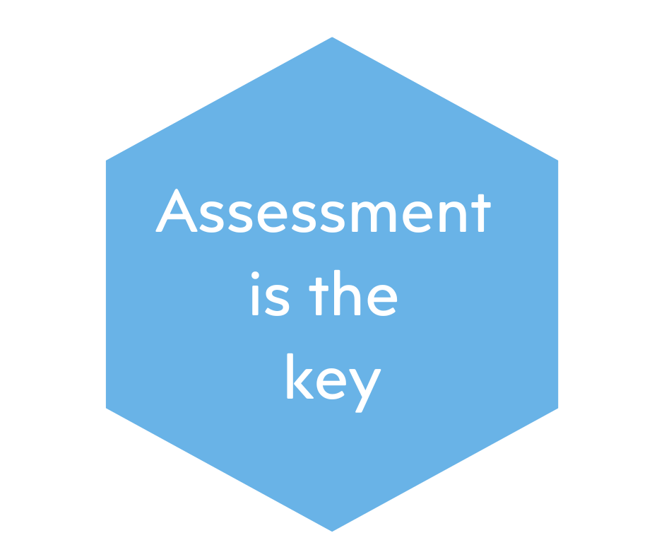
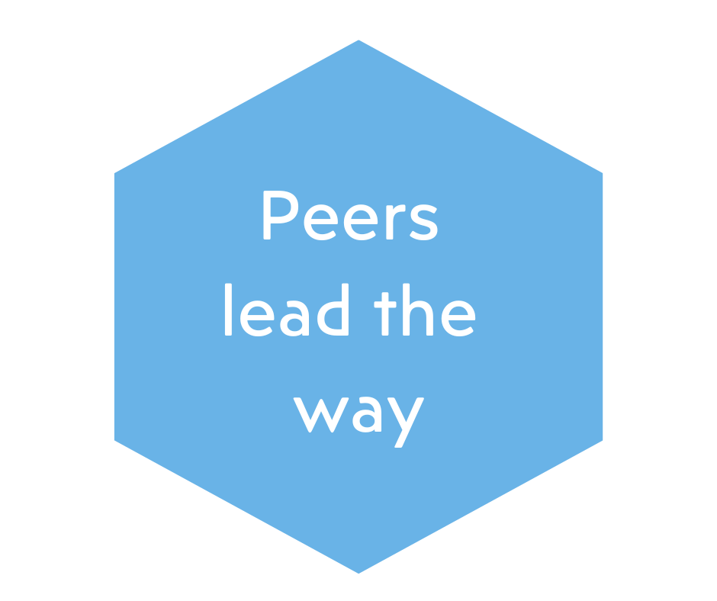
Primary Services
Referral: Meets individual treatment needs - takes into account factors such as lack of insurance and specific characteristics such as gender, veteran status and place of residence.
Information: Through consultation with peer, we provide information on addiction and recovery, as well as information specific to treatment providers and/or type of treatment.
Assessment: Conducts Alabama Dept. of Mental Health placement assessment based on American Society of Addiction Medicine (ASAM) criteria to identify the appropriate level of care.

Slide 4
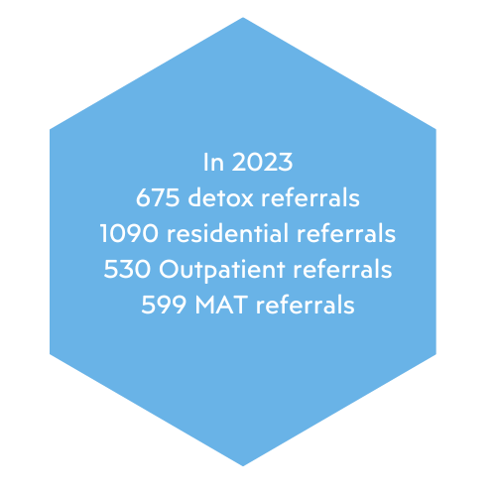
How it works
Peers listen to clients and share personal recovery when appropriate during intake.
Clinical assessment determines appropriate level of care.
Staff relays assessment data to desired treatment programs and provides referral information to client.
Peers maintain regular contact with client until they are in treatment and offer follow-up services.

Slide 5
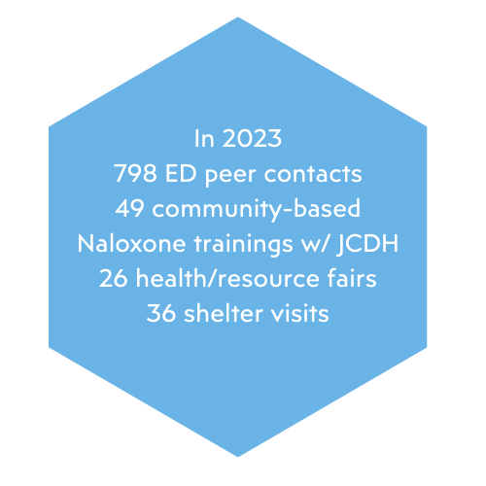
Outreach & Community Support Services
Peers in the Emergency Department
  Partner with UAB Dept. of Emergency Medicine to offer on-site peer services since 2018 / SAMHSA grant to Expand ED-initiated MOUD services.
  Partner with JCDH on NACCHO S-PED (Sustaining Peers in Emergency Department) grant.
Naloxone training and distribution
  Partner with JCDH to offer community-based Naloxone trainings since 2018 (First in the state)
  Partner with JCDH on OD2A (Overdose Data to Action) grant since 2021
Community-based services
  Provide peer outreach at local shelters
  Education at community health/resource fairs

Slide 6
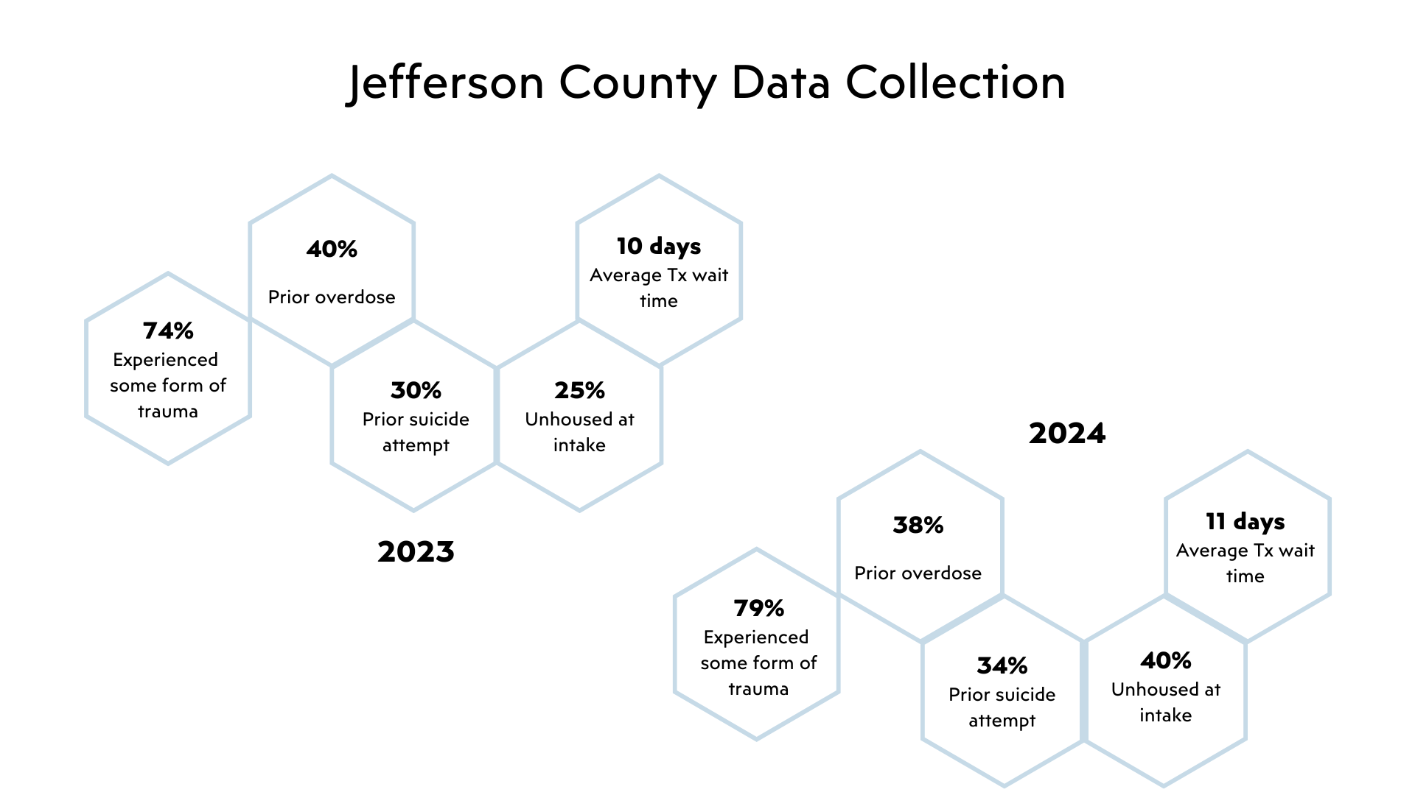

Slide 7
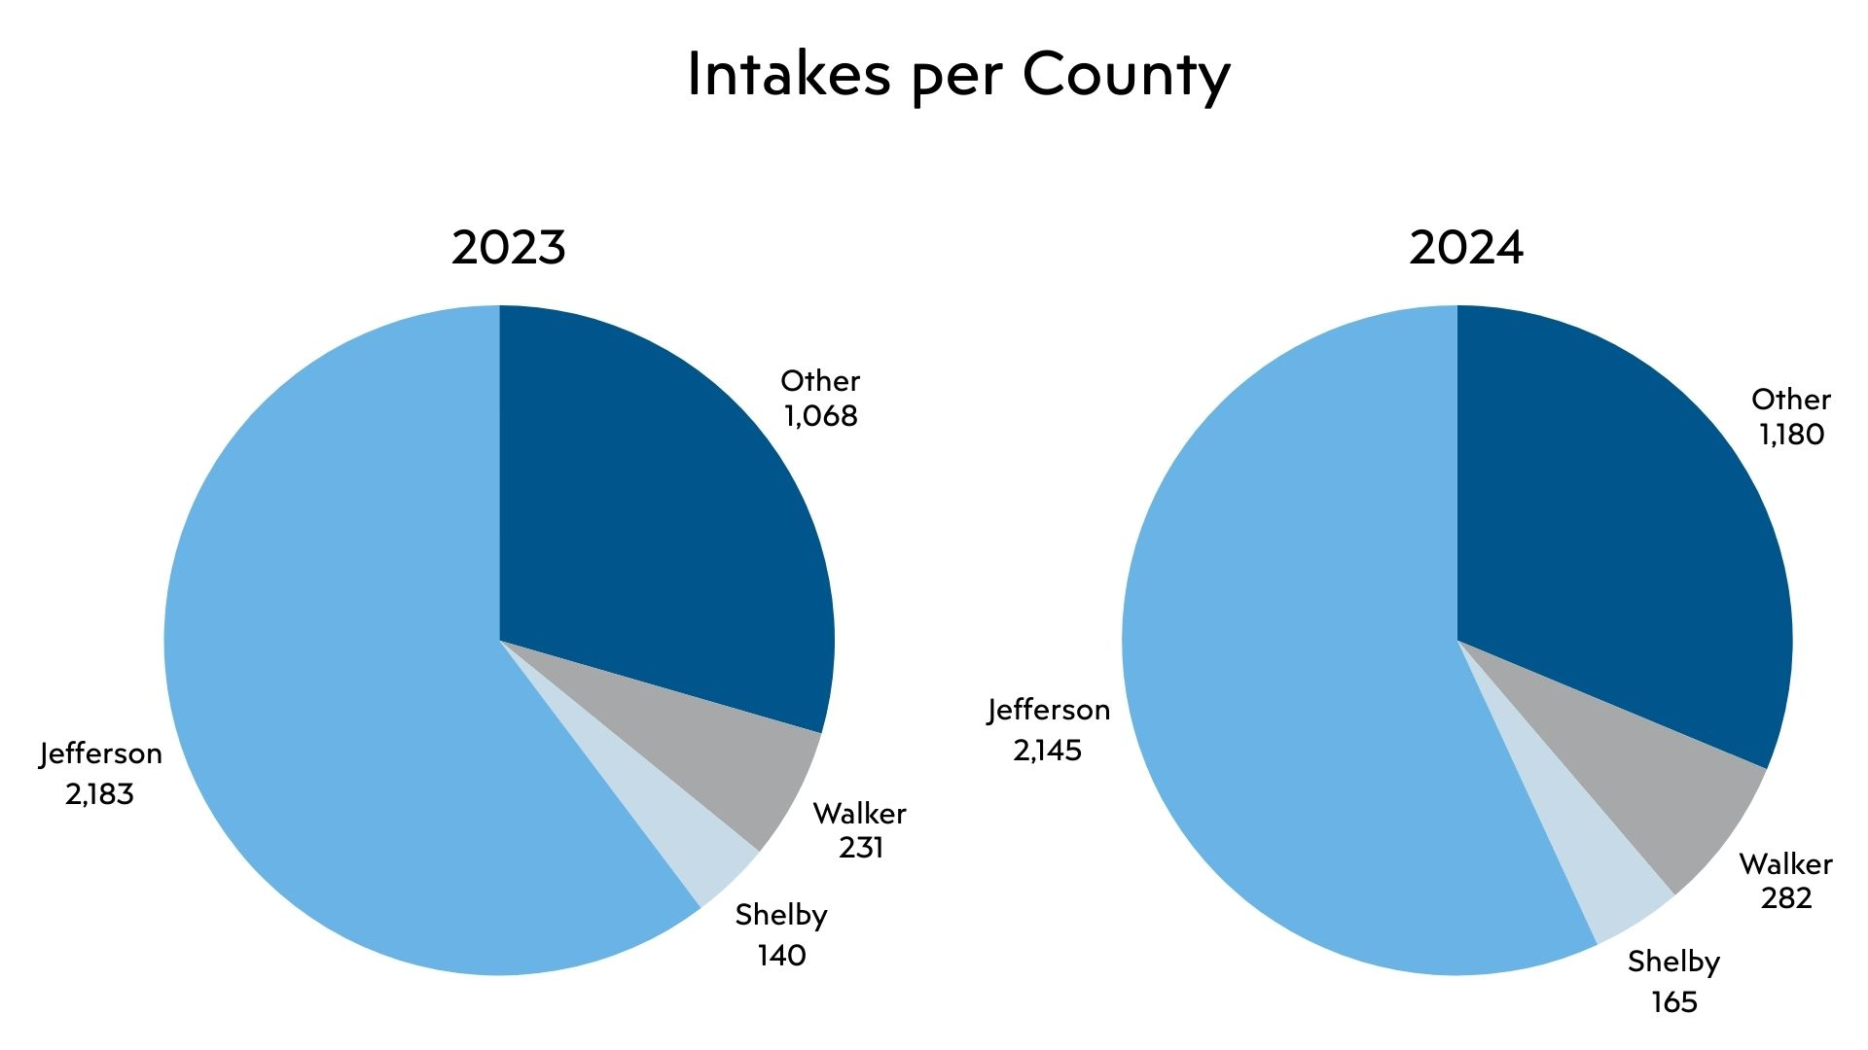

Slide 8
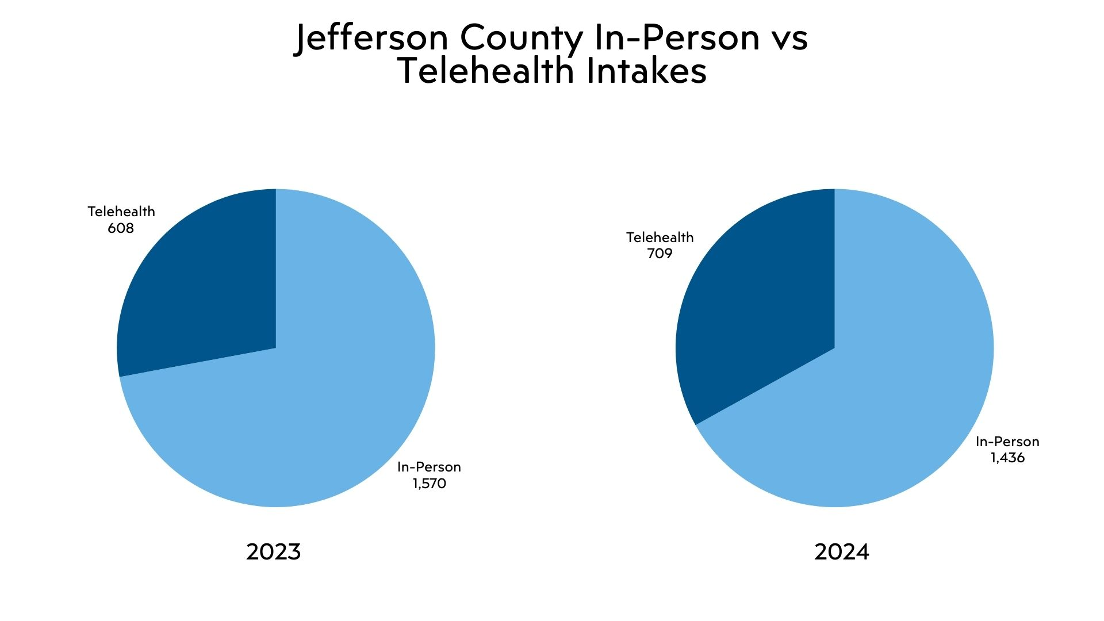

Slide 9
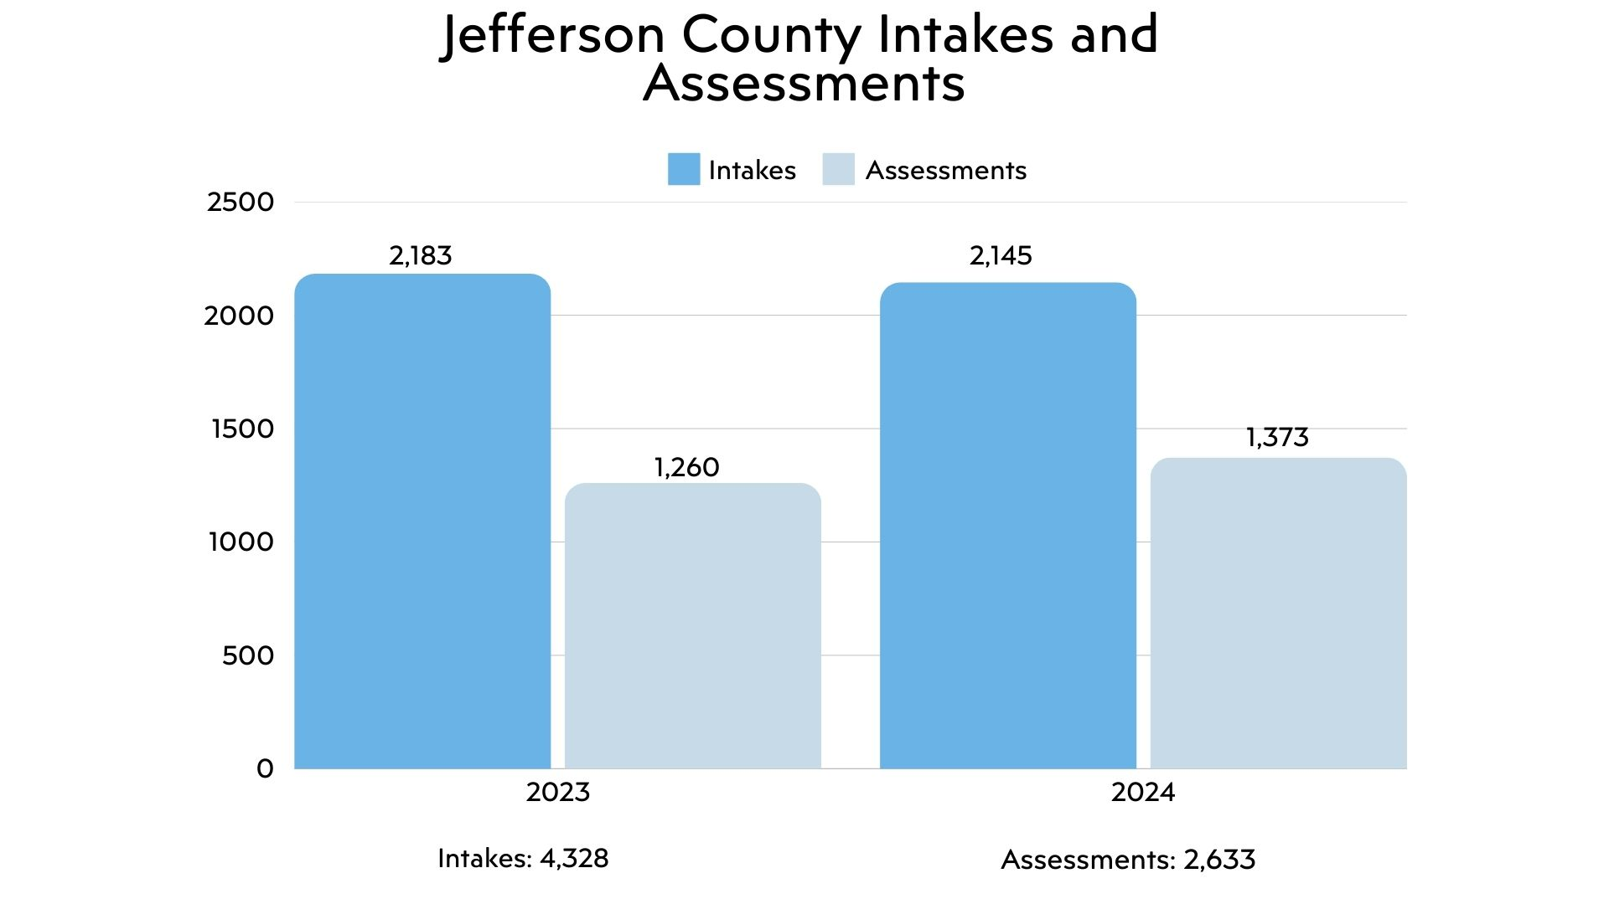

Slide 10
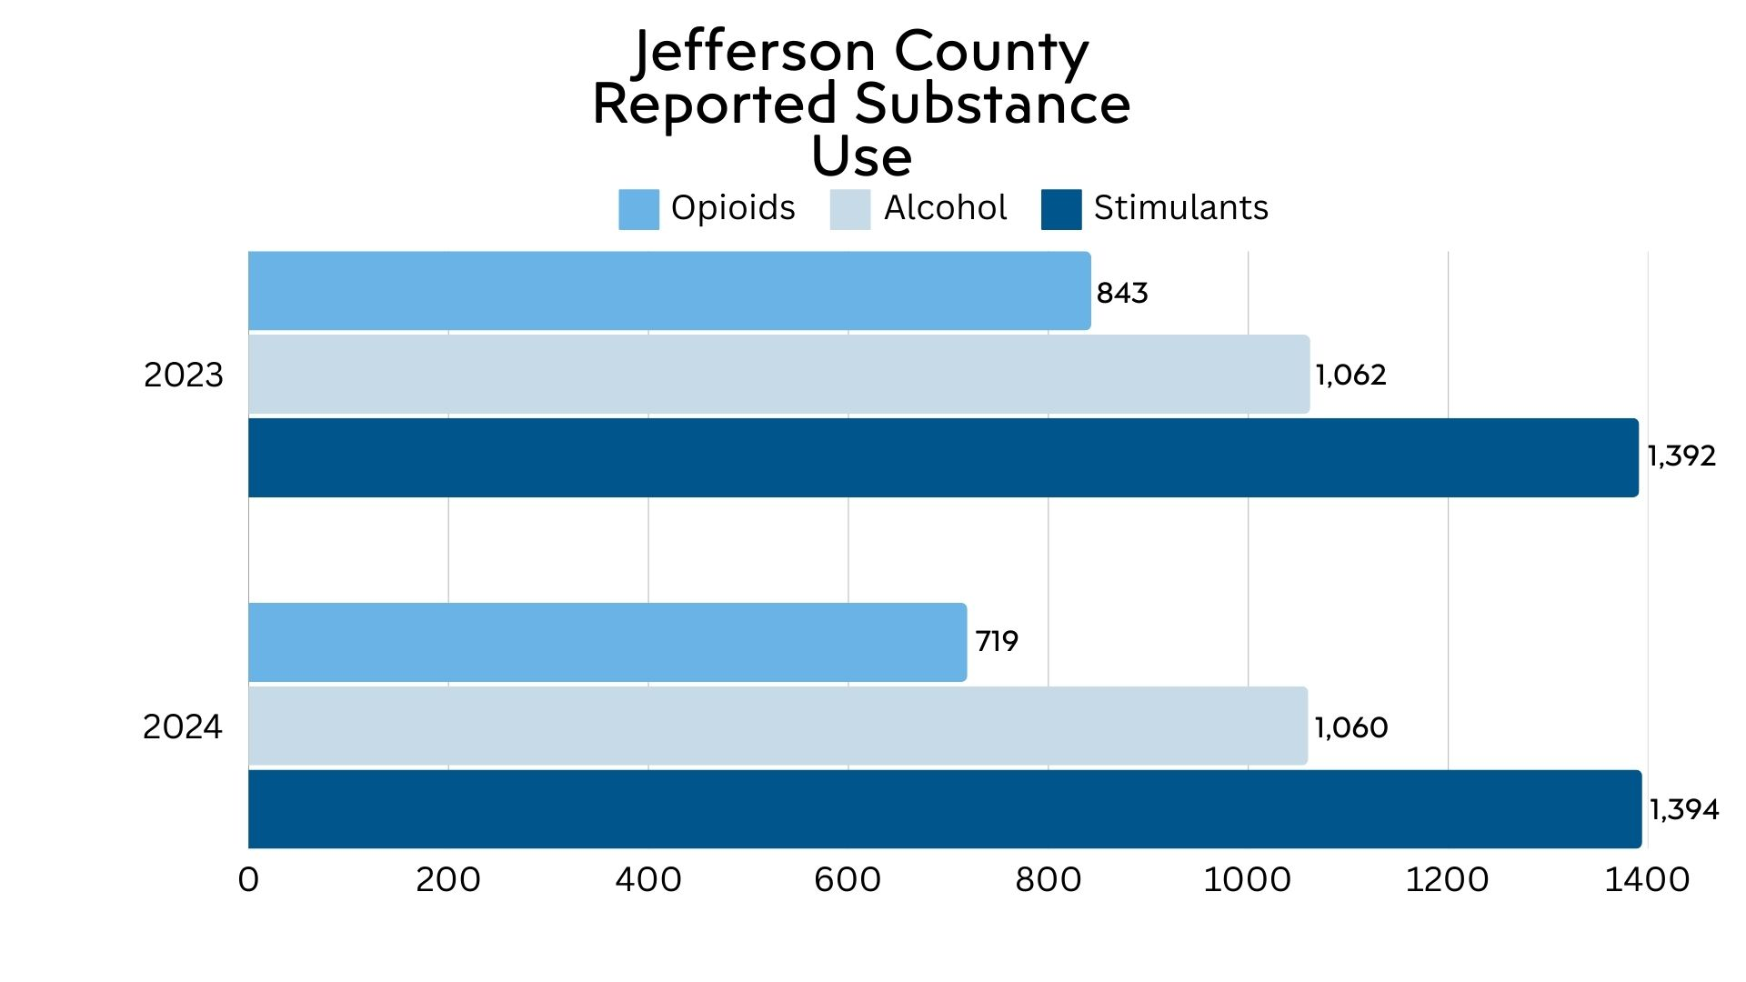

Slide 11
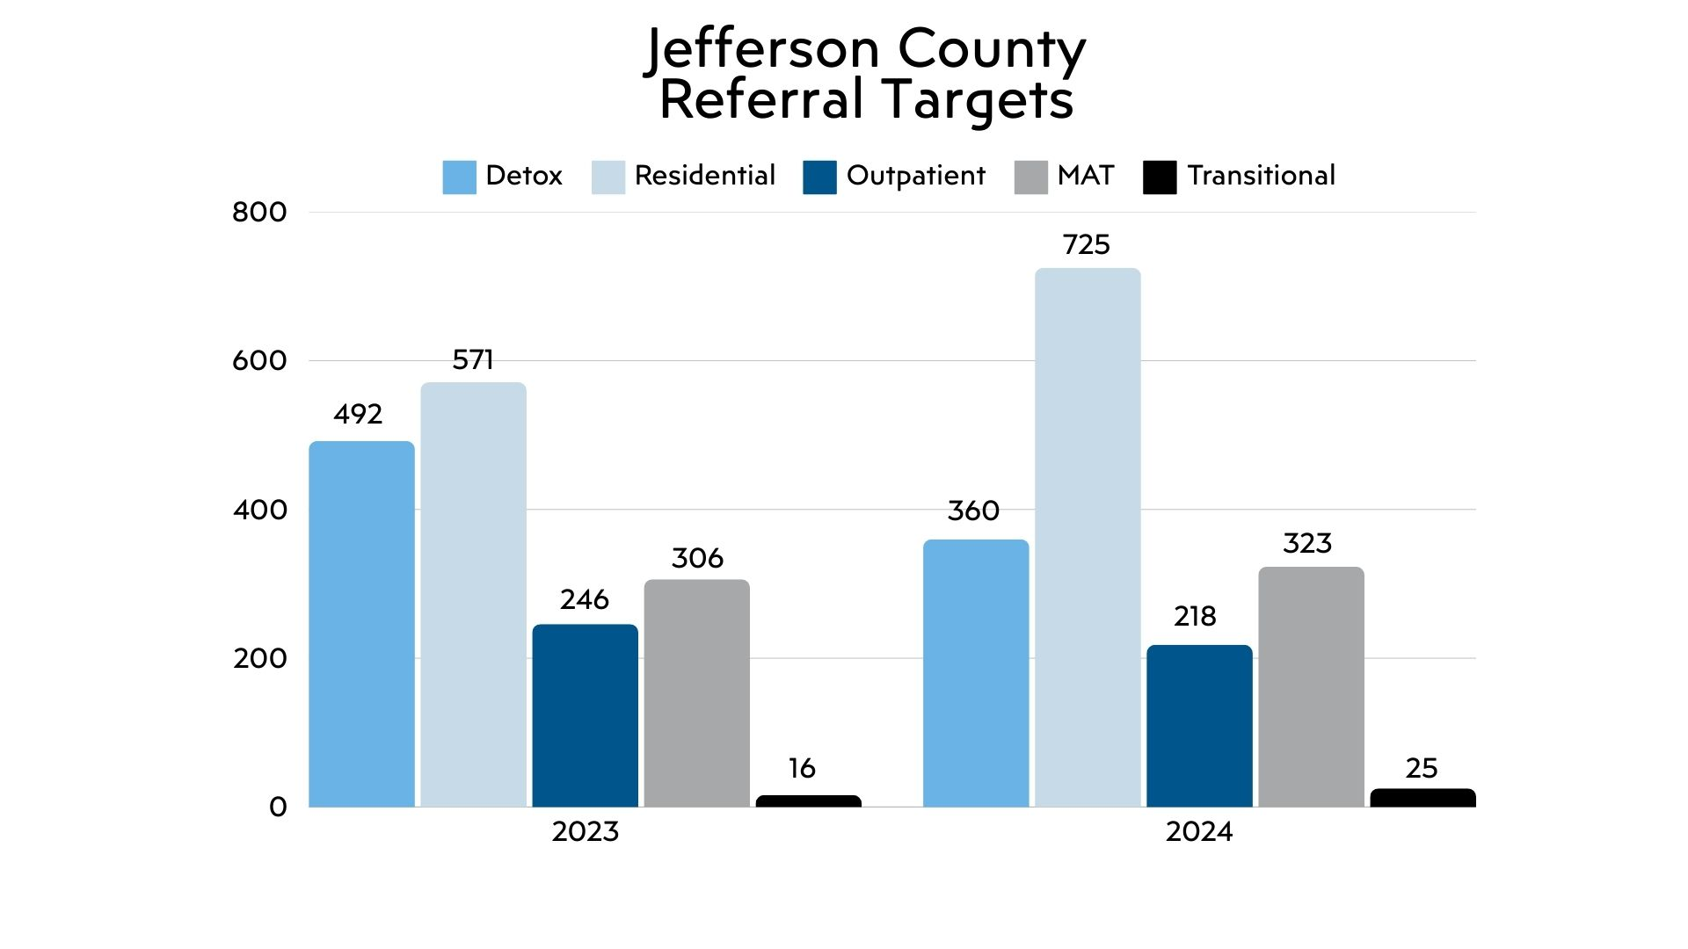

Slide 12
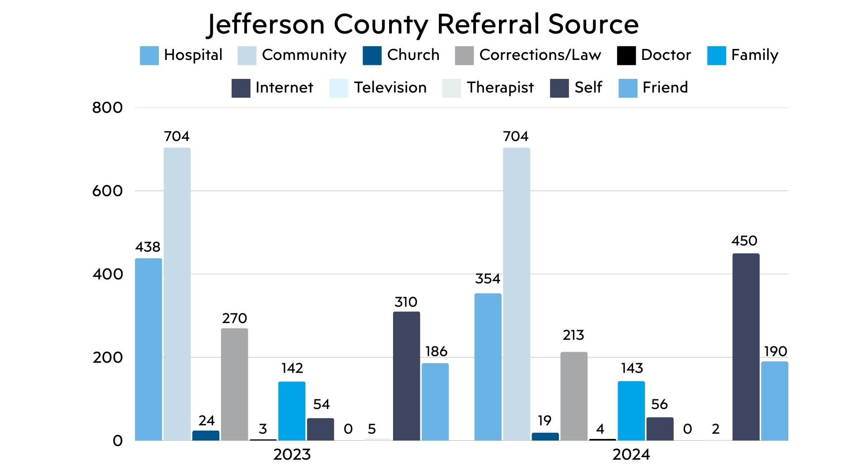

Slide 13
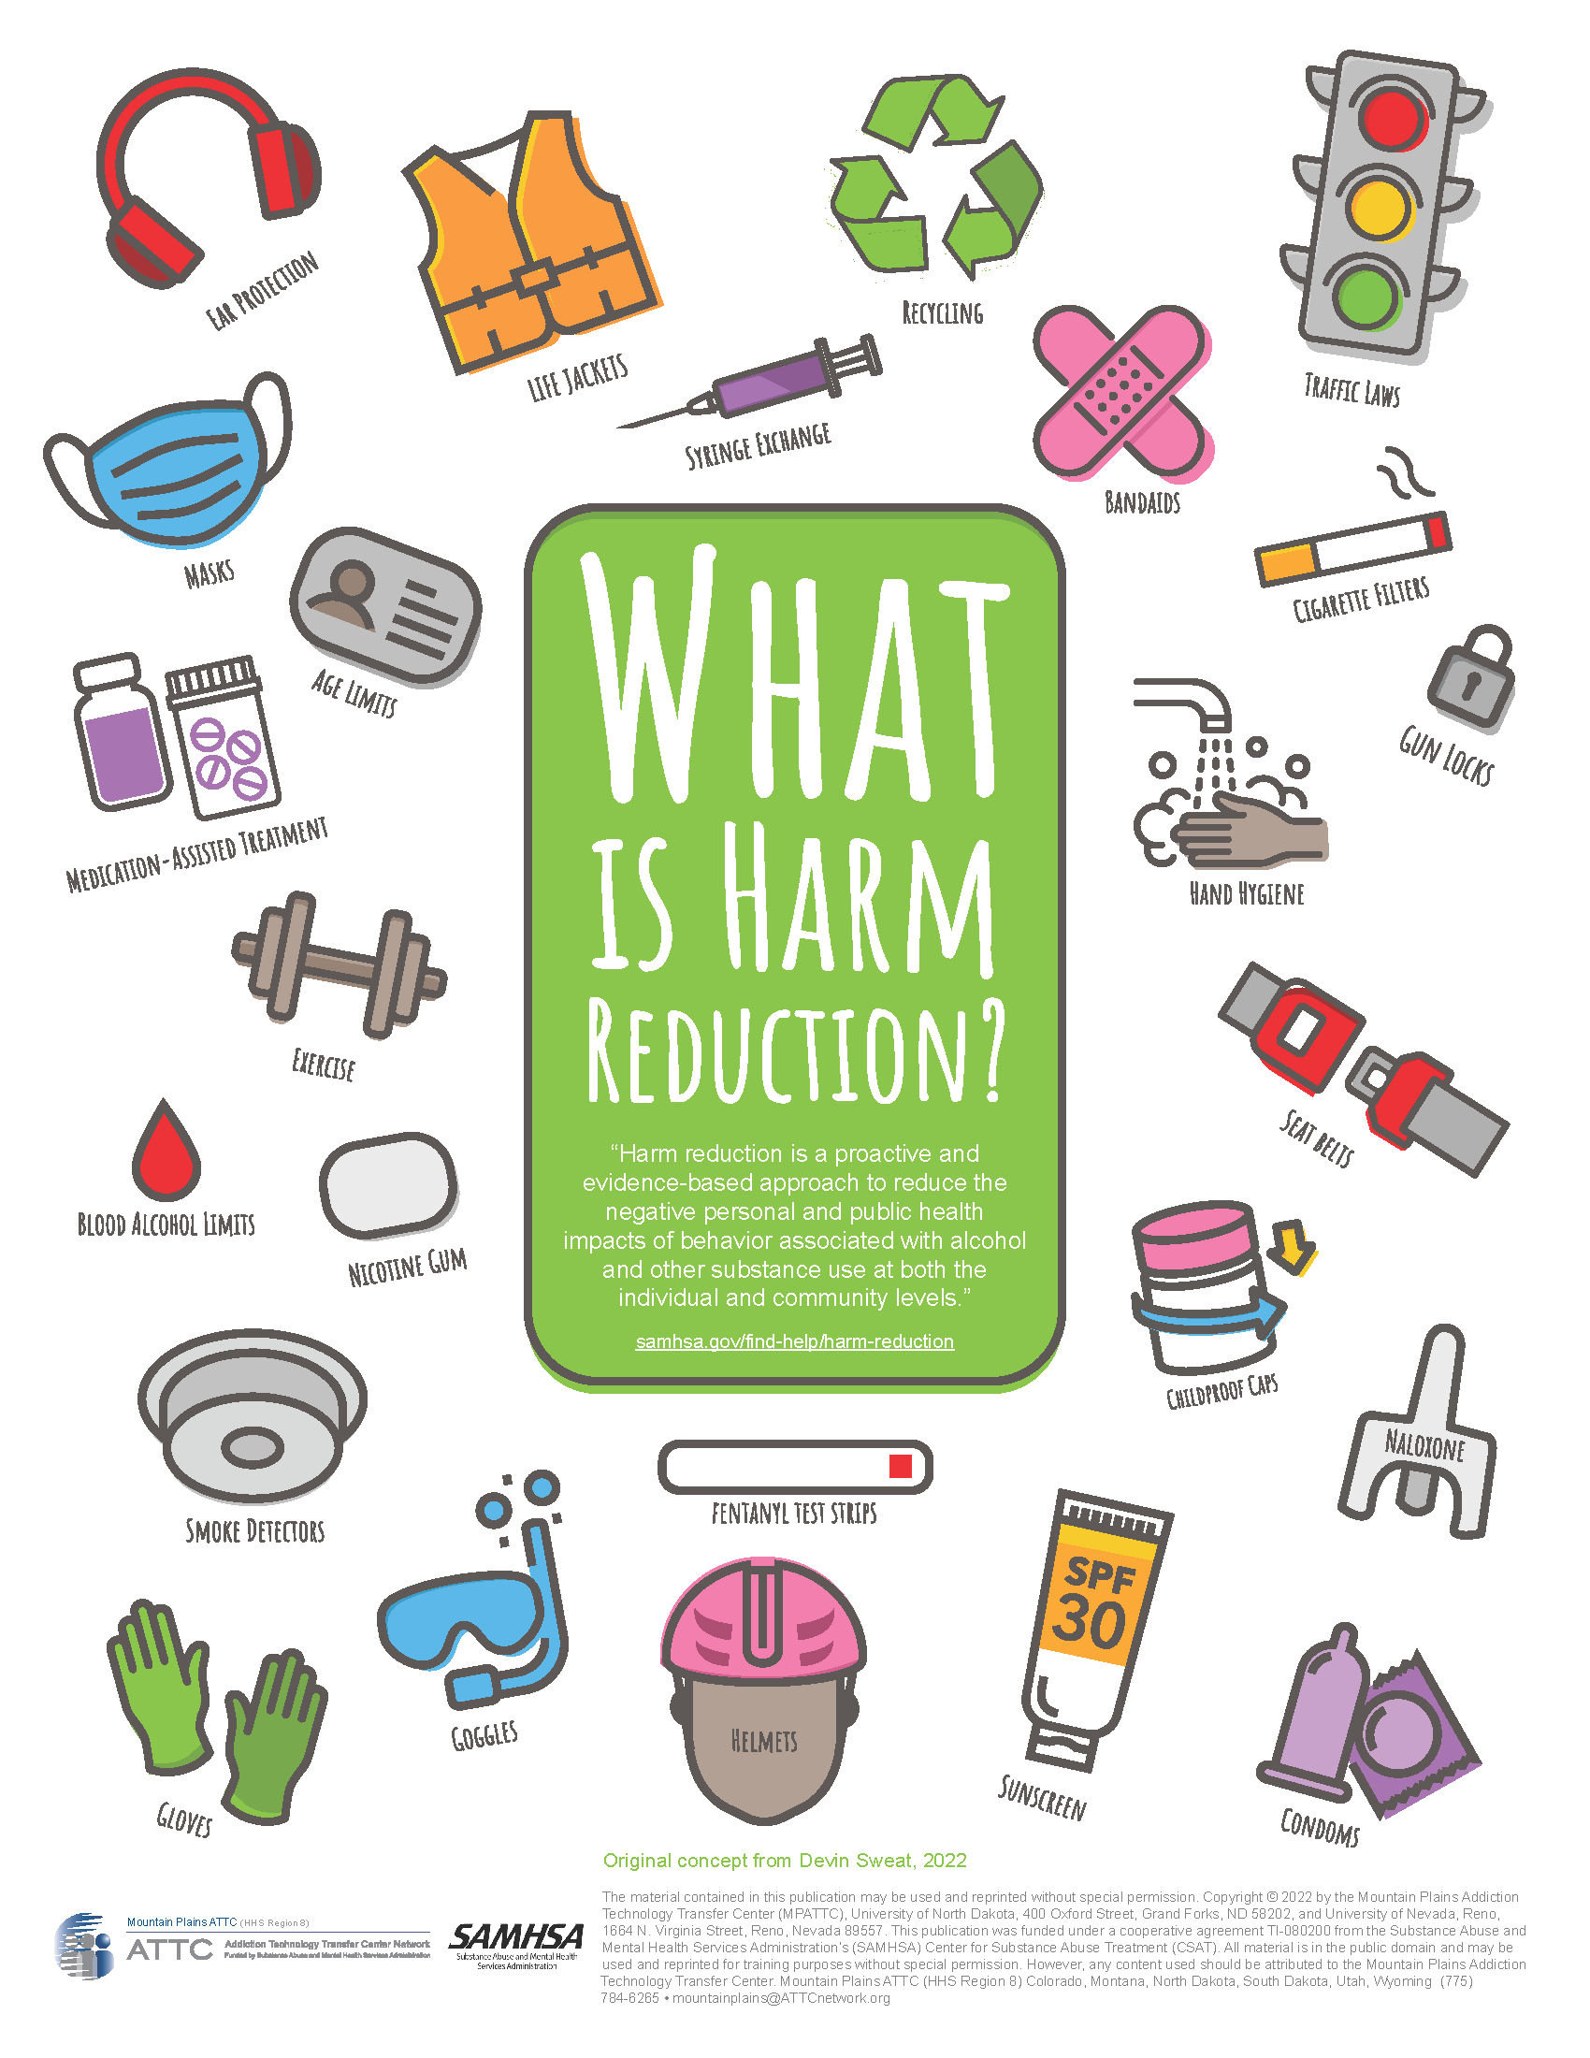
Harm Reduction is…
Harm Reduction is a wide-reaching concept that seeks to enhance the wellbeing of individuals and communities
It addresses many facets of life including housing, employment, recovery relapse prevention and substance use at any level
Harm Reduction is a public health approach

Slide 14
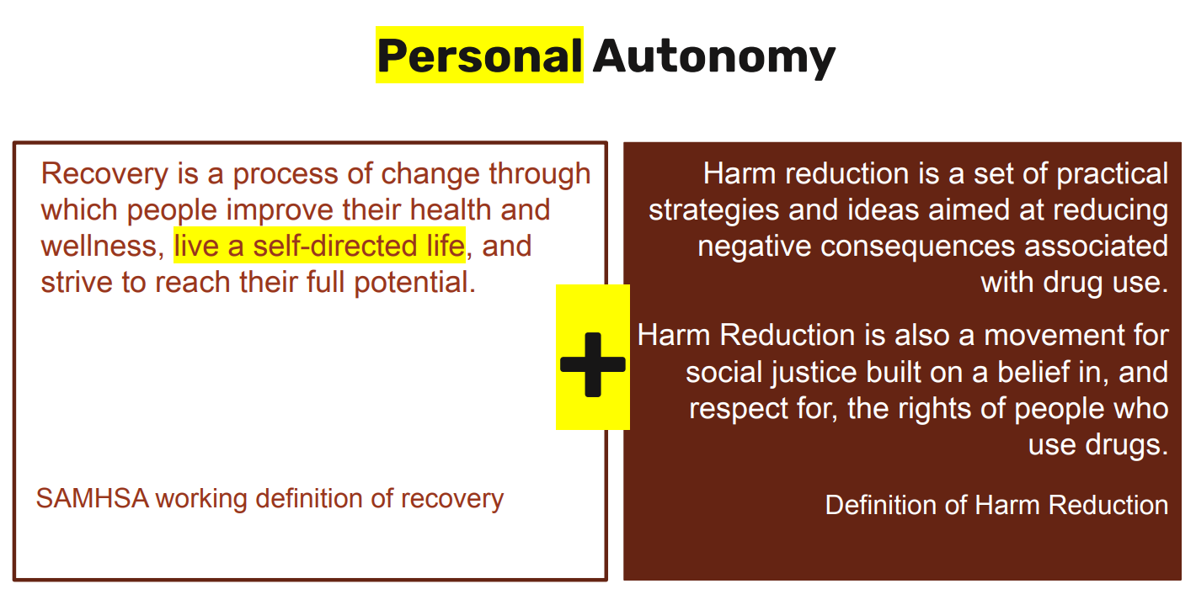

Slide 15
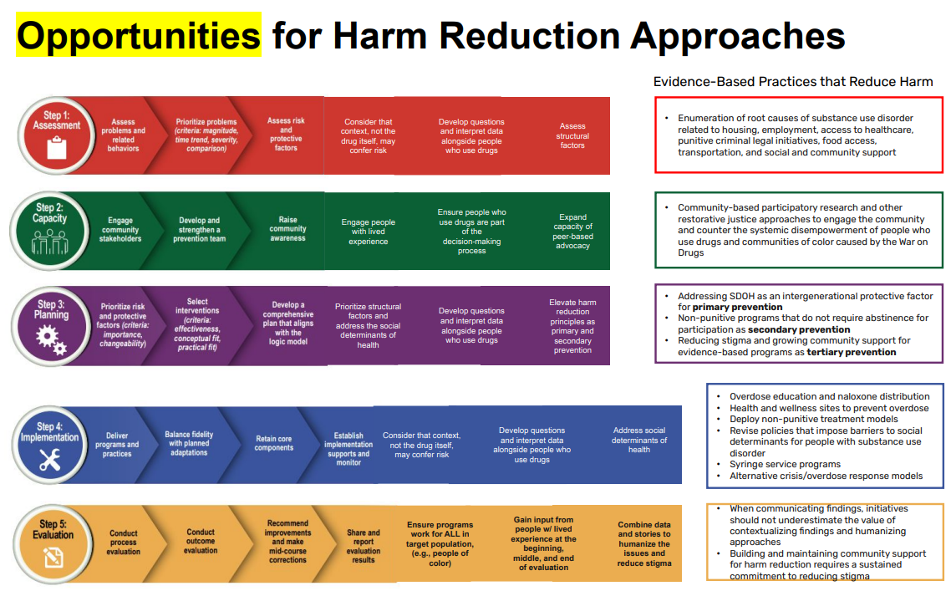

Slide 16
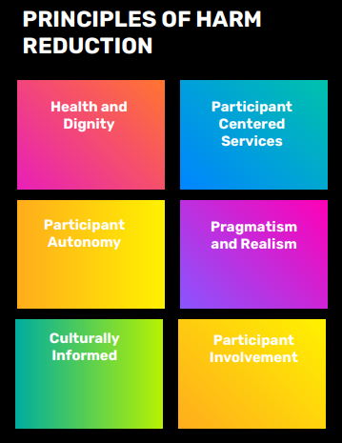
HR developments in AL along the way…
Good Samaritan Law for Naloxone
Establishment of CRSS certification (ADMH) and development of peer workforce
Increase of M.A.T. utilization by treatment providers
Elimination of the X-waiver
Fentanyl Test Strip removed from drug paraphernalia law
FDA approval of Naloxone – Narcan OTC

Slide 17


I need help. Now what?
System navigation & overcoming barriers to recovery
John Bayles
Program Director, Recovery Resource Center, a program of Crisis Center Inc.

Slide 18

My pathway
(not everyone else’s)
STARTS, STOPS / NOT A STRAIGHT LINE
  Introduction to 12 steps (consequence of legal issues)
  Outpatient SUD treatment
  Mental health crisis / stabilization / detox
  SUD treatment Continuum of Care
  Mutual support, therapy, purpose

Slide 19

Clinical treatment model
ASAM - American Society of Addiction Medicine
  Detoxification (medical or supervised)
  Residential / inpatient treatment
  Outpatient
    Partial hospitalization (PHP)
    Intensive Outpatient Therapy (IOP)
    Medication-Assisted Treatment

Slide 20

Other pathways
Different folks, different strokes
Recovery is not one-size-fits all
  Faith-based
    Celebrate Recovery, church-based recovery ministries, prayer, spiritual counseling
  Mutual support (12-step, non-12-step)
  Harm-reduction, incremental change
  Self-directed recovery, natural recovery
  Alternatives (yoga, art, wilderness & adventure)

Slide 21

Changing landscape
Polysubstance use is the norm — people are using combinations (e.g., fentanyl + meth, alcohol + benzos).
Fentanyl saturation: Synthetic opioids dominate street supplies across all regions and substances.
Stimulant resurgence: Methamphetamine and cocaine use are rising nationally, often co-occurring with opioid use.
Counterfeit pills: “Pressed” pills mimicking Xanax, Percocet, and Adderall commonly contain fentanyl or other synthetics.
Over the last five years
Xylazine
(“Tranq”)
Non-opioid sedative used to cut fentanyl and other drugs.
Causes heavy sedation, slowed breathing, and severe skin wounds when injected.
Found in 48+ states (per CDC 2025), increasingly common in rural and urban settings alike.
Not reversed by naloxone— but naloxone should always still be given, since fentanyl is usually present
People often don’t know what’s in their supply — unpredictability drives overdose risk.

Slide 22
Trends require flexibility
Continue distributing naloxone — it still addresses the opioid component.
Promote wound care education and access to medical treatment.
Encourage use in safer settings where someone can monitor for sedation.
Expand testing and data collection to understand local prevalence.
Train first responders and outreach workers on identifying and managing xylazine-related overdoses.
New Response
Addressing the results
Clients may have complex medical and behavioral needs.
Engagement may begin with wound care or crisis intervention before treatment.
Peers and navigators play a crucial role in maintaining trust despite fear or shame.
Harm reduction and navigation together help keep people alive long enough to choose recovery.
Harm reduction now focuses as much on adulteration awareness as on use frequency.

Slide 23
The first question (that should never be the first question)
  For people with insurance the system can be easier to navigate. (“Call the number on the back of your card” – business development model)
  Comprehensive, evidence-based care is more accessible.
  Higher probability of continuity and consistency to promote long term recovery.
People with insurance
  People without insurance face more barriers when trying to access treatment. (Sometimes making long-term recovery more difficult to achieve.)
  State-funded treatment programs have significant waitlists.
  Fragmented systems of care can hamper attempts to achieve & sustain recovery = SYSTEM NAVIGATION REQUIRED
People w/out insurance

Slide 24


What is system
navigation?
Coordinating Care Across Systems
  Addiction treatment often involves multiple sectors:
    Medical care
    Mental health services
    Social services
    Legal or criminal justice systems
  Navigators help coordinate these so the person isn’t lost in gaps between them.
Assessment & Referral
  Helping the person get evaluated to determine the level of care needed.
  Connecting them to the right services, such as rehab centers, MAT providers, or mental health support.
  Reducing Barriers to Access
  Advocacy
  Providing Support and Follow-Up

Slide 25
What It Really Means
Connection
Building trust and linking people to the right resources.
About the relationship, not just referral.
Coordination
Reducing gaps between providers, programs, and systems.
Turns fragmented system into connect pathway.
Advocacy
Ensuring people’s needs and voices are heard across agencies
Staying engaged with clients from first contact through follow-up.
Not fixing every barrier, but walking with the person as they move through them.
Continuity

Slide 26
Types of Systems
Healthcare
Embed harm reduction and navigation in emergency departments and MAT clinics.
Train primary care teams on early intervention and peer linkage
Community
Collaborate with shelters, outreach programs, libraries, and faith organizations.
Use mobile or co-located services for real-time referrals.
Justice System
Coordinate assessments and data sharing across jails, courts & community providers.
Pre-release navigation and warm handoffs to treatment.
True integration means care follows the person, not the paperwork.
The more we collaborate; the fewer transitions are lost in red tape or re-entry barriers.

Slide 27
Other systems to consider
  Faith-based recovery works for a lot of people.
  Religious systems contain many avenues of support.
  Faith-based recovery programs are not clinical treatment, but everyone may not need clinical treatment.
  Stigma can be factor / some incorporate shame-based messaging, guilt
Religious Systems
Employment
systems
  Pressure to work / high stress
  Stigma, discrimination
  Zero-tolerance / punitive policies
  Barriers to hiring or advancement
People don’t experience life in systems — they experience it as one continuous journey.

Slide 28
In Practice: What’s Working
Peer Recovery Specialists
Using experience to build credibility and reduce stigma.
Being the first, trusted voice a person hears in the system – turns “I can’t do this” into “I can try.”
Expanding reach and continuity, especially for rural & justice-involved populations
When travel, work, childcare, probation are barriers
Telehealth
Low-Barrier Entry
Drop-in access, mobile units, and same-day assessments remove waiting and paperwork obstacles.
Direct transitions between agencies keep people from falling through the cracks
Agencies share responsibility for engagement, not just referrals
Warm Handoffs

Slide 29

Individual barriers
  False beliefs about treatment
  Perceived fears
    fear of withdrawal symptoms
    failure/recurrence of use
    stigma and fear of judgment
    loss of relationships
    fear of facing emotions / forced vulnerability
  Low self-esteem or self-worth (intensifies w/ each attempt)
  Trauma history
  Co-occurring mental health disorders

Slide 30

1
Social barriers
  Stigma, STIGMA, stigma
  Social Determinants of Health
    1. Economic stability 2. Education access & quality 3. Healthcare access & quality 4. Neighborhood & built environment 5. Social & community context
  Family & friends
    lacking support; absence of positive support systems
    presence of negative supports; reinforcing harmful behaviors

Slide 31

Structural/systemic
barriers
  Problems related to treatment provider services
    waiting lists, ineffective models, financial problems, lack of training
  Legal barriers
    policies that favor enforcement
    requiring total abstinence vs. harm reduction
    Criminal records restrict access to jobs, housing, etc.
    lack of focus on reentry / little follow-up
  Fragmentation / lack of integrated, holistic care

Slide 32
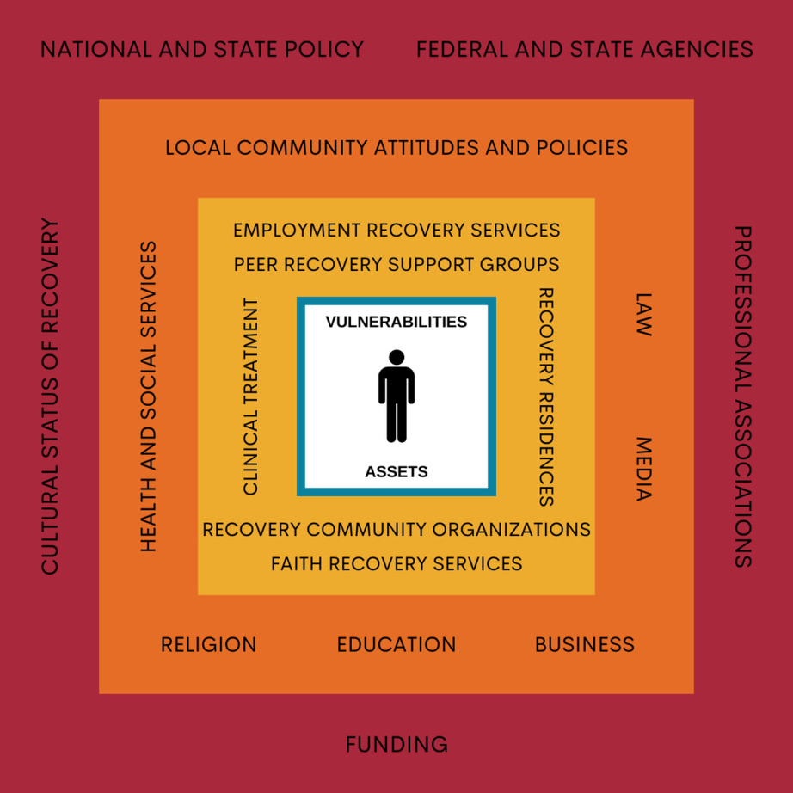
A solution:
Recovery Oriented Systems of Care (ROSC)
A Recovery-Oriented System of Care (ROSC) is a coordinated network of community-based services and supports that help individuals achieve, maintain, and enhance recovery from substance use disorders. ROSC emphasizes person-centered, strengths-based, and long-term support.
Integrated services:
  Substance use treatment
  Mental health
  Medical care
  Housing
  Employment
  Education
  Justice system

Slide 33
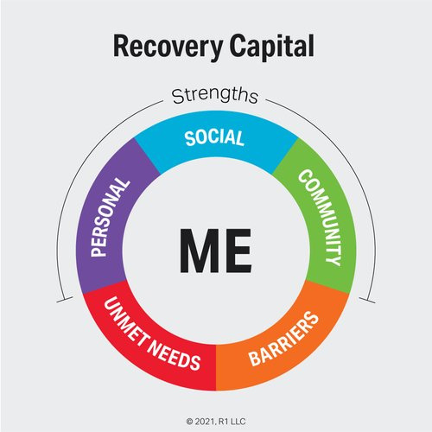
The goal:
Recovery Capital
Recovery capital refers to all the strengths, resources, and supports a person has that help them start and maintain recovery from addiction.
Think of it as the “toolkit” or “fuel” someone uses to build a healthy, sober life.
  Personal Capital
    Your health, coping skills, self-esteem, motivation, and education.
  Social Capital
    Support from family, friends, mentors, or recovery groups who encourage sobriety.
  Community Capital
    Access to safe housing, treatment programs, healthcare, jobs, and recovery-friendly environments.
  Cultural Capital
    Beliefs, values, and traditions (like faith, identity, or cultural pride) that support recovery.

Slide 34
Historical Approaches in the U.S. to Address Alcohol/Drug Use
Creating categories of licit and illicit
Most substances that are now illicit were legal at one time -- morphine, cocaine, marijuana/cannabis LSD Ecstasy
Locating the problem in the person, not the substance (Solution = Demand reduction /moral theory)
Locating the problem in the substance, not the person (Solution = Prohibition, criminal justice model / War on drugs, supply reduction)
Harm reduction movement locates the problem in the relationship between the person and the substance (drug and setting), which may change over time.

Slide 35
Implicit / Explicit over the years
Growing awareness of the health consequences of tobacco & excessive alcohol consumption
Framed in public health terms as a threat to the health of the community with social costs
Banning these substances was unrealistic, so new measures were devised to reduce harm
  Bottle labeling
  Policies / laws i.e. minimum ages, drinking & driving
  Just say no / don’t start
Nicotine Prevention strategies
  reduce recruitment of new smokers (regulate advertising)
Reduce risks of smoking
  (safer cigarettes such
  as filters lower tar and nicotine switching
  to nicotine enhanced chewing gum)
Reduce second-hand smoke (environmental policies)
the 60s

Slide 36
Implicit / Explicit over the years
OPIOIDS
Methadone treatment
Approved for substitution therapy for dependence to opiates
Used in detox to alleviate withdrawal symptoms
Used in MTA models of treatment Methadone to Abstinence in short timeframe (usually 6 months)
MMTP Methadone maintenance Potentially and practically Lifelong intervention
the 70s

Slide 37
Explicit over the years
the 80s
Disease prevention model to reduce transmission (primary or secondary prevention) of blood-borne pathogens such as HIV or Viral Hepatitis
70s Drug user organizing in Netherlands to reduce spread of viral Hepatitis B (Junkie Unions)
80s HIV/AIDS prevention from activists -- needle exchange
HIV is a greater threat than drug use / abstinence should not be the only goal, or necessarily the first goal / Reach out to users and engage them / Provide innovative services / Use a multi-disciplinary approach
1988 Needle exchange in New York City – Dept. of Health

Slide 38
Birth of modern movement
1993 Harm Reduction Working Group formed * half of whom are people of color who saw harm reduction as a social justice movement
1994 Harm Reduction Coalition incorporated in San Francisco
1995 First Regional Harm Reduction conference held in New York City
1996 Oakland and New York offices of HRC opened
1996 First National Harm Reduction Conference held in Oakland, CA
1998 Bridging the Gap conference held in SF
(http//www.harmreduction.org/pubs/news/spring99/g
arcia.html)
the 90s

Slide 39
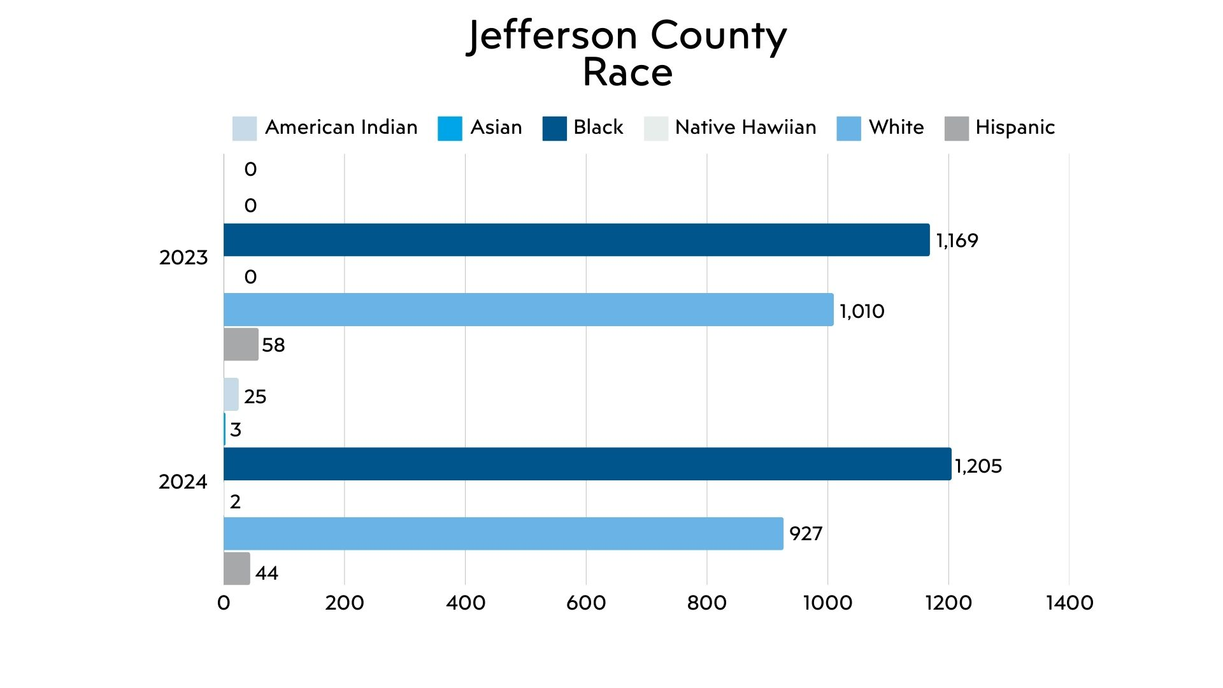

Slide 40
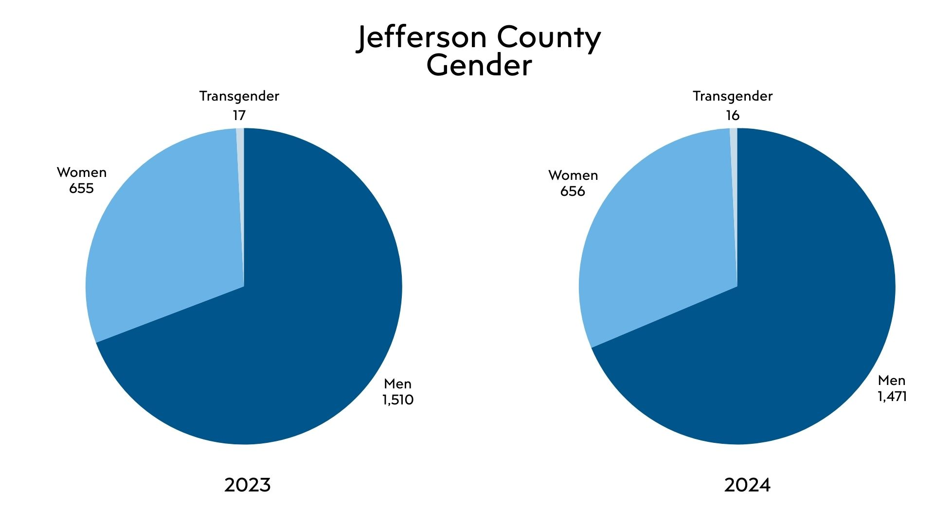

Slide 41


rrcintake@crisiscenterbham.org
John Bayles, Program Director
Recovery Resource Center
A program of Crisis Center, Inc. jbayles@crisiscenterbham.org
Impact

