Slide 1
Introducing Reach Out and Read
Notes:
Thank you for inviting me to speak today! My name is Amy Crosby and I am the Statewide Coordinator for Reach Out and Read-Alabama

Slide 2
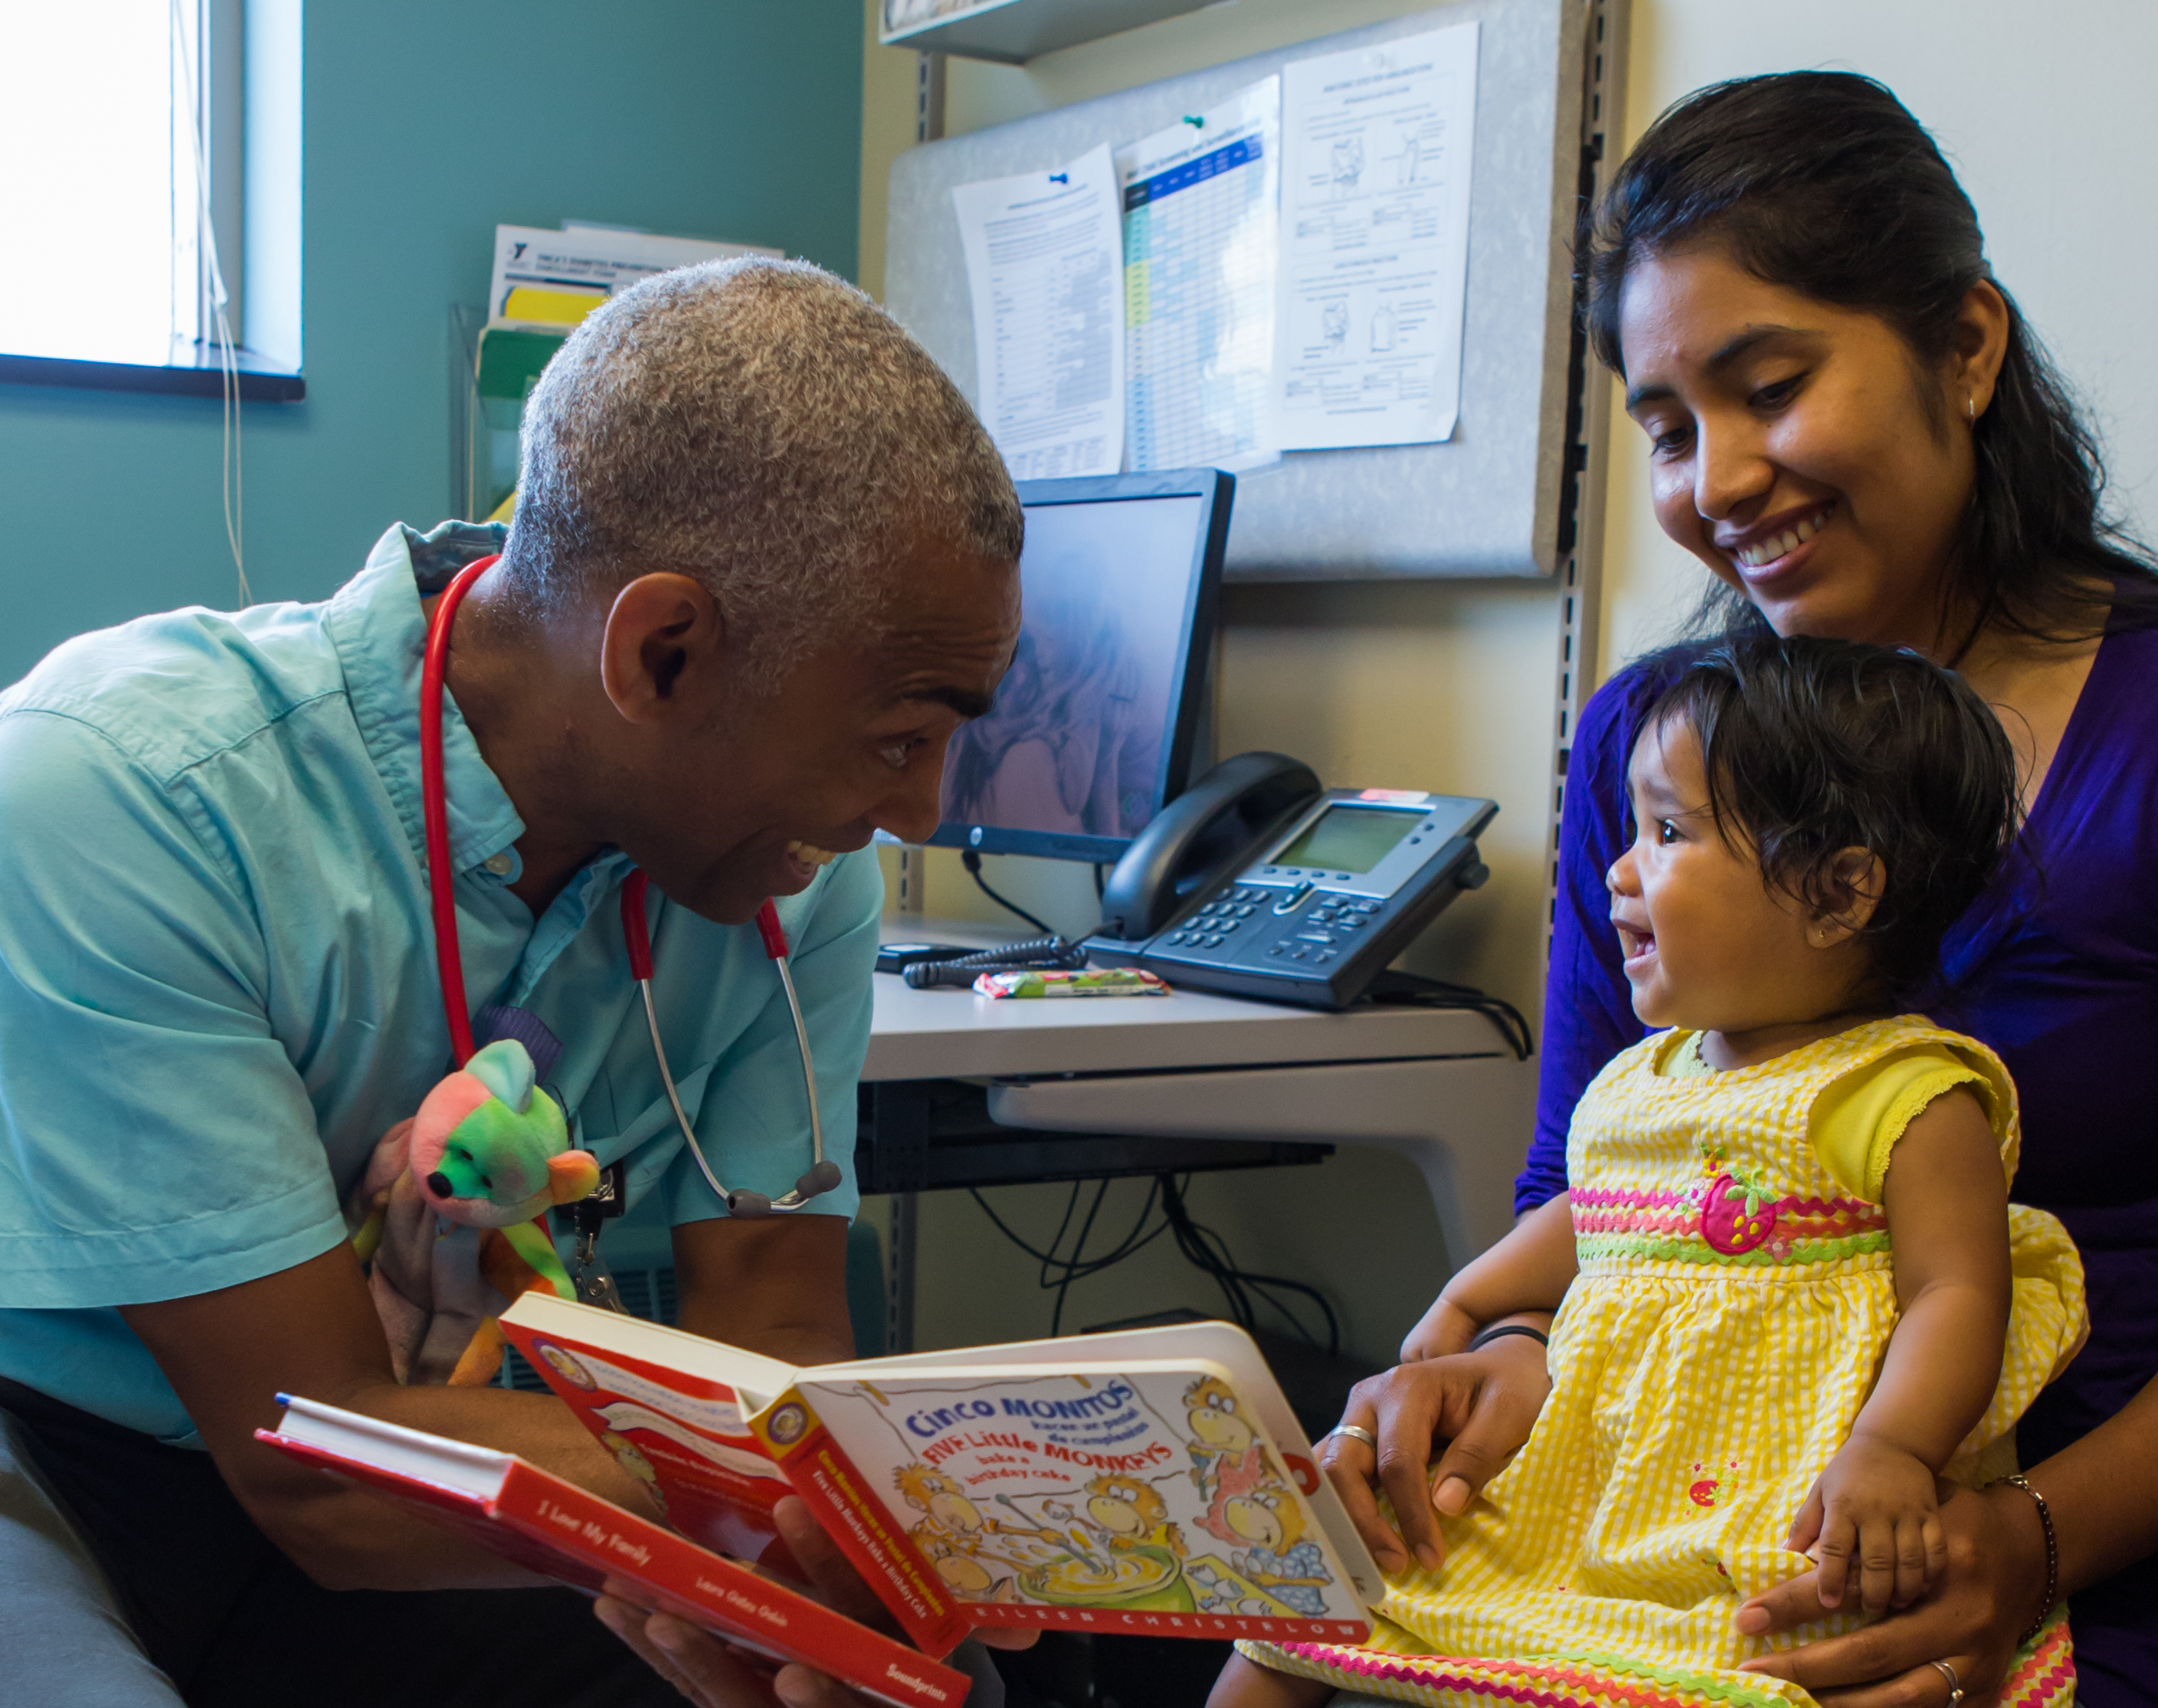

Reach Out and Read’s Mission Statement
We give young children a foundation for success by incorporating books into pediatric care and encouraging families to read aloud together.
Notes:
What do we do?

Slide 3





Early Childhood Experiences Influence the Trajectory of a Child’s Life
Change
Alter
Impact
the way our genes work
the way our brains form and function
our resilience
to stress
Affect
Influence
our cognitive and social-emotional development
our health and well-being into adulthood
https://pediatrics.aappublications.org/content/148/2/e2021052582
Notes:
As we know, the experiences we have early in life influence the trajectory of our lives in many ways, such as changing the way our genes work, altering our brains, affecting our cognitive and social-emotional development, and influencing our health and well-being well into adulthood.

Slide 4

Adverse Childhood Experiences (ACEs) Diminish Lifelong Well-Being
Adverse Childhood Experiences (ACEs) are stressful or traumatic events, such as economic hardship, racism, neighborhood violence, deportation/loss of a caregiver. Frequent, repeated exposure to ACEs is associated with negative health and educational outcomes including:
Interpersonal and self-directed violence;
Physical inactivity, obesity, diabetes, cancer, heart disease, respiratory disease;
Socioeconomic challenges including not graduating from high school and being unemployed.
  Safe, stable, and nurturing relationships help mitigate the consequences of ACEs.
Bethell et al., 2019., doi: 10.1377/hlthaff.2018.054
Notes:
The ongoing longitudinal Adverse Childhood Experiences Study of adults has found significant associations between chronic conditions, quality of life and life expectancy in adulthood, and the trauma and stress associated with adverse childhood experiences.
A safe, stable, and nurturing relationships help mitigate the consequences of ACEs.

Slide 5
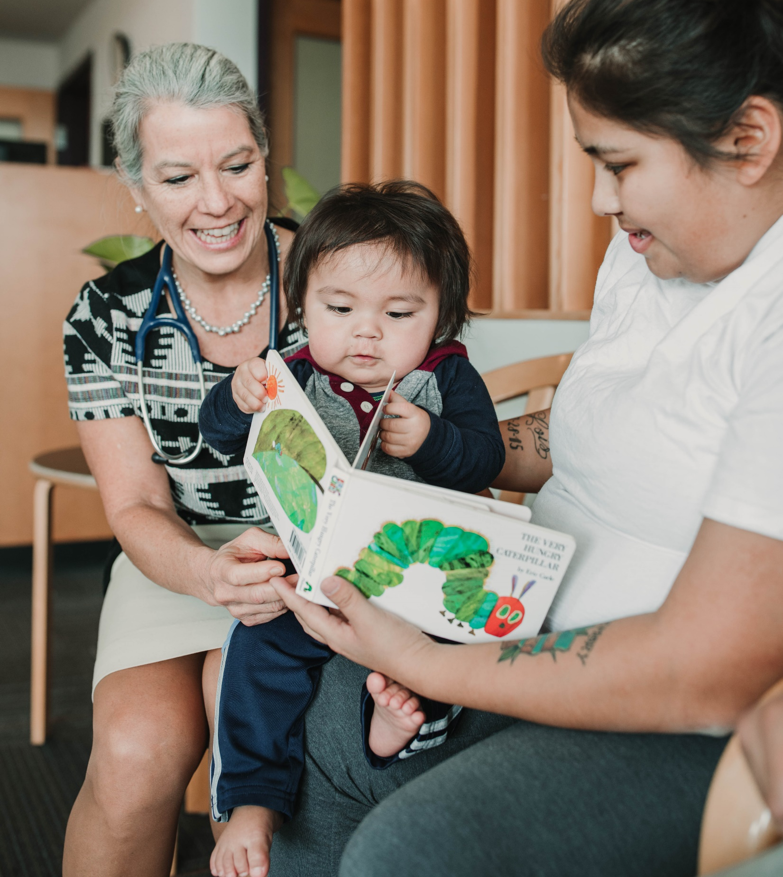

Positive Childhood Experiences Are an Antidote to ACEs
ROR contributes to a culture of positive childhood experiences and healthy family relationships that provide a child with the resilience to cope with stress. These positive experiences include:
Reading together
Storytelling/singing
Playing with peers
Family outings
Family meals
Notes:
How does ROR help?
ROR it is a strategy that contributes to a culture of positive childhood experiences.
We know that prolonged activation of stress response systems in the body and brain, especially in young children, can have damaging effects on learning, behavior, and health across the lifespan. The positive childhood experiences listed above help a child build the resilience to cope with stress, helping them to thrive even amid adversity.

Slide 6
Positive Childhood Experiences Mitigate the Effects of ACEs
4+ ACEs
Positive Childhood Experiences can reduce depression in adulthood as a result of experiencing 4 ACEs by
66%
3 ACEs
Depression in Adulthood
2 ACEs
1 ACE
Positive Childhood Experiences
Bethell et al., 2019. doi:10.1001/jamapediatrics.2019.3007
Notes:
Here we are looking at the effect on a more longitudinal level, and how we stand to support mitigating lifelong adverse outcomes.
An increase in positive childhood experiences reduces depression in adulthood by 66%

Slide 7
Positive Childhood Experiences Overcome the Effects of ACEs
Positive Childhood Experiences can increase the % of flourishing children by
2X
Flourishing Children
Positive Childhood Experiences have a greater effect than ACEs on whether children flourish
0 ACEs
1 ACE
2-3 ACEs
4-9 ACEs
Positive Childhood Experiences
Bethell et al., 2019., doi: 10.1377/hlthaff.2018.054
Notes:
Here we see that an increase in positive childhood experiences results in an increase the % of children that flourish
Positive Childhood Experiences have a greater effect than ACEs on whether children flourish

Slide 8

Our Model
At routine health check ups from infancy through 5 years,
Reach Out and Read-trained doctors and nurse practitioners:
talk with families about the benefits of reading aloud and engaging with their young children
encourage them to cuddle up, read together at home, and build routines around books
show them how to look at books and talk about the stories with their infants, toddlers, and preschoolers
and give the child a new book to take home and keep
During the exam, providers also use the book for developmental surveillance, observing how the child and caregiver interact with the book and each other
Notes:
The Reach Out and Read model promotes pediatric healthcare providers to talk with families about the benefits of reading aloud and engaging with young children, encourage families to cuddle up and read together as well as build routines around books, they also show families how to look at books and talk about the stories with infants, toddlers, and preschoolers, and give the child a new book to keep. Providers can also use the book as a tool for developmental surveillance.

Slide 9

Reach Out and Read in Two Minutes
Reach Out and Read at the 4-Month Well-Child Visit
Notes:
This is a short 2 minute video showing a 4 month well-child visit incorporating the Reach Out and Read model

Slide 10

We Have Unparalleled Access at Regular Well-Child Checkups
91% of children under age 5 see their doctor at least once a year.
Medical providers have early access to families and are a trusted source of information.
By embedding our model in the existing healthcare system,
our model is
cost-effective and scalable
Notes:
Reach Out and Read has unparalleled access to children. 91% of children under 5 visit their doctor yearly, medical providers have early access to families, and are a trusted source of information. BY embedding the ROR model in existing health care systems, the model is cost-effective and scalable

Slide 11

Our Outcomes are Evidence-Based
https://reachoutandread.org/why-we-matter/the-evidence/
Families are
2.5X more likely
to read with their children
Children’s language ability improves with increased exposure to Reach Out and Read
Families are
2.5X more likely
to report enjoying reading together
Children’s language development is improved by 3-6 months
Reach Out and Read is the only national early literacy program
endorsed by the American Academy of Pediatrics.
Notes:
Families are 2 and a half times more likely to read with their children and enjoy it, a child’s language ability improves with increased exposure to ROR,, improving by 3-6 months. ROR is the only national literacy program endorsed by the AAP

Slide 12






We Enhance Other Components of Well-Child Checkups
Increased developmental screenings
Increased
well-child
checkup attendance
Improved
patient-clinician relationships
Increased
well-child
checkup compliance
Increased
referrals to resources for families
https://reachoutandread.org/why-we-matter/the-evidence/
Notes:
As you can see, ROR enhances the other components of a well-child visit and creates a positive cycle
Well-child check-up attendance increases, which leads to increased developmental screenings and referrals to resources, this leads to an improvement in patient-provider relationships, causing increased compliance with the well-child checkups

Slide 13
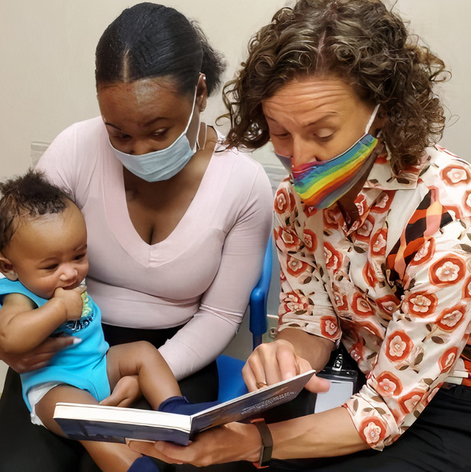
We Contribute to Stronger Primary Care
When delivered with fidelity, Reach Out and Read improves provider satisfaction and enhances patient-provider relationships:
Parents are more likely to rate their pediatrician as helpful.
Staff at successful sites express heightened commitments to their community and show higher levels of teamwork.
Pediatricians experience less stress and burnout.
https://reachoutandread.org/why-we-matter/the-evidence/
Notes:
With program fidelity, ROR improves provider satisfaction and enhances the patient-provider relationship. There is also an effect on the entire clinic as sites show higher levels of communication and team work.

Slide 14
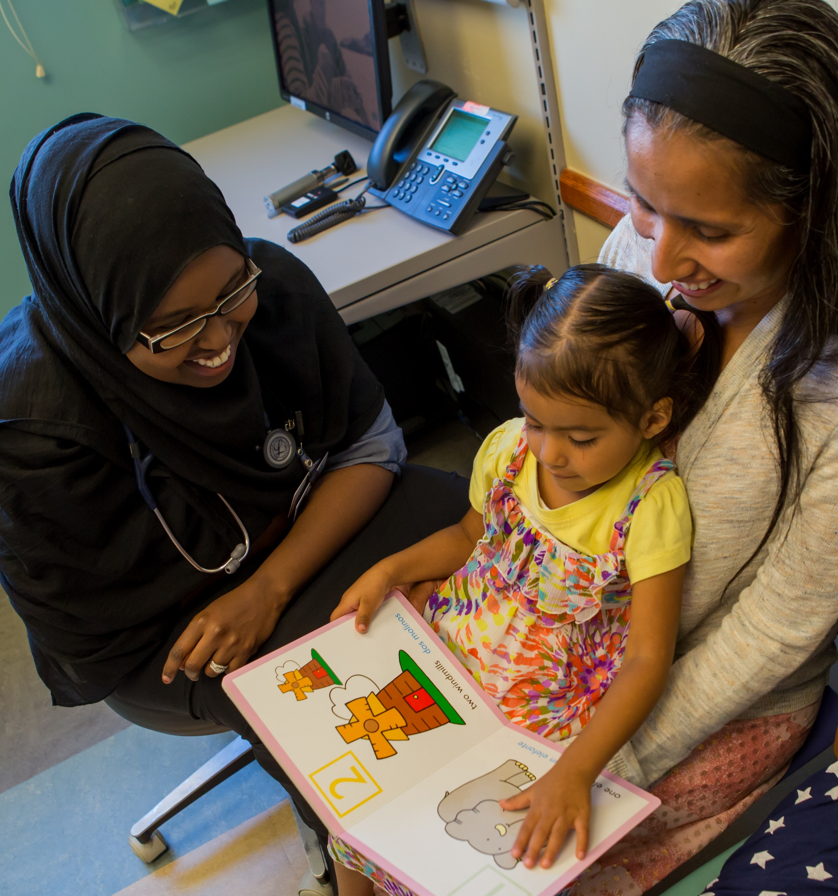
We’re Committed to Serving the Backgrounds of All Families
We’re increasing access to inclusive books for young people of all races and backgrounds. We promote:
Bilingual books in 26 languages;
Stories, images, and characters that accurately reflect and affirm a diverse range of identities, allowing children to see themselves and their world;
Our books reflect the diversity of children in our communities so that we can help to reduce the damaging impacts of racism on public health.
Notes:
When parents engage with their children in the language they speak best, they provide the foundation by which early language and literacy develops.
We strive to ensure that the books we provide are representative of each clinic’s patient population.

Slide 15



Reach Out and Read-Alabama
Over 60,000 children served
Over 100,000 new
books distributed annually
Over 300 medical providers participate in our program
We have 58 program sites and 20 clinics in the process to become a ROR program site in Alabama.
Notes:
Alabama Numbers
We serve over 60,000 children annually, distributing over 100,000 new books, we have over 300 participating providers in 58 programs and and additional 20 programs in the process of becoming a program site.

Slide 16
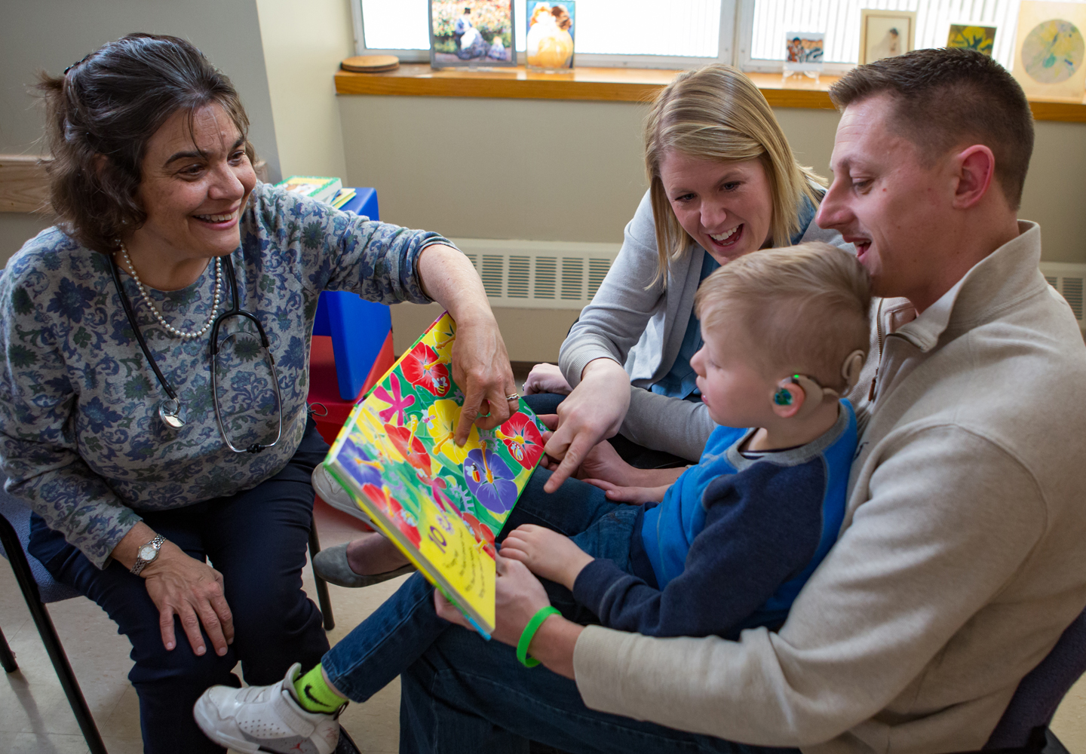
Join Us In This Work
“We believe that reading with a child is an important aspect of their overall development. Reading helps develop early literacy skills, builds their vocabulary, can help them learn social and communication skills, even help them learn to cope with emotions. Books can foster imagination and spark their curiosity. Beyond that, the time spent reading together promotes bonding and helps to build and strengthen relationships between a parent and their child. Through this partnership, we can help provide children in our area with a solid foundation and opportunity to flourish in school and beyond”
-Tonya Miller, MD, FAAP, Kids R Us Pediatrics in Arab.
We need partners like you to help us give all children and families the resources they need to thrive.
Please join us in this work.
Notes:
We believe that reading with a child is an important aspect of their overall development. Reading helps develop early literacy skills, builds their vocabulary, can help them learn social and communication skills, even help them learn to cope with emotions. Books cam foster imagination and spark their curiosity. Beyond that, the time spent reading together promotes bonding and helps to build and strengthen relationships between a parent and their child. Through this partnership, we can help provide children in our area with a solid foundation and opportunity to flourish in school and beyond”
-Tonya Miller, MD, FAAP, Kids R Us Pediatrics in Arab.

Slide 17
Reach Out and Read-Alabama
Reach Out and Read-Alabama, a program of the Alabama Chapter-American Academy of Pediatrics, gives young children a foundation for success by incorporating books into pediatric care and encouraging families to read aloud together.
By integrating reading into pediatric practices, advising families about the importance of reading aloud, and giving books at well-child visits, we foster enduring family bonds between caregivers and their children that promote healthy childhood development.
Notes:
Our mission is to give young children a foundation for success by incorporating books into pediatric care and encouraging families to read aloud together.
We believe that By integrating reading into pediatric practices, advising families about the importance of reading aloud, and giving books at well-child visits, we foster enduring family bonds between caregivers and their children that promote healthy childhood development

Slide 18
Partnerships
Community partnerships are essential in helping to provide resources to prepare every child for success in their educational pathway and life.
Books at home, parents reading aloud, and early language skills have long been demonstrated to be vital precursors to later success in learning to read. If we start with babies, engaging parents to effectively support language development at home, we can change the trajectory of children’s lives.
By partnering with communities, doctors, and families, we can help all children in Alabama arrive ready for kindergarten.
Reach Out and Read is grateful to our network of private and public supporters, whose generosity and commitment to our mission enhance our promotion of early literacy and school readiness. These partnerships enable Reach Out and Read to serve thousands of children and their families in Alabama.
Partners include the Alabama Department of Early Childhood Education, the Alabama Department of Public Health, the Alabama Department of Mental Health, local Public Libraries, The University of Alabama, Auburn University, The University of Alabama at Birmingham, Children’s of Alabama, Lee County District Attorney’s Office, Tuscaloosa County District Attorney’s Office and many more!
Notes:
Books at home, parents reading aloud, and early language skills have long been demonstrated to be vital
precursors to later success
By partnering with communities, doctors, and families, we can help all children in Alabama arrive ready for kindergarten.
We are grateful to our network of private and public supporters, whose generosity and commitment to our mission enhance our promotion of early literacy and school readiness.
Partners include the Alabama Department of Early Childhood Education, the Alabama Department of Public Health, the Alabama Department of Mental Health, local Public Libraries, The University of Alabama, Auburn University, The University of Alabama at Birmingham, Children’s of Alabama, Lee County District Attorney’s Office, Tuscaloosa County District Attorney’s Office and many more!

Slide 19
Reach Out and Read-Alabama
Since 1996, over 300 medical providers in 67 practices and clinics have prescribed more than 1.6 million brand new books to Alabama’s youngest and neediest children. These books are more than the stories inside...they are the key to unlocking the potential in every child in Alabama, and that is where Reach Out and Read-Alabama steps in.
Reach Out and Read-Alabama’s pediatric healthcare providers and volunteers, and with the long-standing support of the Alabama Chapter-AAP, we are now reaching over 60,000 children each year, most of whom are growing up at risk.
Notes:
Since Reach Out and Read-Alabama started in 1996 as a program of the AL Chapter of the AAP our providers have prescribed over 1.6 million new books to children in our state. With continued support, we are now serving over 60,000 each year

Slide 20
Campaign for Grade-Level Reading
Through the Campaign for Grade-Level Reading, Reach Out and Read-Alabama was able to expand its services to children living in the five pilot counties selected: Jefferson, Macon, Marshall, Monroe, and Randolph.
“Reach Out and Read significantly impacts children by providing greater exposure to reading during the all-important early years. We want parents to understand how important it is to read to their children. Research shows a major difference between children who are read to on a regular basis and those who have a word gap. Families served by the program will read together more often, and their children will enter school with larger vocabularies and stronger language skills, better prepared to achieve their potential.”
Dr. Barbara Cooper, Secretary, Alabama Department of Early Childhood Education
Notes:
In July of 2021, Governor Kay Ivey announced a new partnership that would assist Reach Out and Read-Alabama and their mission to integrate reading aloud into pediatric care by providing books and coaching to help families make reading a part of their daily routine.
53% of Alabama children aren’t proficient in reading by fourth grade. This percentage is even higher for the pilot counties the campaign serves.
The partnership also includes state agencies like the Alabama Department of Early Childhood Education (ADECE), Alabama Medicaid Agency (AMA) and the Alabama Department of Public Health (ADPH).

Slide 21
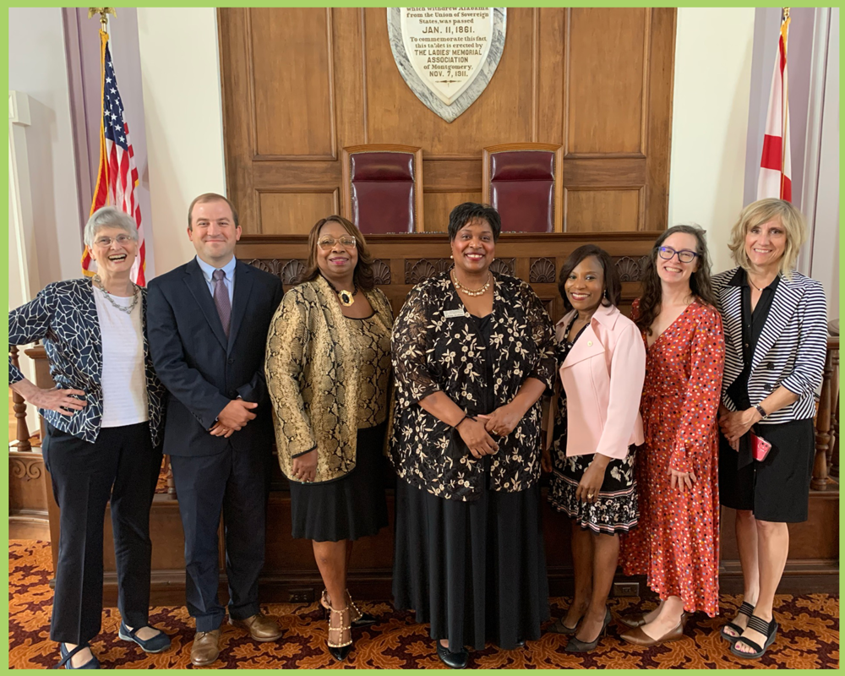
Campaign for Grade-Level Reading Press Conference
Dr. Marsha Raulerson, Pediatrician; Marshall County District Judge Jay Mastin; Macon County District Judge Deborah Biggers; Liletta Jenkins, Department of Early Children Education; Secretary Barbara Copper, Department of Early Childhood Education; Amy Crosby, Statewide Coordinator Reach Out and Read-Alabama; Linda Lee, Executive Director Alabama Chapter of the American Academy of Pediatrics
Notes:
Campaign for Grade Level Reading press conference with Governor Ivey on July 1, 2021
Dr. Marsha Raulerson, Pediatrician in Brewton, Alabama; Marshall County District Judge Jay Mastin; Macon County District Judge Deborah Biggers (Judge Mastin and Judge Biggers are also chairs of the Marshall and Macon County CPCs) ; Liletta Jenkins, Department of Early Children Education; Secretary Barbara Copper, Department of Early Childhood Education; Amy Crosby, Statewide Coordinator Reach Out and Read-Alabama; Linda Lee, Executive Director Alabama Chapter of the American Academy of Pediatrics

Slide 22
The Next Chapter
Early Relational Health
The relationships that we have in early childhood shape the trajectory of our lives, and those who love and nurture us provide the foundation for a healthy and fulfilling life in which we contribute to our community and to society. The more that we learn about the importance of the early months and years for fostering healthy brain development, the more convinced we are of the importance of pediatric primary care for its unparalleled access to, and influence on families and children during this critical developmental window.
The Next Chapter Vision ROR will maximize the potential of pediatric primary care to promote positive interactions that foster healthy development during the critical early years of a child’s life.
We imagine a future in which:
  Pediatric healthcare providers support positive, language-rich interactions through early literacy promotion as a standard of care
  Parents and caregivers are well supported as they engage their young children as part of the daily routine and understand the crucial role they play in laying the foundation for healthy development
  All children grow up with books and reading, with talking and with singing in the arms of those who love them and care for them.
Notes:
Reach Out and Read’s Next Chapter is focusing on Early Relational Health. WE know the relationships that we have in early childhood shape the trajectory of our lives, and those who love and nurture us provide the foundation for a healthy and fulfilling life in which we contribute to our community and to society.
ROR’s nationwide expansion over the past few decades means that thousands of primary care providers in millions of routine pediatric visits are families build positive language rich interactions and book-centered routines into their young children’s lives. But helping families begin and sustain these essential patterns of positive and responsive interaction is complex and challenging.
We aspire to use decades of experience, our evidence based model, and our extensive network into an even more powerful force for change,
The Next Chapter Vision will maximize the potential of pediatric primary care to promote positive interactions that foster healthy development during the critical early years of a child’s life.
We imagine a future in which:
• Pediatric healthcare providers support positive, language-rich interactions through early literacy promotion as a standard of care
• families are well supported as they engage their young children as part of the daily routine and understand the crucial role they play in laying the foundation for healthy development
• All children grow up with books and reading

Slide 23
Early Relational Health
Dyadic Emotional Connection
Focus on the babies, the people who care for them,
and the places where they live and grow.
Notes:
I would like to show you a short video with an example of a dyadic emotional connection. In a dyadic emotional connection, the emotional expressions of both people inform observers about the expressers.
STOP at 1:52

Slide 24
Center for the Study of Social Policy (CSSP)
Reach Out and Read is a part of the CSSP initiative to promote Early Relational Health.
Early relational health (ERH) is an emergent term that has galvanized the interest of many leaders in the child and public health sectors and simply means that healthy and positive child development emerges best in the context of nurturing, warm, and responsive early parent/caregiver-child relationships, when children are surrounded by safe communities with strong trust and social connectedness.
https://cssp.org/our-work/project/advancing-early-relational-health/
Notes:
Reach Out and Read is a part of the CSSP initiative to promote Early Relational Health.
Early relational health (ERH) is an emergent term that has galvanized the interest of many leaders in the child and public health sectors and simply means that healthy and positive child development emerges best in the context of nurturing, warm, and responsive early parent/caregiver-child relationships, when children are surrounded by safe communities with strong trust and social connectedness.

Slide 25
CSSP and the AAP Statement on Early Relational Health
Our ERH work has been grounded on the knowledge that the foundational relationships babies and toddlers experience with their caregivers provide the stability and supports needed for health, development, and well-being—now and for a lifetime.[ii] The AAP statement authoritatively illustrates how this concept of supporting safe, stable, and nurturing relationships (SSNR’s) builds on interdisciplinary research from the study of neurodevelopment, neurobiology, early childhood development, social-emotional development, mental health, resilience, and trauma.
The statement highlights the importance of focusing on opportunities for a positive, strengths-based, and solution-oriented response to mitigate toxic stress and a risk-based screening approach that has emphasized the potential negative biological consequences in the absence of supportive social and emotional buffers.
The AAP Statement on Early Relational Health
Notes:
August 1, 2021, the AAP released a Policy Statement Regarding Early Relational Health
SSNR – safe, stable, nurturing relationships
Our ERH work has been grounded on the knowledge that the foundational relationships babies and toddlers experience with their caregivers provide the stability and supports needed for health, development, and well-being—now and for a lifetime.[
the statement advances anew that relational health provides opportunities for a positive, strength-based, and solution-oriented response. The AAP writes: “Even more importantly, a strengths-based, relational health framework leverages those SSNRs [safe, stable, and nurturing relationships] to proactively promote the skills needed to respond to future adversity in a healthy, adaptive manner.”

Slide 26
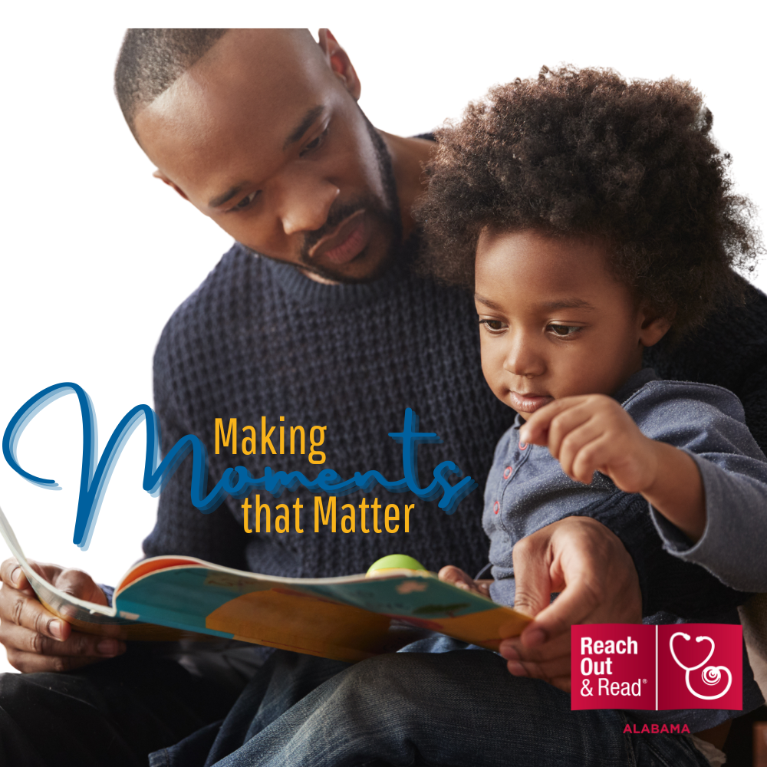
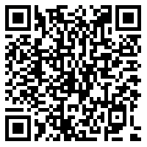
How can I support Reach Out and Read-Alabama?
Notes:
How can you support Reach Out and Read-Alabama? There are several ways to help: spread the word about what are doing in Alabama, donate, or host a fundraiser. The QR code on this slide will take you to a donation page for our End Of Year campaign – Making Moments That Matter.

Slide 27
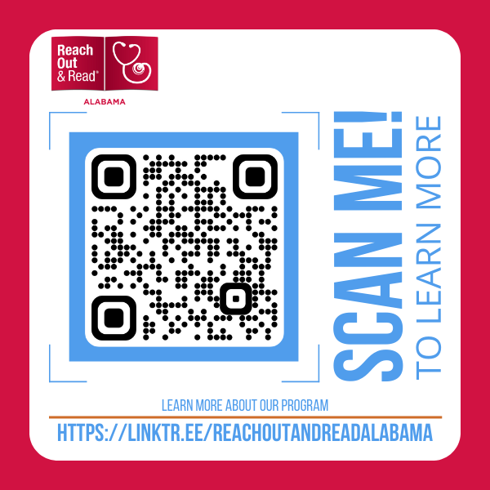
How can I support Reach Out and Read-Alabama?
Scan the QR code for ways to support Reach Out and Read-Alabama!
Notes:
As for fundrasiers, we have developed a virtual book drive. This allows anyone to have the ability to host a virtual book drive. By scanning this qr code, you will be taken to our linktree that has information about hosting a virtual book drive. It will also direct you to our website and all of our social media.

Slide 28
Reach Out and Read-Alabama
Reach Out and Read-Alabama Staff
Amy Crosby
Statewide Coordinator
acrosby@roralabama.org
Salina Sowell
Program & Communications Coordinator
stsowell@roralabama.org

Slide 29
Thank You!

