Slide 1

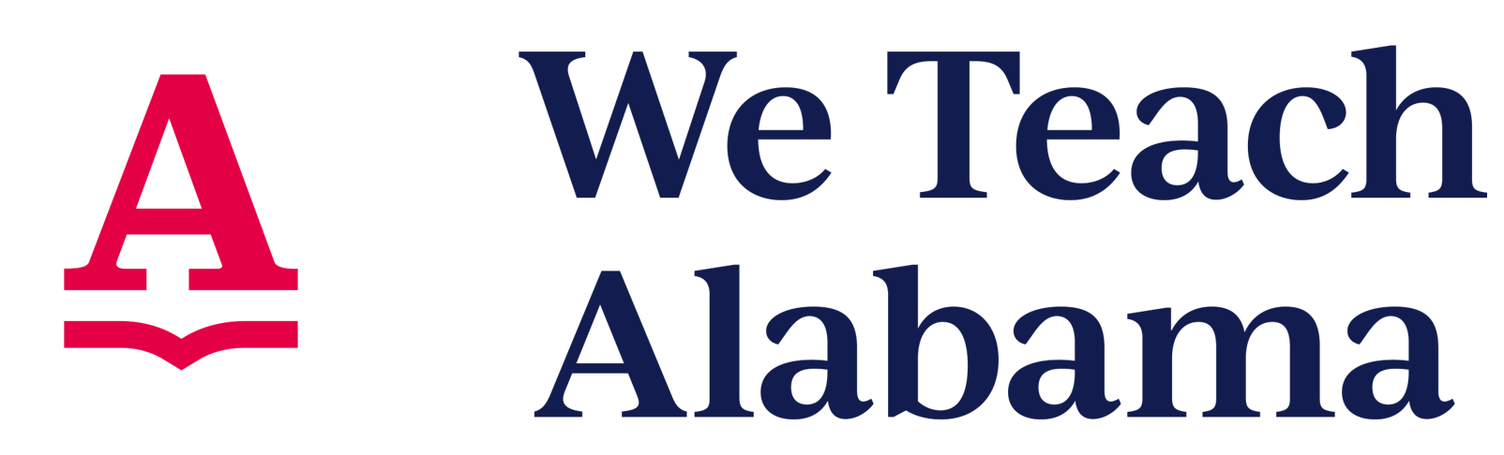
Preparing for Success in Mathematics!
Numeracy Act Overview
February 8, 2023

Slide 2
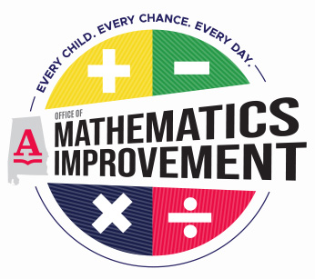


















Meet the Regional Coordinators!
ALABAMA STATE DEPARTMENT ^{of} EDUCATION

Slide 3
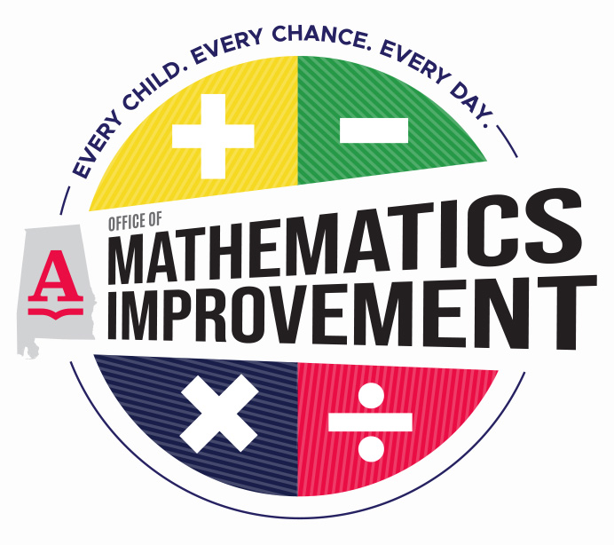

Dr. Karen Anderson​
Director
Dr. Nickey Johnson
Regional Coordinator​​
ALABAMA STATE DEPARTMENT ^{of} EDUCATION

Slide 4

Alabama Numeracy Act
ALABAMA STATE DEPARTMENT ^{of} EDUCATION

Slide 5
Alabama Numeracy Act
The Alabama Numeracy Act was established to implement steps to improve mathematics proficiency of public schools K-5 grade students and ensure that those students are proficient in mathematics at or above grade level by the end of the fifth grade by monitoring the progression of each student from one grade to the other.
(ANA p. 1)

Slide 6
Alabama Numeracy Act
An elementary school teacher should not engage in any practice that minimizes sense making and understanding of mathematics concepts.
(ANA p. 15)

Slide 7
Alabama Numeracy Act:
Expectations for Mathematics Instruction
Build fluency with procedures on a foundation of conceptual understanding, strategic reasoning, and problem solving over time.
Provide students access to tools, including any available technology, that support mathematical thinking.
Provide a learning environment that promotes student reasoning, student discourse, and student questioning and critiquing the reasoning of their peers.
Provide students with descriptive and timely feedback on assessments to include strengths, weaknesses, and next steps for progress toward learning targets.
(ANA p. 14)

Slide 8
Mathematical Practices
ALABAMA STATE DEPARTMENT ^{of} EDUCATION

Slide 9
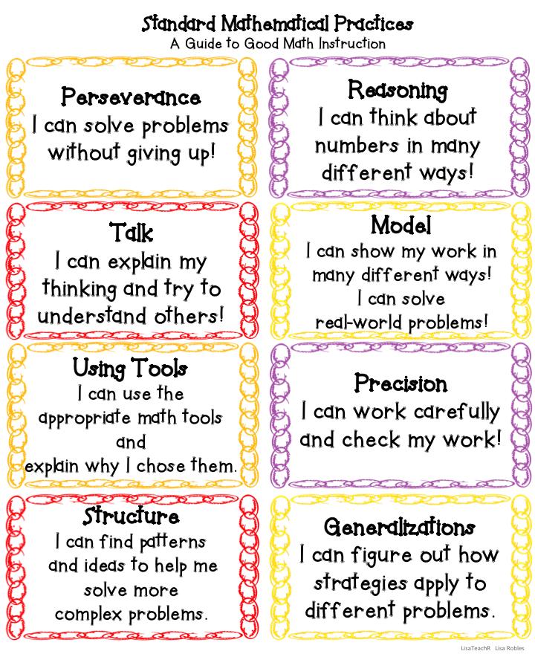
Standards for Mathematical Practice

Slide 10
Resources
ALABAMA STATE DEPARTMENT ^{of} EDUCATION

Slide 11
Resources
https://elementarymath.edc.org/​
https://youngmathematicians.edc.org/​
https://dreme.stanford.edu/
Math | NAEYC

Slide 12



 | On Twitter: @OMIALSDE
 | YouTube Channel: OMIALSDE
 | Facebook: OMI ALSDE
Hashtags: #OMIbettertogether #OMIgetonboard
Follow us on Social Media!

Slide 13

Questions?
Karen Anderson, Ph.D.
Director
Office of Mathematics Improvement
kanderson1@alsde.edu

Slide 14
